Slide 1

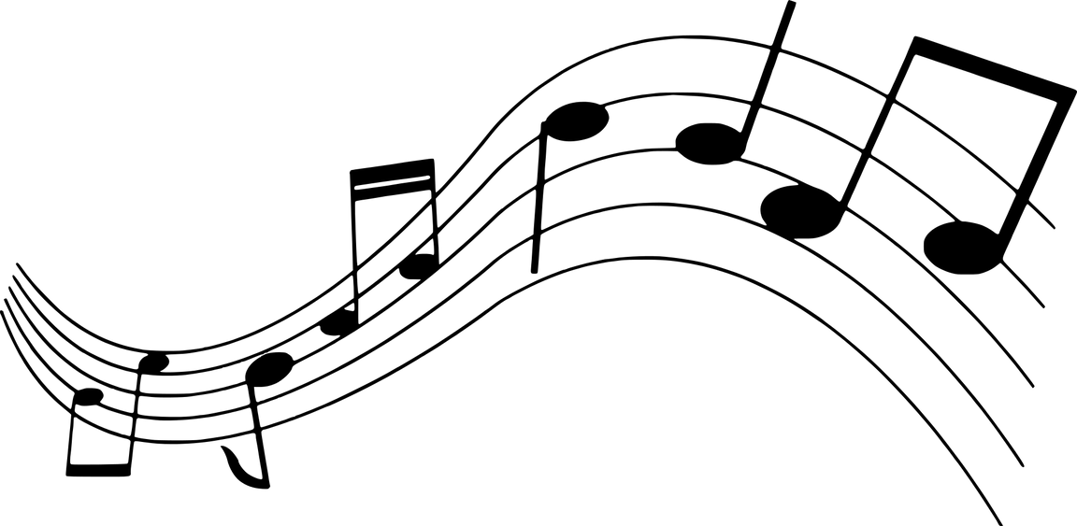

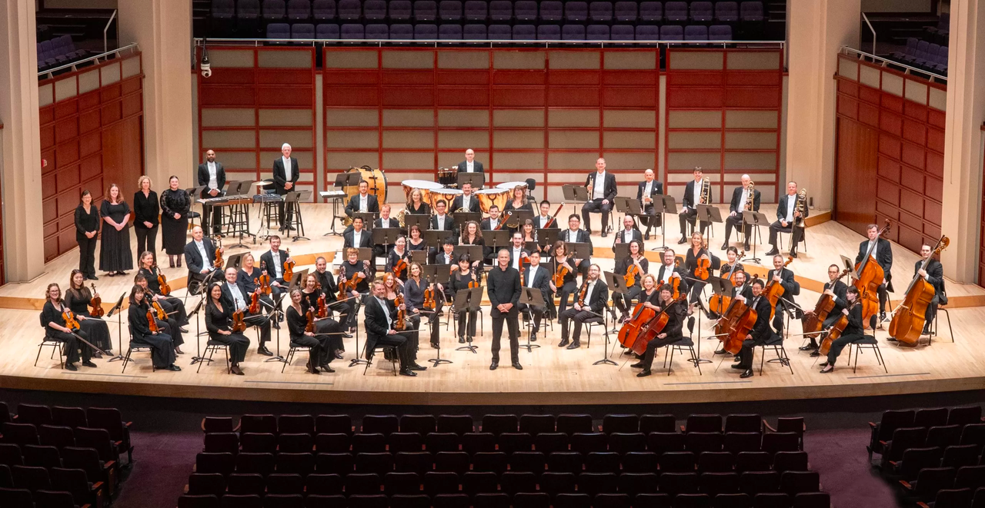


PRESENTS:
THE NEW WORLD SYMPHONY
BY ANTONÍN DVOŘÁK
Lessons and Materials created by Lucíola Lewis (Orchestra Director, Green Hope High School) and Colin Richardson (History Teacher, Green Hope High School)

Slide 2
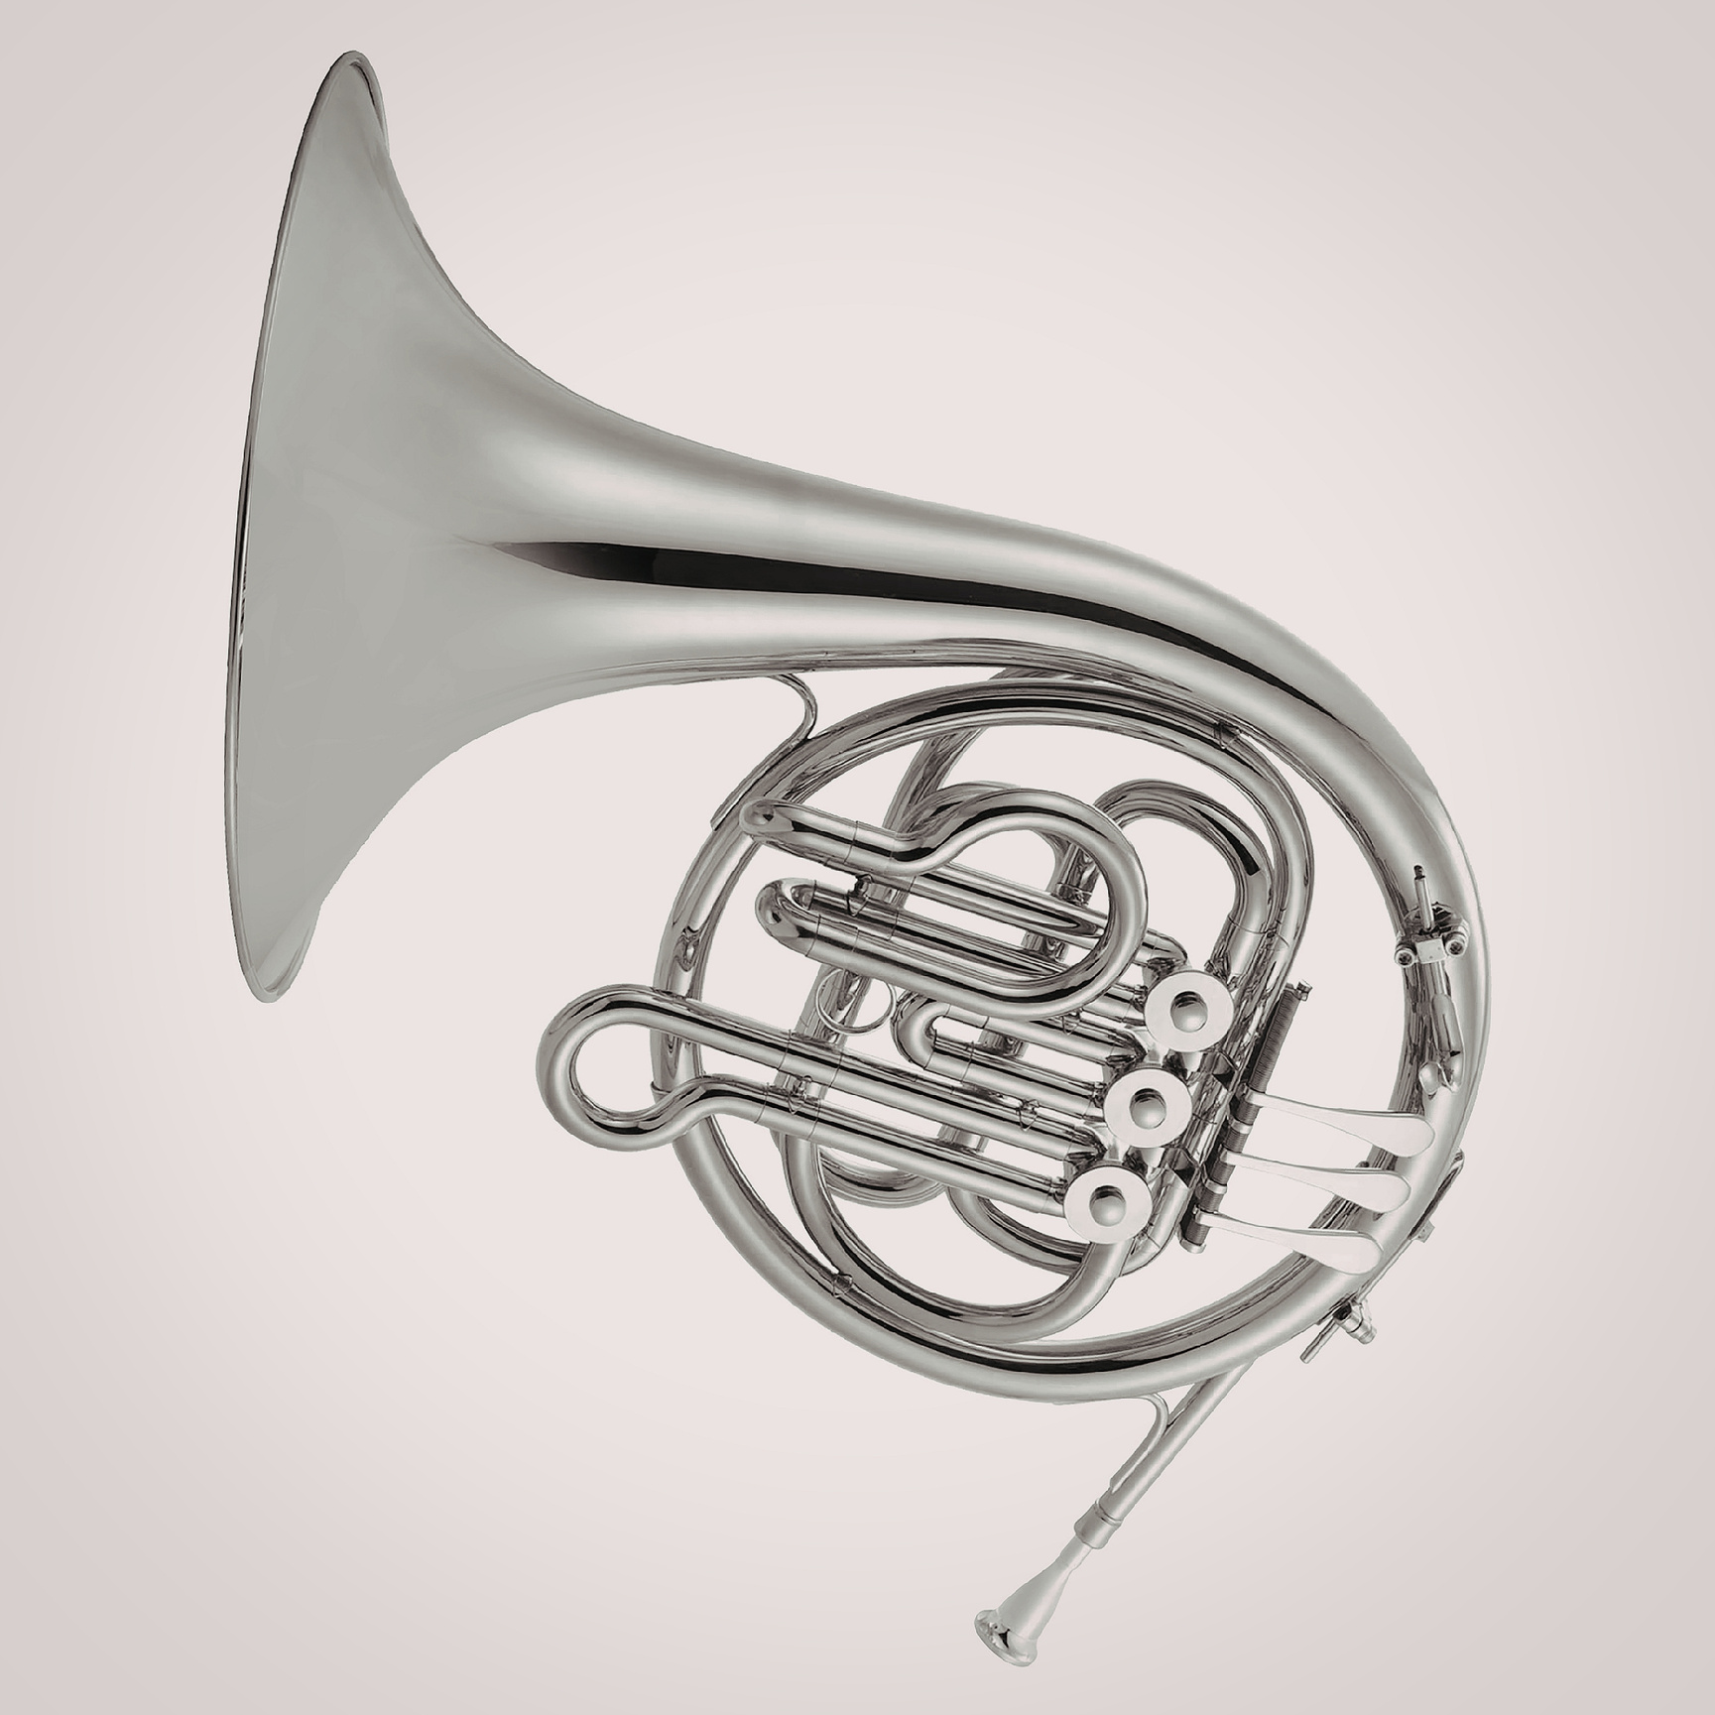
Students will analyze Antonin Dvořák’s New World Symphony and connect it to broader interdisciplinary questions of historical context and creation of music.

Slide 3
B.CN.1 Relate musical ideas and works with personal, societal, cultural, historical, and daily life contexts, including diverse and marginalized groups.
B.CN.1.2 Identify how the creation and performance of music is supported by concepts from other content areas.
B.CN.2.1 Describe how various individuals contribute to the creation, production, design, and marketing of music.
Novice General Music

Slide 4
N.CN.1 Relate musical ideas and works with personal, societal, cultural, historical, and daily life contexts, including diverse and marginalized groups.
N.CN.1.2 Explain how concepts from other content areas can inspire the development of musical ideas
N.CN.2.2 Compare how various innovative tools and ideas have been used in a variety of musical works.
Novice Vocal and Instrumental Music

Slide 5

Where do you hear music in everyday life?

Slide 6
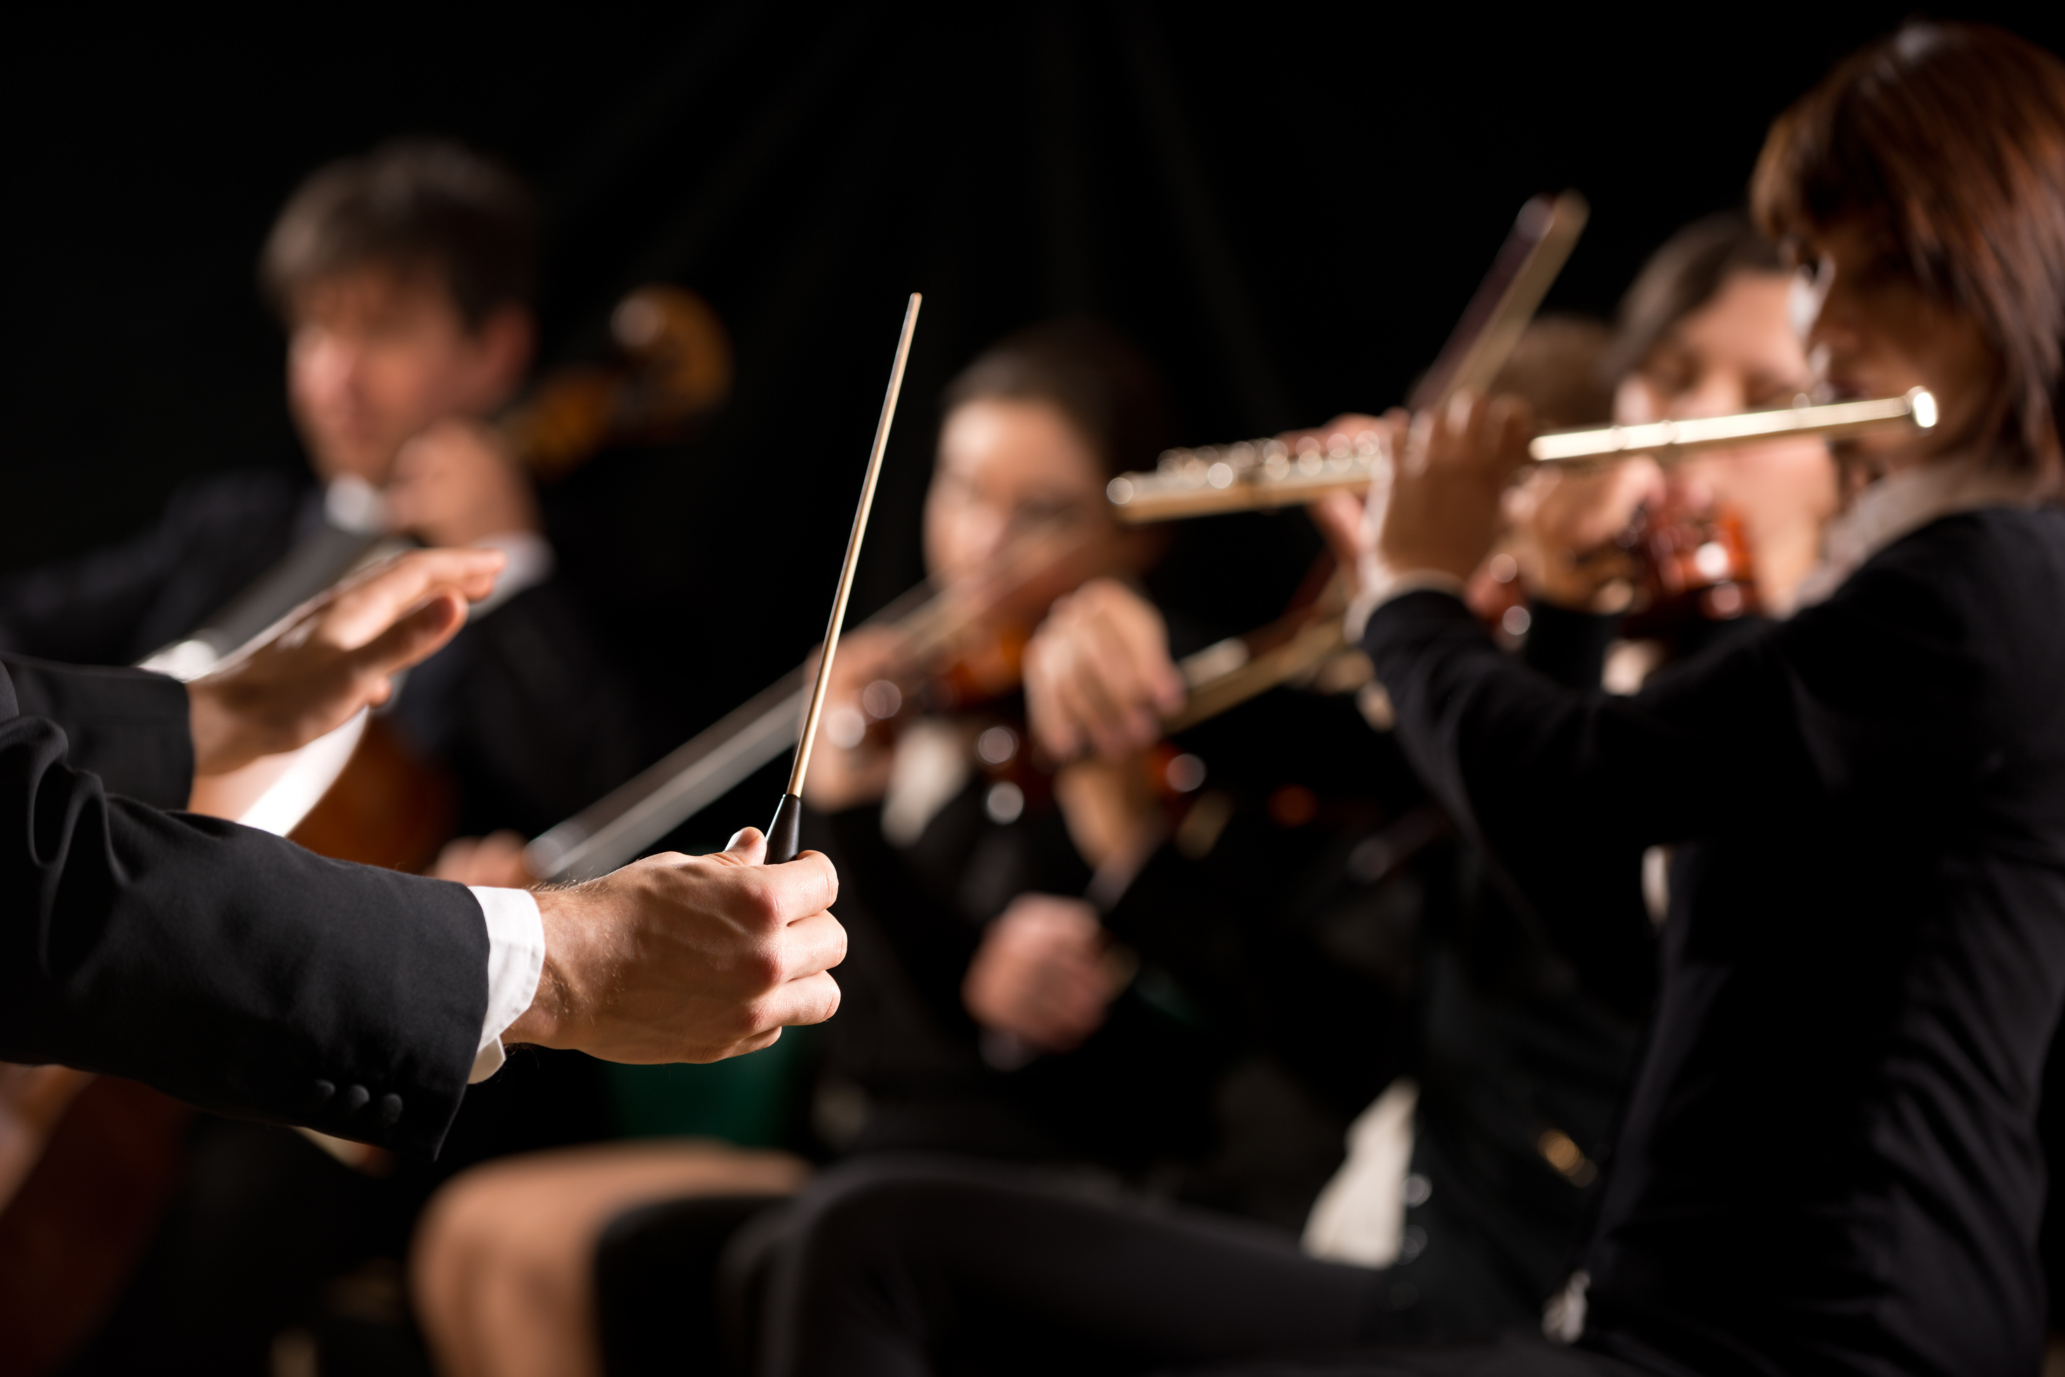
Read the following article
How The 'New World' Symphony Introduced American Music To Itself

Slide 7


Discussion:
Discuss the article with your class.

Slide 8
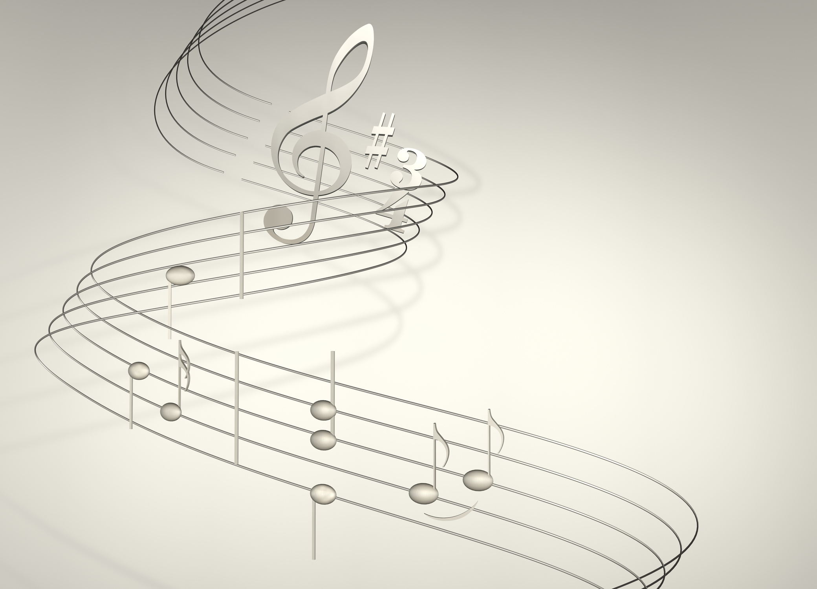
Music Vocabulary:
Movement I
Allegro Molto: A directive to perform the indicated passage of a composition at a very fast tempo.
Largo: A slow and solemn tempo marking, having between 40 and 60 beats per minute.
Motif: A short tune or musical figure that characterizes and unifies a composition. It can be of any length but is usually only a few notes long. A motif can be a melodic, harmonic or rhythmic pattern that is easily recognizable throughout the composition.
Pastoral: A composition representing rural, or country life. Example:
Beethoven's Symphony No. 6

Slide 9
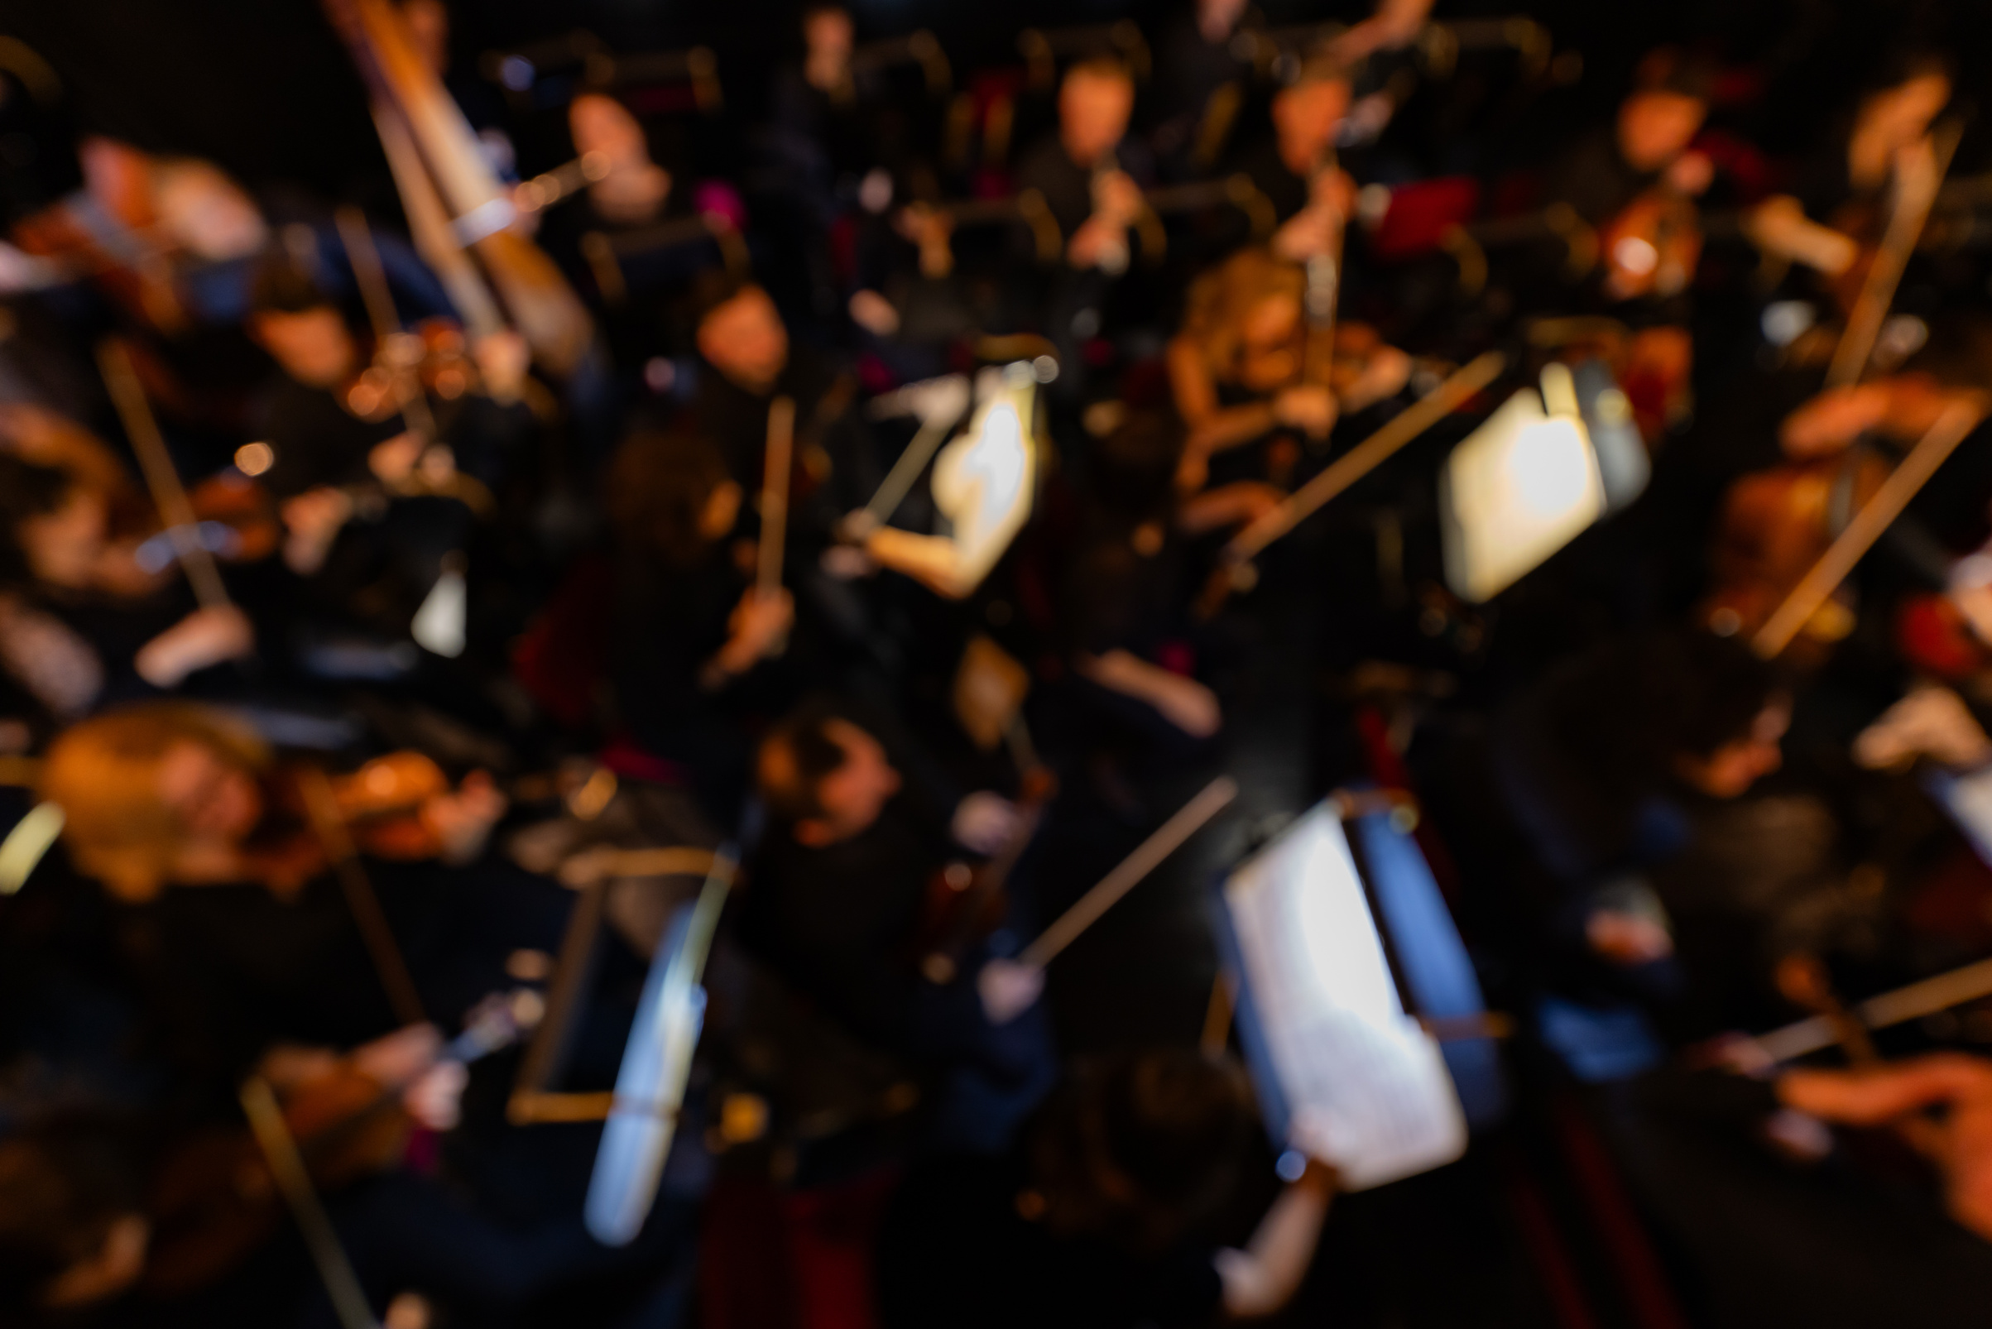
The New World Symphony by Antonín Dvořák
Performed by The North Carolina Symphony Orchestra

Slide 10
Vocabulary:
Movement II
Authentic:
: not false or imitation : REAL, ACTUAL
Synthesized:
: to produce (something, such as music) by an electronic synthesizer
Salient:
: standing out conspicuously : PROMINENT
especially : of notable significance

Slide 11
Vocabulary:
Movement III
The Song of Hiawatha: “Longfellow used rhythmic poetry to convey various Native American myths to a popular audience. Primarily, the epic poem highlights the stories of the Ojibwe people of the Lake Superior region. Its main focuses are the adventures of a fictional Ojibwe hero, Hiawatha, his gifts to his people, and his tragic love story with a Dakota woman, Minnehaha.” - National Park Service

Slide 12
Vocabulary:
Movement IV
Glints: : to appear briefly or faintly

Slide 13
Class Discussion:
How does knowing the story of this piece’s creation change your experience of listening?

Slide 14
Class Discussion:
What are some specific ways you heard the piece illustrate how “Dvořák wove American roots music into his vast symphonic canvas?”

Slide 15
Class Discussion:
What do you think the composer’s assistant, Harry Burleigh, would think about this piece?

Slide 16
Class Discussion:
What “music” from everyday life might we listen more carefully to?

Slide 17

Sources
1
Huizenga, T. (2018, November 24). “How The “New World” Symphony Introduced American Music To Itself.” NPR.org. https://www.npr.org/sections/deceptivecadence/2018/11/24/669557133/dvorak-new-world-symphony-american-anthem
2
Kapilow, R. (2019). Listening for America: inside the great American songbook from Gershwin to Sondheim. Liveright Publishing Corporation.
3
Program for “Dvořák: New World Symphony” at Meymandi Concert Hall, Raleigh. North Carolina Symphony, 2025. https://ncsymphony.org/wp-content/uploads/2025/09/2526-FF01-NEW-WORLD-print-file.pdf
4
OnMusic Dictionary. (n.d.). OnMusic Dictionary. https://dictionary.onmusic.org/
5
Merriam-Webster. (2026). Merriam-Webster.com Dictionary. https://www.merriam-webster.com/

