Slide 1

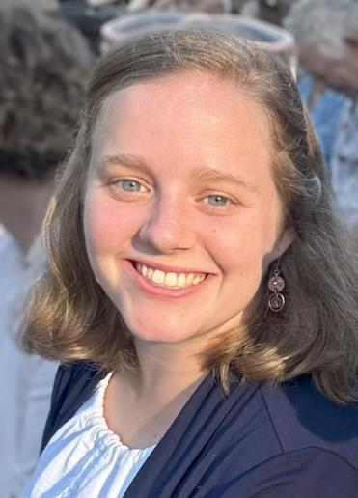
Taylor Babson
Trent Park Elementary School
Craven County Schools
taylor.babson@cravenk12.org
Farandole
Georges Bizet

Slide 2

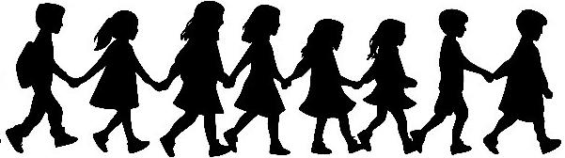
Farandole
From L’Arlesienne No.2
By Georges Bizet

Slide 3
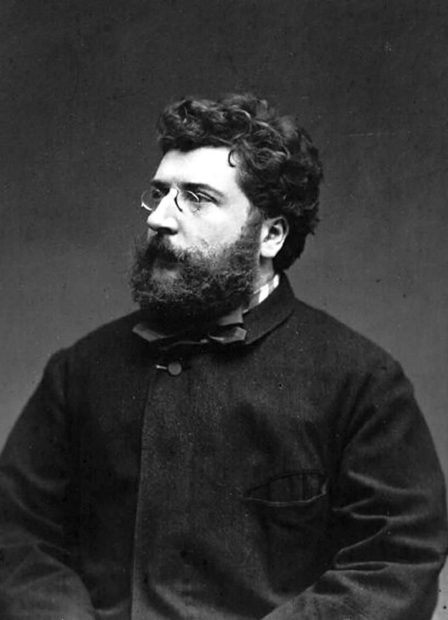
Georges Bizet 1833-1875
History
Romantic Era: Emotional expression, Programmatic (stories and scenes) Nationalism (Folk melodies, national themes)
“Farandole” was originally created as background music for a play called L’Arlesienne which was a flop. Bizet rearranged the music for a concert orchestra and it was a hit!
The music switches between two different melodies.

Slide 4

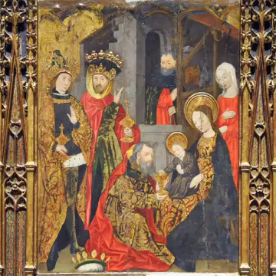
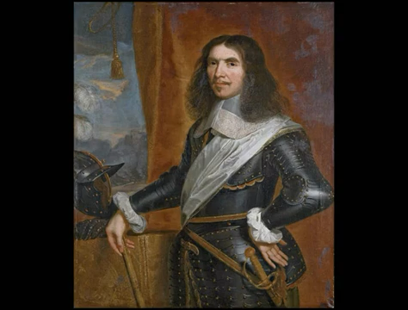
Melody/Theme 1: March of the Kings
The melody is from a French carol called “Le Marche De Rois”
It has been used in many different religious, military, and folk songs.
Sung version with French lyrics
Instrumental: Marche du régiment de Turenne - Jean-Baptiste Lully

Slide 5
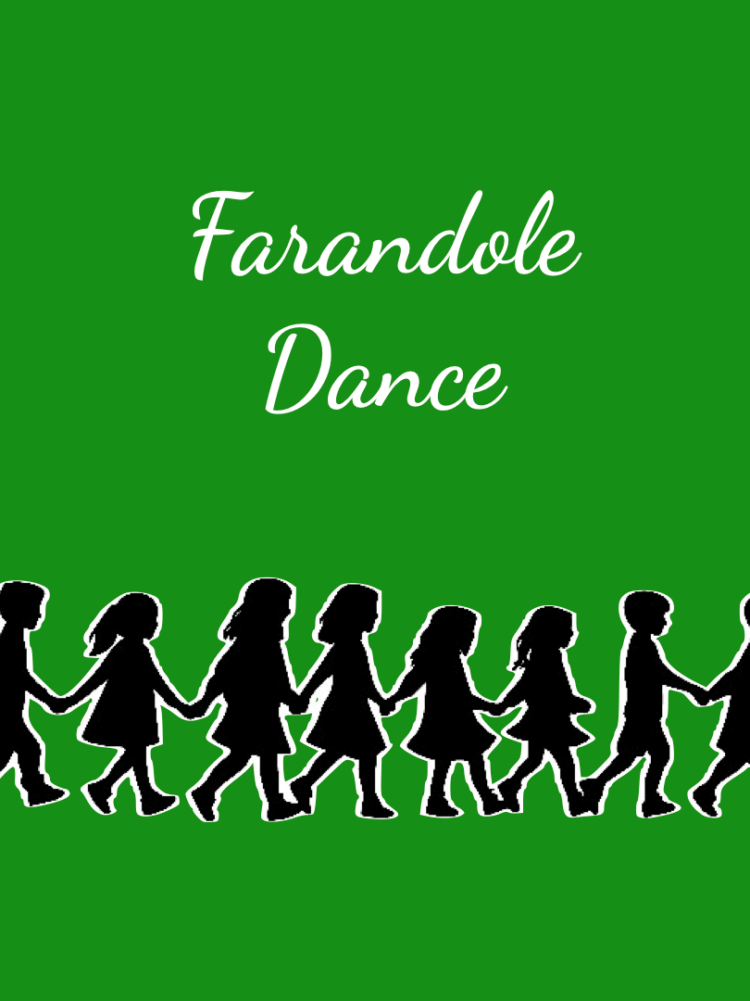
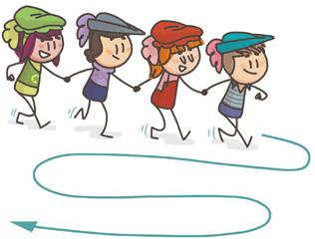
Melody/Theme 2: Farandole Dance
The melody comes from a French folk dance.
The dancers join hands to form a chain and follow a leader to make different shapes

Slide 6
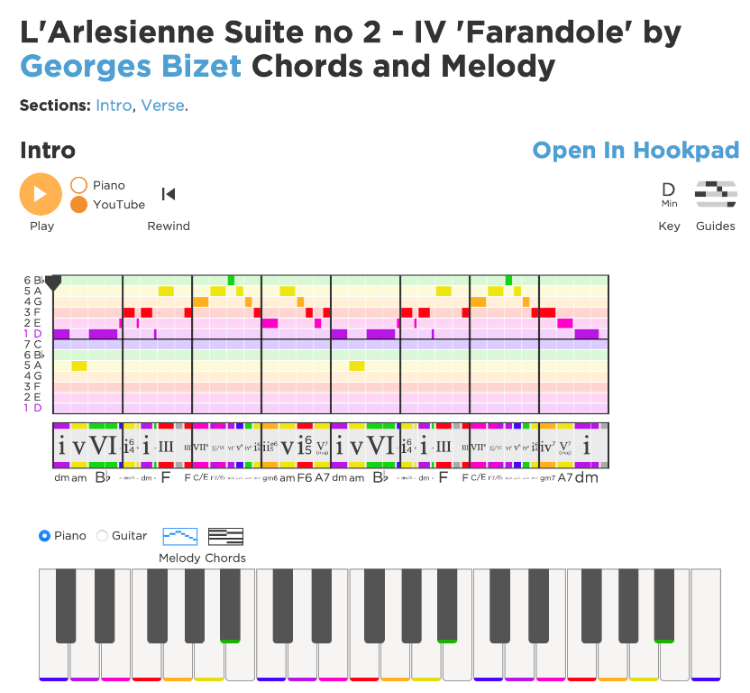
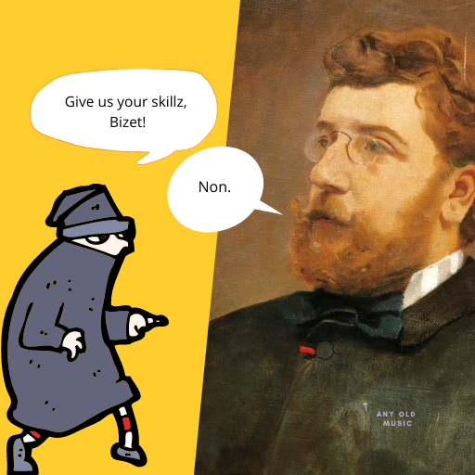
Additional Websites with information
Melody/theme Visualizer
https://www.hooktheory.com/theorytab/view/georges-bizet/larlesienne-suite-no-2---iv-farandole
Piece Analysis
https://anyoldmusic.com/what-can-we-learn-from-farandole-larlesienne-no-2-georges-bizet-ernest-guiraud/

Slide 7
Lesson Activity 1: Form Map
Lesson Activity 2: Weaving Freeze Dance
Lesson Activity 3: Instrument Play Alongs

Slide 8
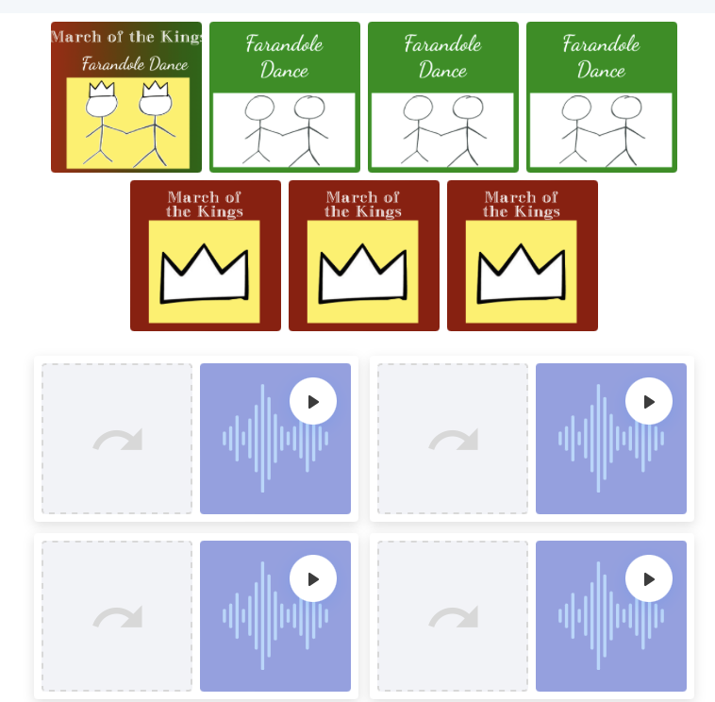

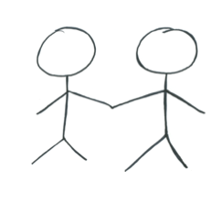
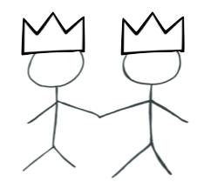
Lesson Activity 1: Form Map
Practice listening for each melody/theme with an audio matching game
https://interacty.me/projects/cb6cc5a599f43881
Model drawing the shapes for each melody/theme
(Crown, Stick Figures)

Slide 9
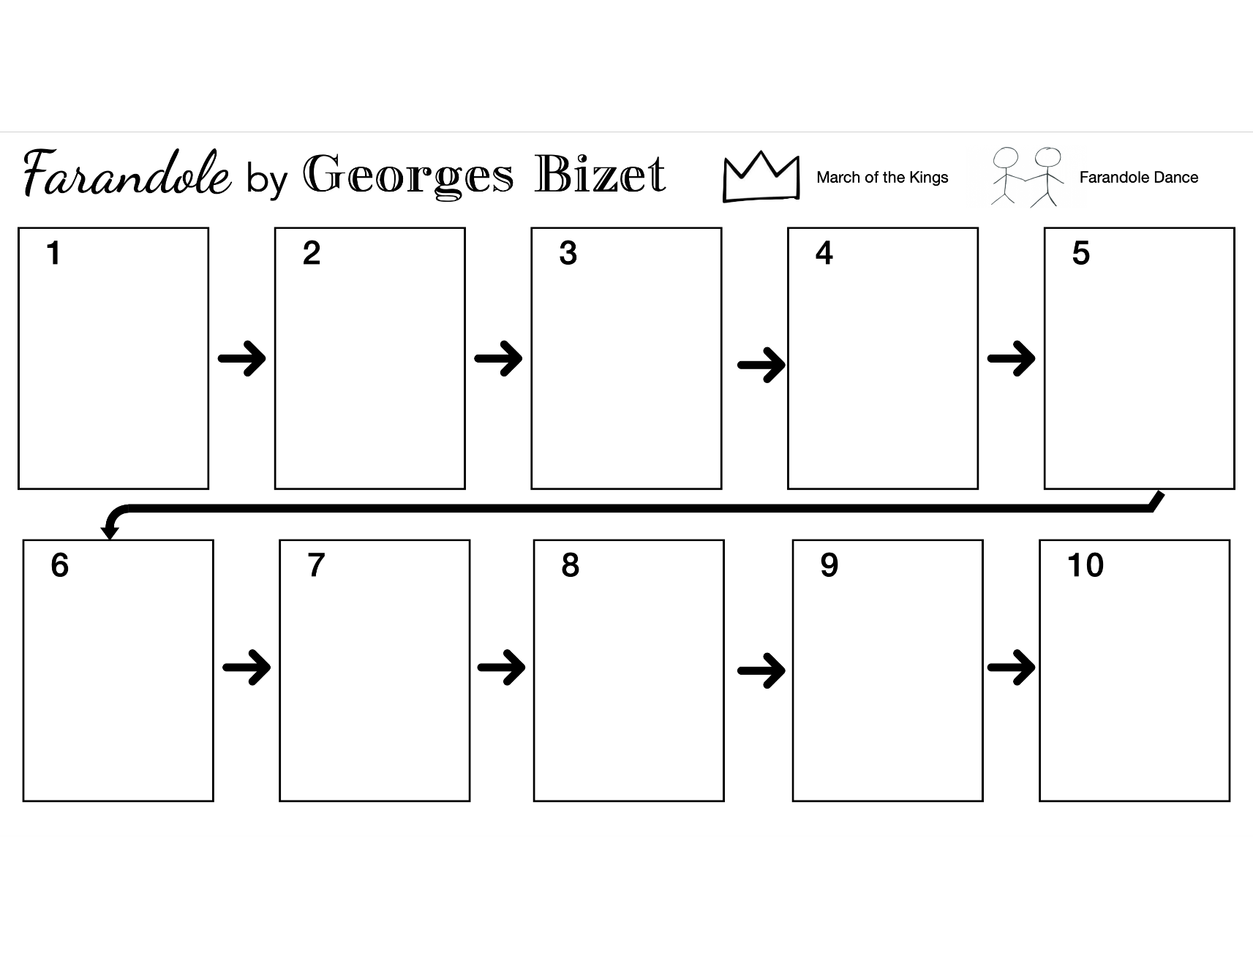
Lesson Activity 1: Form Map

Slide 10
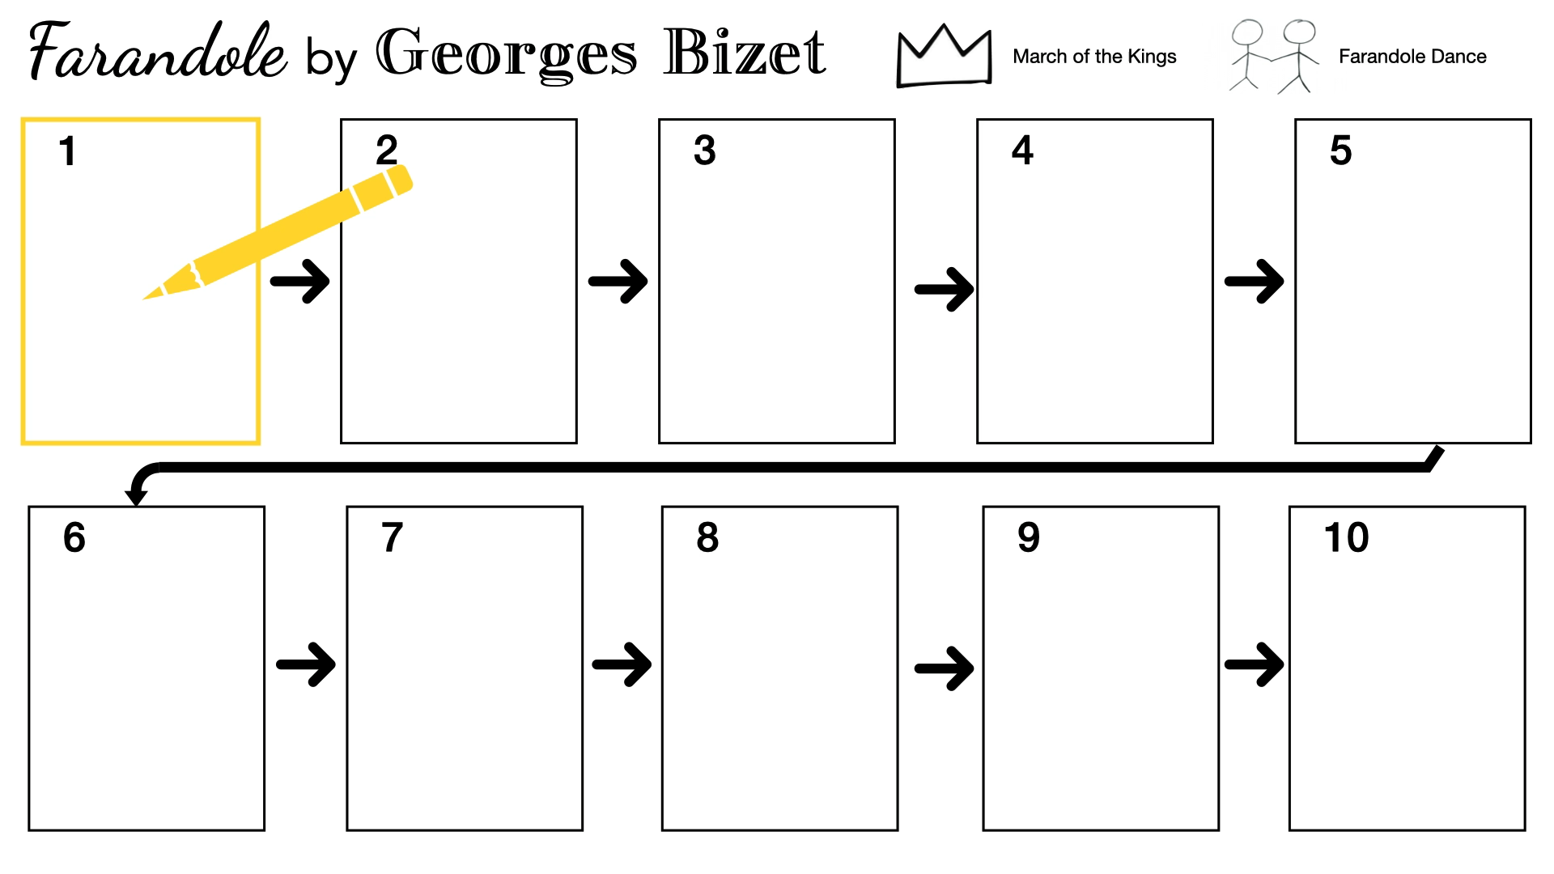
Lesson Activity 1: Form Map

Slide 11
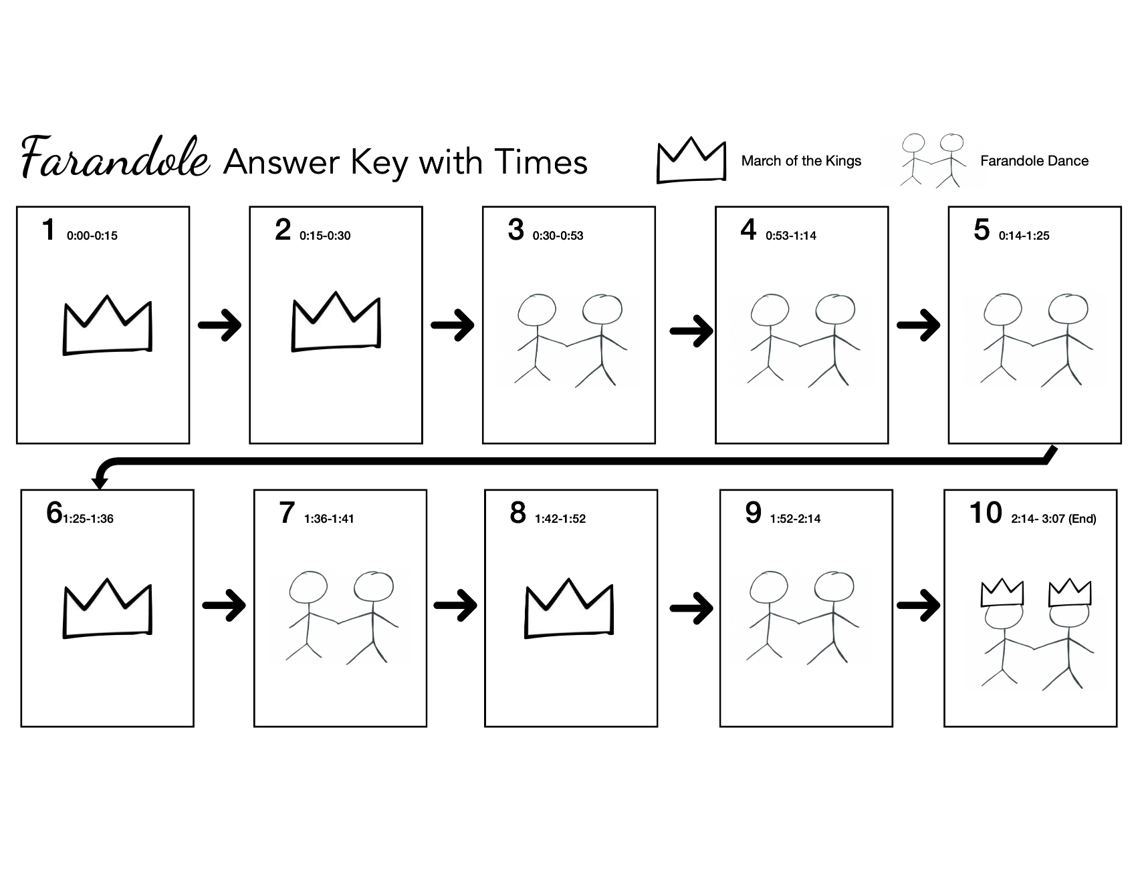

Slide 12
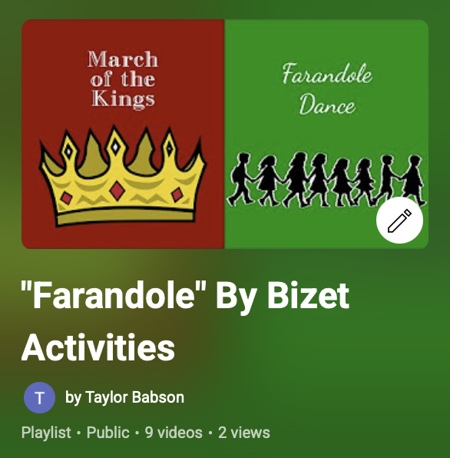
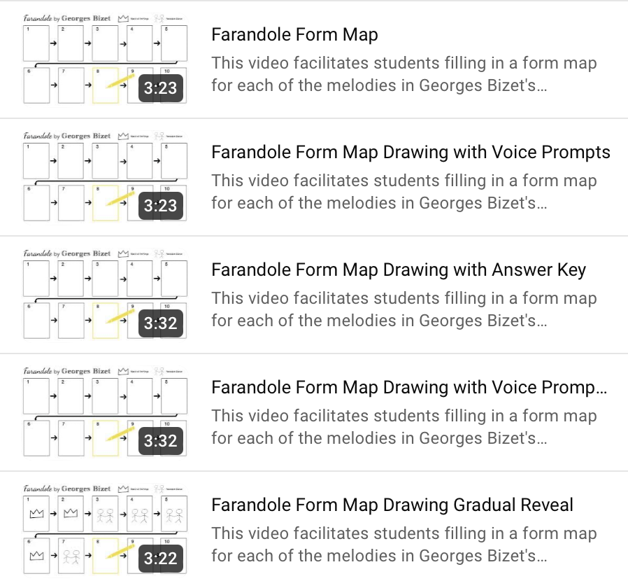
Lesson Activity 1: Form Map Video Versions
https://youtube.com/playlist?list=PLlWLyQ0CPEJBP_WA8kF4XqmJyvGVe9BkS&si=inmqrOrMPXIpmHl0

Slide 13
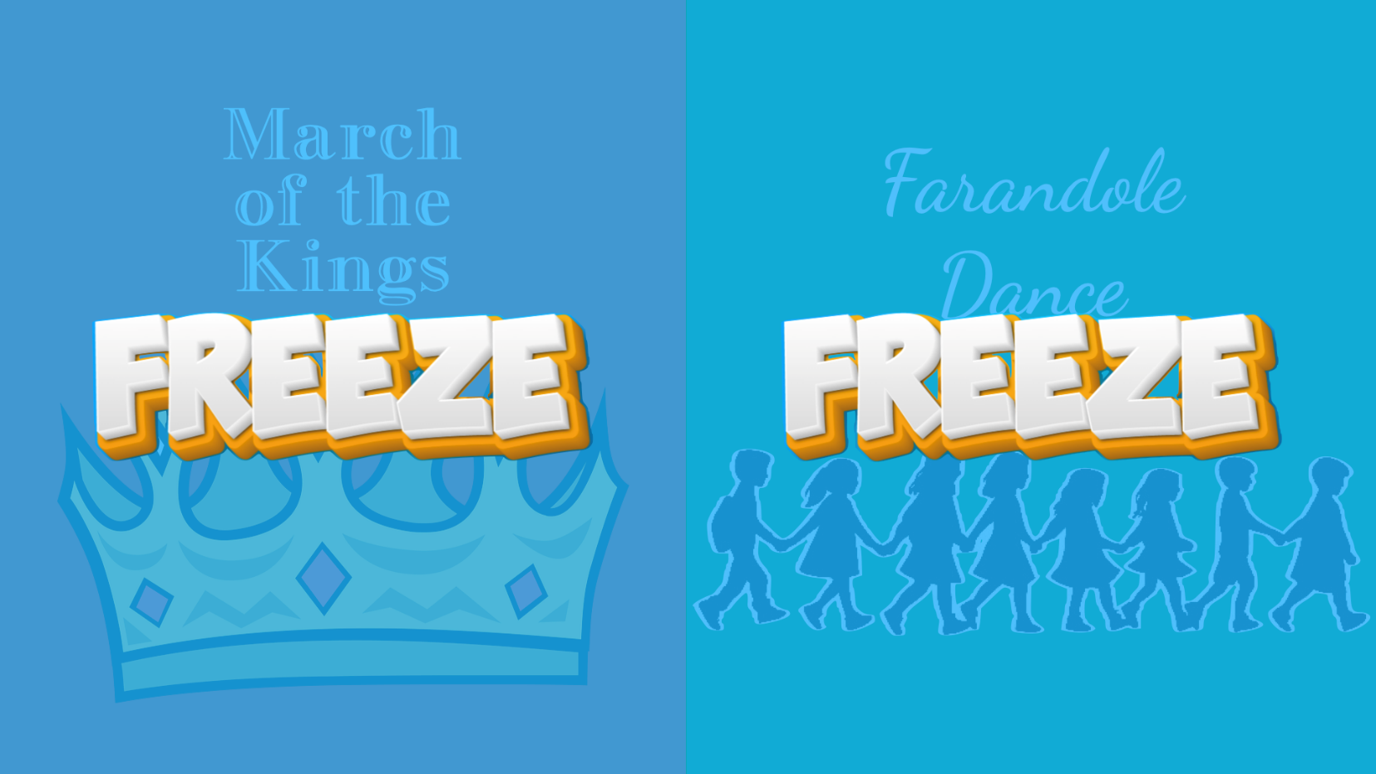
Lesson Activity 2: Weaving Freeze Dance

Slide 14

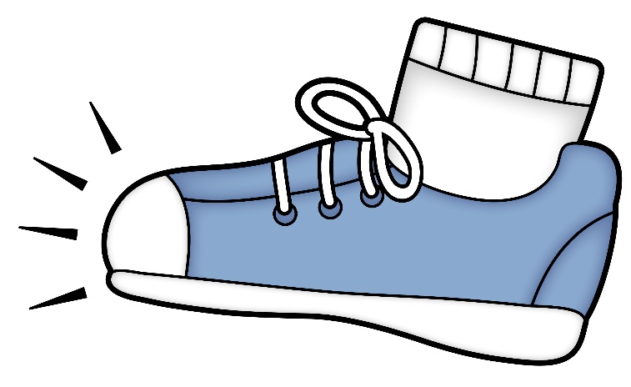
March

Slide 15
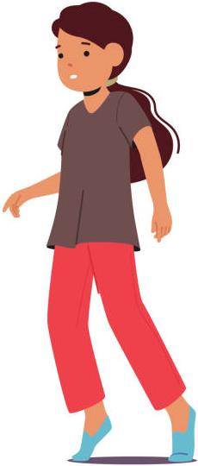
Toe Taps

Slide 16
Follow the Leader
Join hands
Hold shoulders
Hold rope
No touch follow

Slide 17
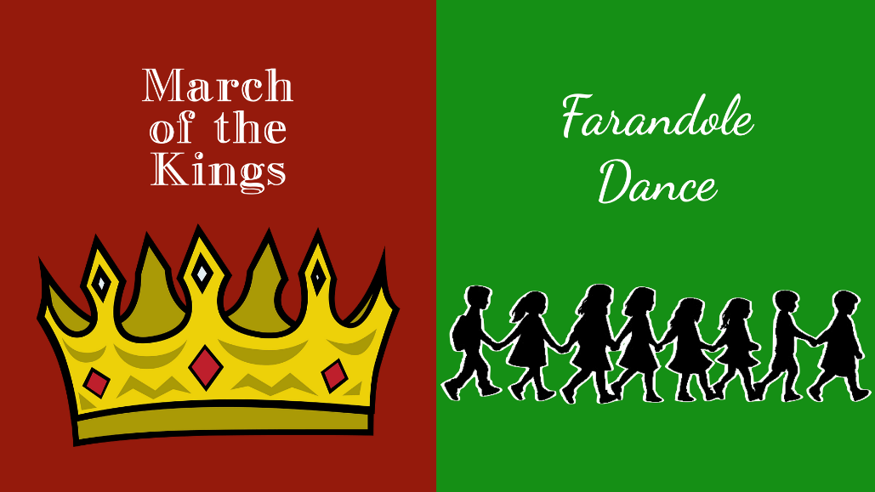
Split into
two groups
Each group will move when their melody is playing and FREEZE when it stops
Kings will march and freeze around the room
Farandoles will follow the leader in a path around the kings then freeze

Slide 18
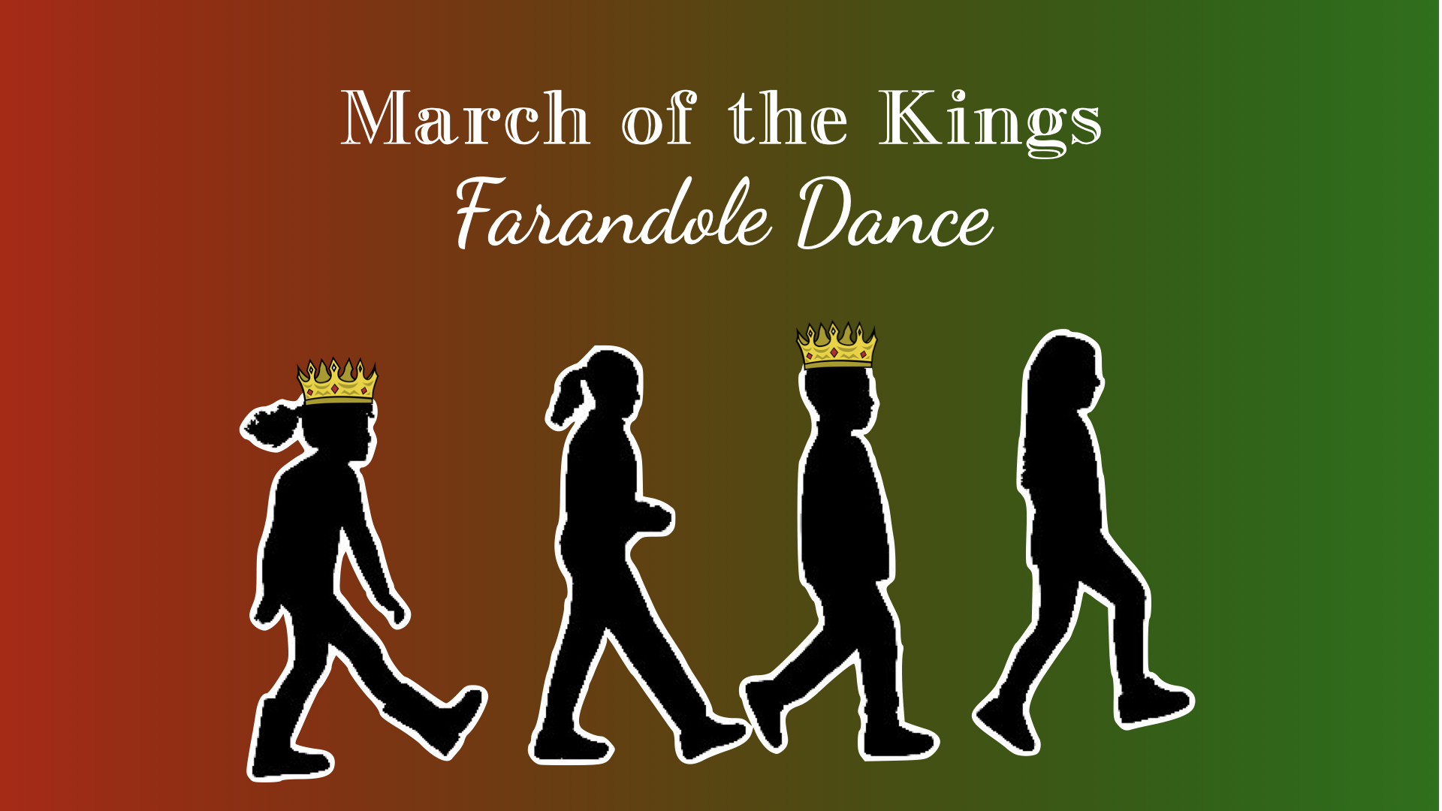

Slide 19
Movement
Expectations
How can we perform this dance accurately and safely?
Only move during your turn
Small safe steps
Respect others space
Include everyone

Slide 20
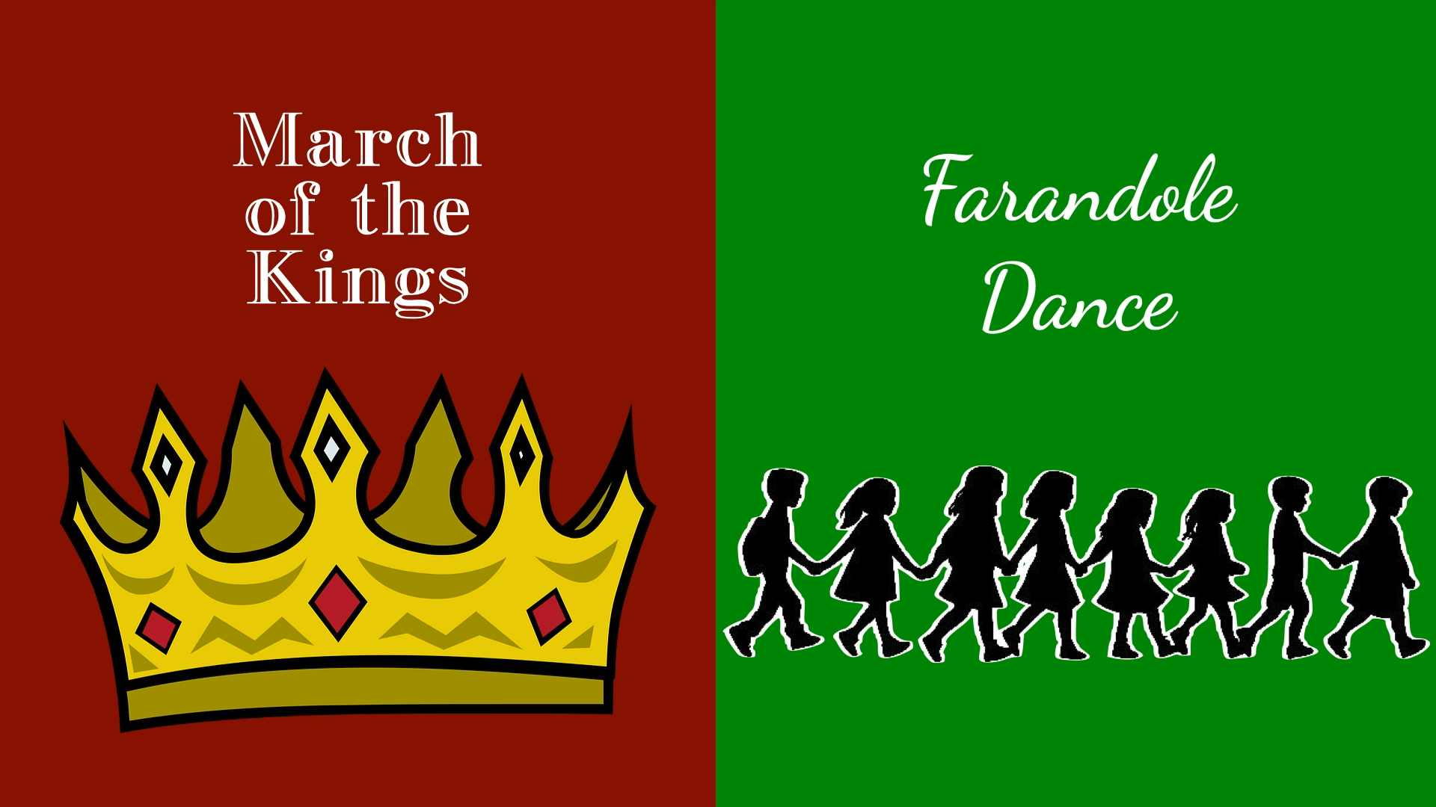

Move when your Melody plays!

Slide 21
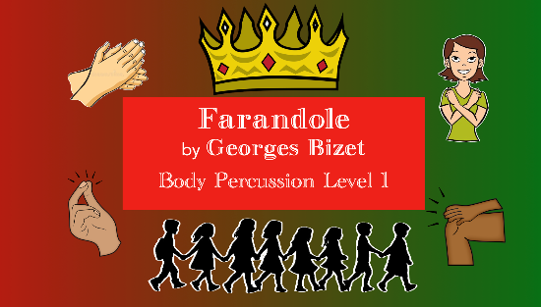
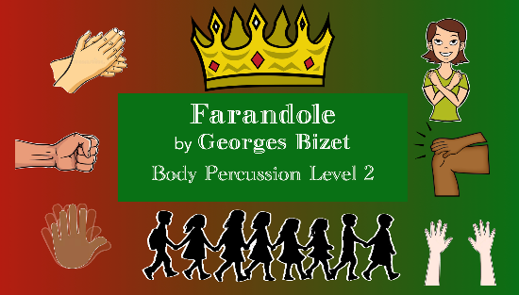
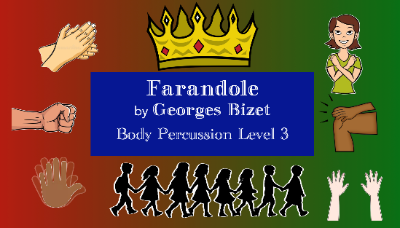
Non-Locomotor Body Percussion Version
https://youtube.com/playlist?list=PLlWLyQ0CPEJBP_WA8kF4XqmJyvGVe9BkS&si=inmqrOrMPXIpmHl0

Slide 22
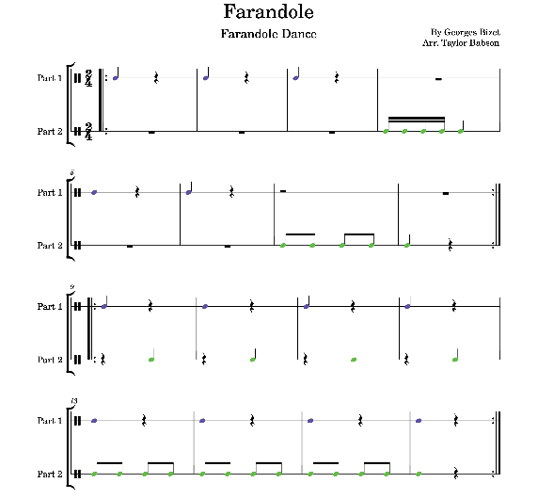


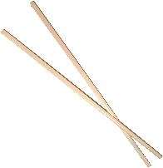

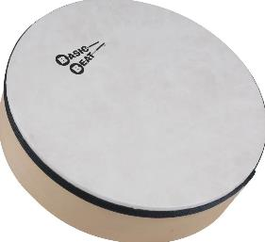


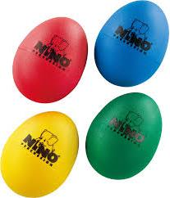
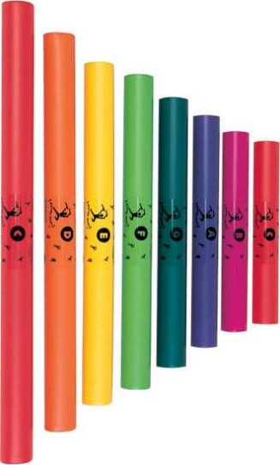
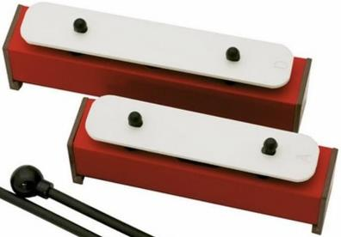
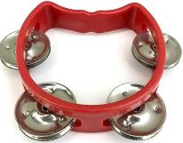
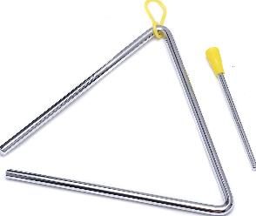
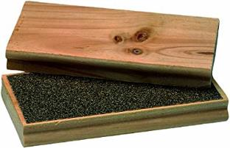
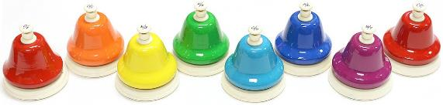
Lesson Activity 3: Instrument Play Alongs

Slide 23

Lesson Activity 3: Instrument Play Alongs
Solfege (Minor)
Pitch
Note Names
Quarter Note
Half Note
Whole Note
(Eighth Notes)

Slide 24
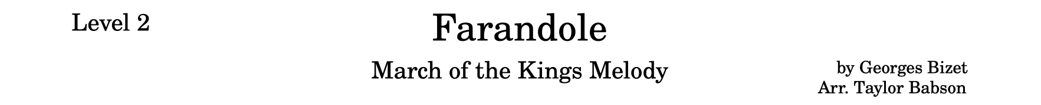
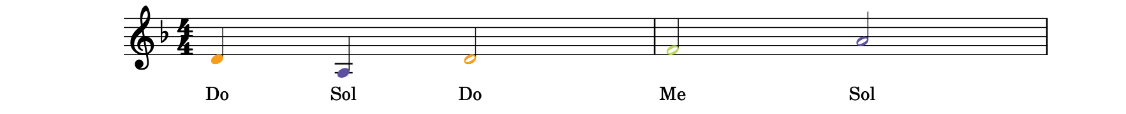
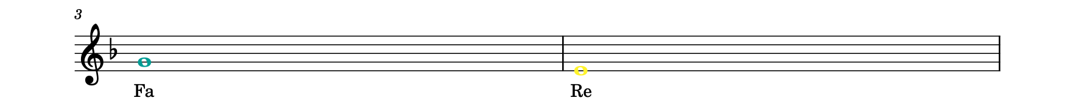
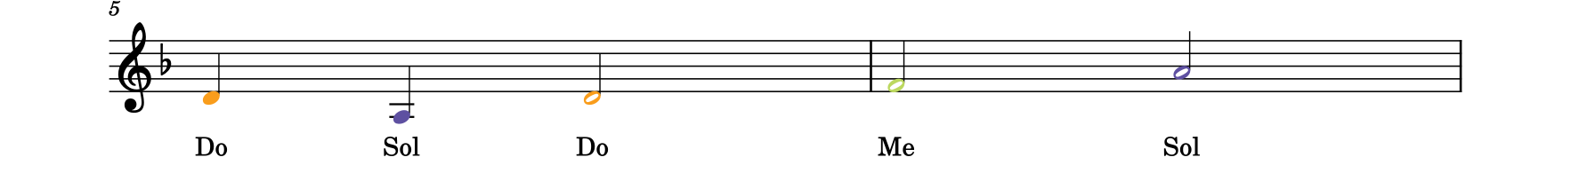
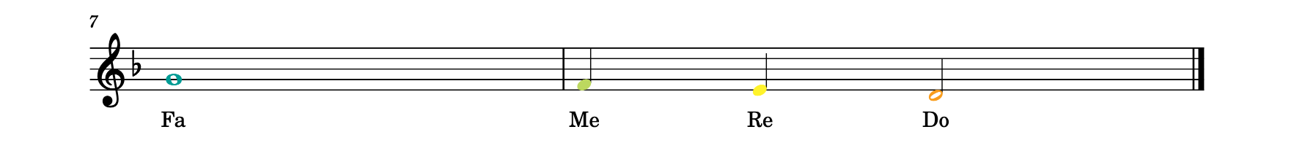
Lesson Activity 3: March of the kings Play Along

Slide 25
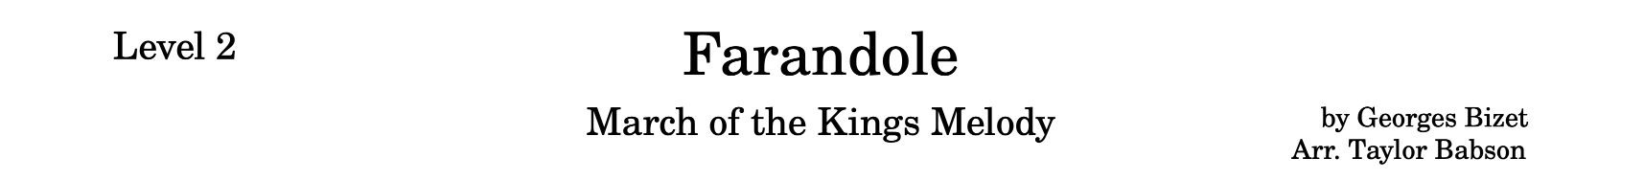
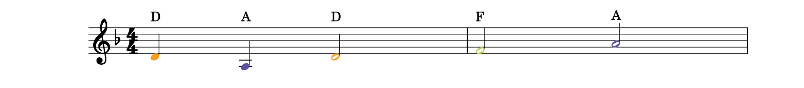
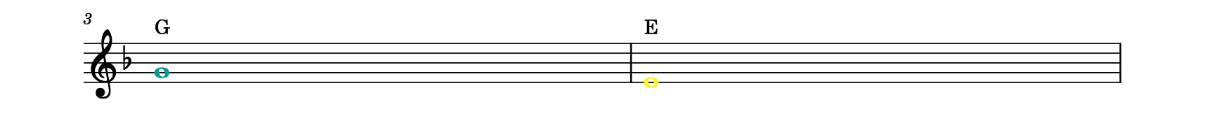
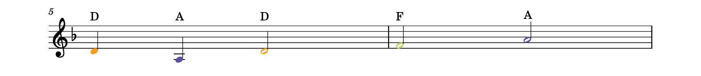
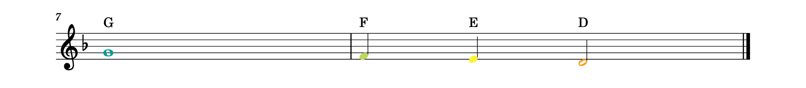
Lesson Activity 3: March of the kings Play Along

Slide 26

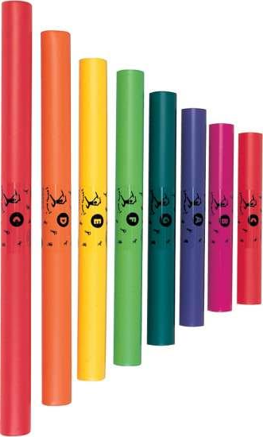
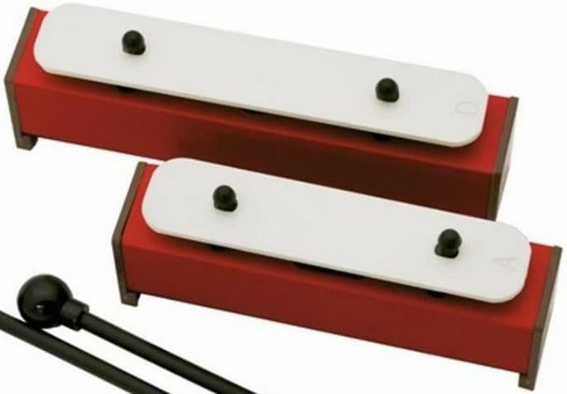
Lesson Activity 3: March of the kings Play Along

Slide 27
Lesson Activity 3: March of the kings Play Along

Slide 28
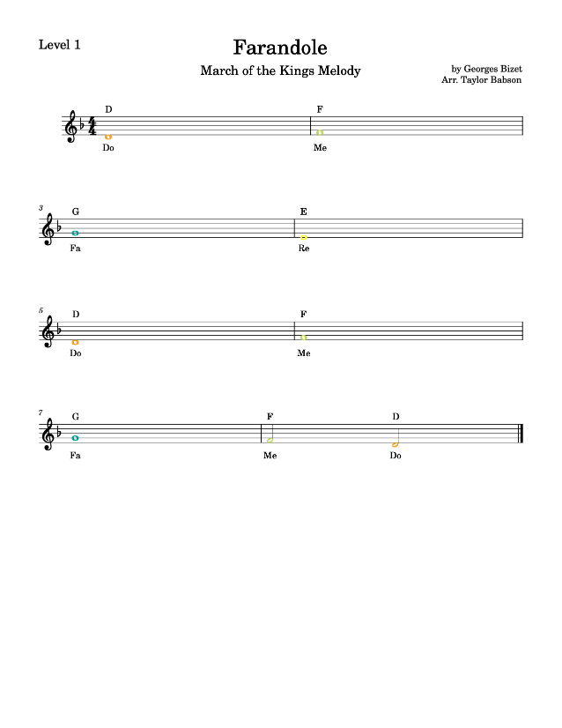
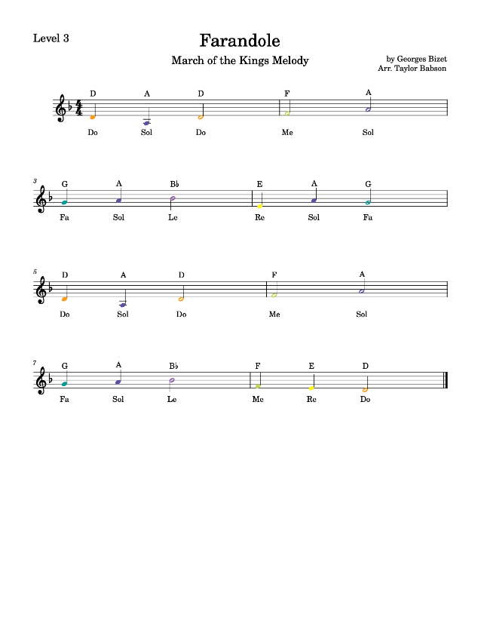



Slide 29

Lesson Activity 3: Dance Theme Play Along
Rhythm (Unpitched)
Two parts
Quarter Note
Quarter Rest
Half Rest
Eighth Notes
Sixteenth Notes

Slide 30

Lesson Activity 3: Dance Theme Play Along

Slide 31

Lesson Activity 3: Dance Theme Play Along

Slide 32




Lesson Activity 3: Dance Theme Play Along
Part 1
Part 2

Slide 33
Lesson Activity 3: Dance Theme Play Along

Slide 34
Lesson Activity 3: Dance Theme Play Along

Slide 35

Lesson Activity 3: Dance Theme Play Along

Slide 36
Lesson Activity 3: Instrument Play Alongs

Slide 37
Farandole
From L’Arlesienne No.2
By Georges Bizet

