Slide 1

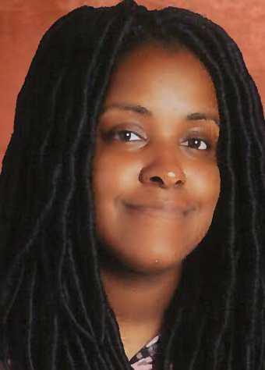
Stephanie Sanders
Barton Pond Elementary
Wake County Public School System
“Ode to Joy”
Ludwig van Beethoven
Arr. Terry Mizesko

Slide 2
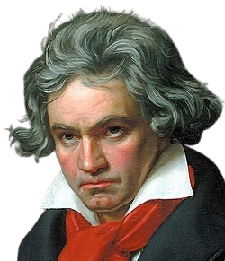
“Ode to Joy”
Symphony
No.9
Musical Element: Melody
Month Year

Slide 3
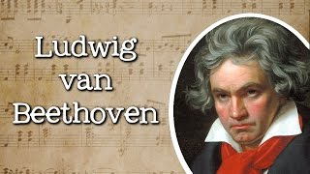
Biographical Information
Month Year

Slide 4

“Ode to Joy”
Activity 1: Performance
Month Year

Slide 5
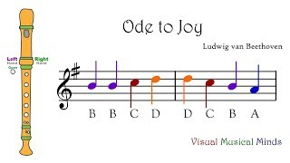
“Ode to Joy”
Activity 1: Performance
Month Year

Slide 6
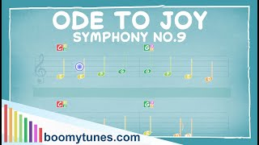
“Ode to Joy”
Activity 1: Performance
Month Year

Slide 7
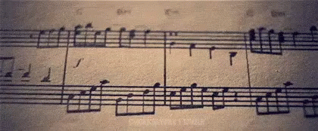
“Ode to Joy”
Activity 2:
Biography Compositions
Month Year

Slide 8
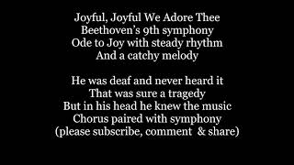
“Ode to Joy”
Activity 2:
Biography Compositions
Month Year

Slide 9
“Ode to Joy”
Activity 3:
Comparing and Contrasting Performances
Month Year

Slide 10
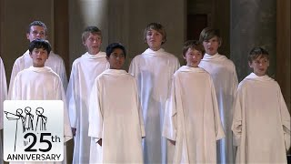
“Ode to Joy”
Activity 3: Comparing and Contrasting Performance #1
Month Year

Slide 11
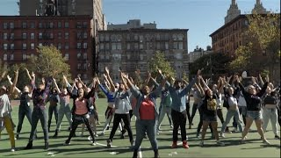
“Ode to Joy”
Activity 3: Comparing and Contrasting Performance #2
Month Year

Slide 12
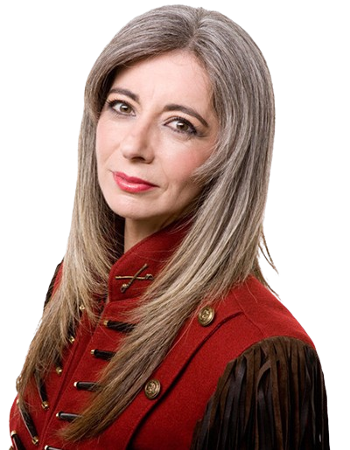
Musical Careers:
Evelyn Glennie
Month Year

Slide 13
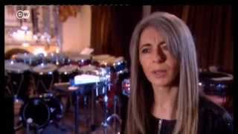
Musical Careers:
Evelyn Glennie
Month Year

Slide 14
Musical Careers:
What is a Concert Musician?
A person who performs music professionally in a concert setting independently and collaboratively
Month Year

Slide 15
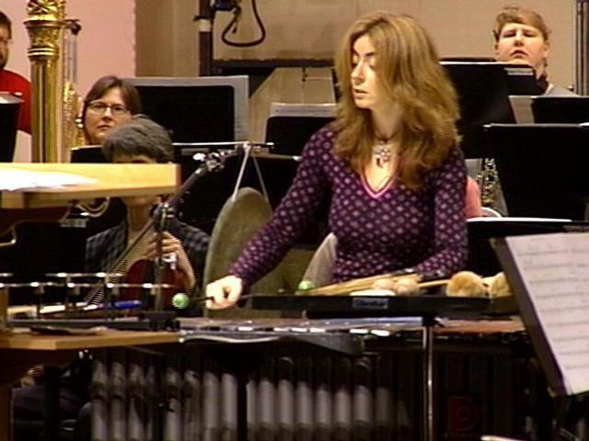
Article: Evelyn Glennie & The NC Symphony
Month Year

Slide 16
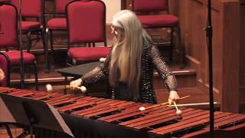
Activity #4: Evelyn Glennie Writing Exercise: Option 1
How does this music make you feel? What memories arise as you listen to this music?
Month Year

Slide 17
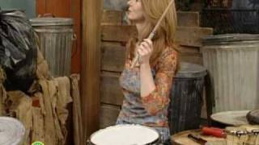
Activity #4: Evelyn Glennie Writing Exercise: Option 2
How does this music make you feel? What memories arise as you listen to this music?
Month Year

Slide 18
Works Cited
“A Close Up of a Sheet of Music with a Lot of Notes”. Tenor. 10 September 2017. https://tenor.com/view/music-gif-9715722.
“A Headshot of Evelyn Glennie”. 28 May 2025. PAS.org. Percussive Arts Society, https://pas.org/evelyn-glennie/.
Boomy Tunes. “Ode To Joy - BOOMWHACKERS & BELLS Score”. YouTube, uploaded by Boomy Tunes, 28 Jan. 2021, https://www.youtube.com/watch?v=nLeIT3QwKFo.
DW News. “Percussionist Evelyn Glennie, Euromaxx”. YouTube, uploaded by DW News, 24 Apr. 2012, https://www.youtube.com/watch?v=xchpJBmfGeE.
“Evelyn Glennie Performing Onstage”. 3 Aug 2006. WRAL News. WRAL, https://www.wral.com/story/141156/.
Free School. “Ludwig van Beethoven”. YouTube, uploaded by Free School, 2 Aug. 2016,https://www.youtube.com/watch?v=ms9tyNKtjcs&t=1s.
Libera Official. “Libera in America: Joyful Joyful, We Adore Thee”. YouTube, uploaded by Libera Official, 2 Mar. 2015, https://www.youtube.com/watch?v=MAkXHhs9vOc.
“Percussionist Beats Her Own Drum for Deaf Children”. WRAL News. 3 Aug. 2026, https://www.wral.com/story/141156/.

Slide 19
Works Cited
Manitoba Chamber Orchestra. “Dame Evelyn Glennie Performs Corelli’s La Folia”. YouTube, upload by Manitoba Chamber Orchestra, 13 Dec. 2018, https://www.youtube.com/watch?v=Bcdnn3HyH2s.
Rowen, David. “Joyful, Joyful - Sister Act 2 [Tiffany Mann, Kyle Taylor Parker, David Rowen, & Melissa Victor]”. YouTube, uploaded by David Rowen, 11 Nov. 2016, https://www.youtube.com/watch?v=-KP3XizrZHQ.
Sesame Street. “Sesame Street: Evelyn Glennie Plays the Drums”. YouTube, uploaded by Sesame Street, 20 Feb. 2009, https://www.youtube.com/watch?v=jVw5KawqUIg.
Stacey Plays Hymns. “Joyful, Joyful, We Adore Thee (Sing Along with Lyrics)”. YouTube, uploaded by Stacy Plays Hymns, 19 Aug. 2023, https://www.youtube.com/watch?v=tpmyuIs314E.
Stieler, Joseph Karl . “Ludwig van Beethoven, 1820”. Digital Image. Wikipedia, The Wikimedia Foundation. 19 June 2023.Web. 26 May 2025.
SZABO MUSIC. “BEETHOVEN SYMPHONY NINE 9 Lyrics Words Text Trending Sing Along Music song ODE TO JOY JOYFUL JOYFUL”. YouTube, uploaded by SZABO MUSIC, 23 Mar. 2020, https://www.youtube.com/watch?v=-8C2USP_UIs.
Visual Musical Minds. “VMM Recorder Song 11: Ode to Joy”. YouTube, uploaded by Visual Musical Minds, 25 Nov. 2017, https://www.youtube.com/watch?v=nLeIT3QwKFo.

