Slide 1
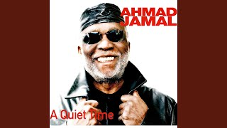
TEXTURE
Fanfare & Themes of Unity
Anthony E. Kelley
Dena Byers - Durham Public Schools
Laurie Siegel - Carolina Theatre

Slide 2
TEXTURE
ART
-the visual and tactile quality of a surface
-the way something feels

Slide 3
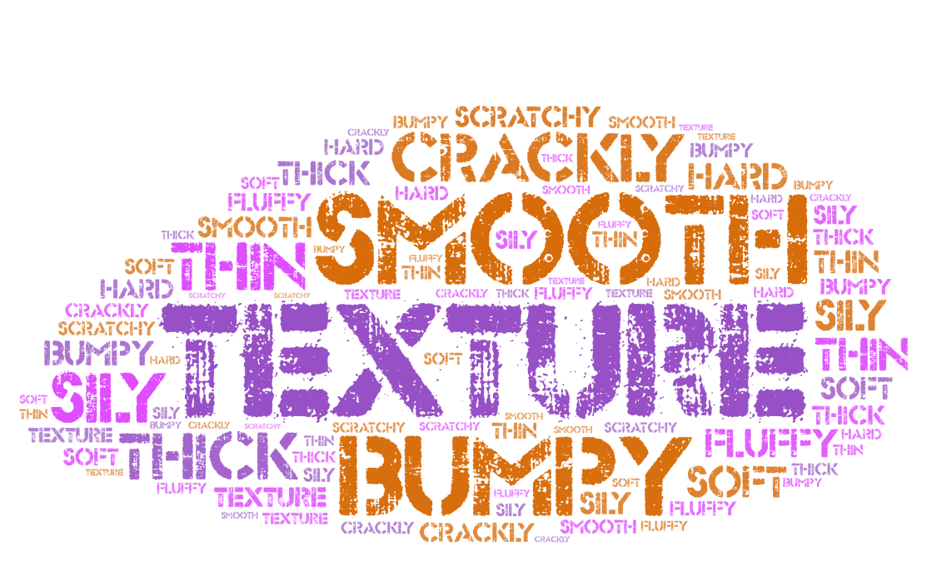

Slide 4
TEXTURE
ART
-the visual and tactile quality of a surface
-the way something feels
MUSIC
-how the different melodic and harmonic layers combine to create the overall sound
-how many instruments are playing at a time
(monophonic vs. homophonic)

Slide 5
It’s time for SQUILT!
Super
Quiet
UnInterrupted
Listening
Time

Slide 6
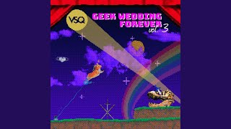

Slide 7
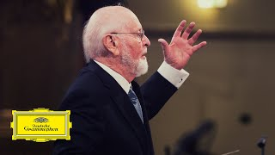

Slide 8
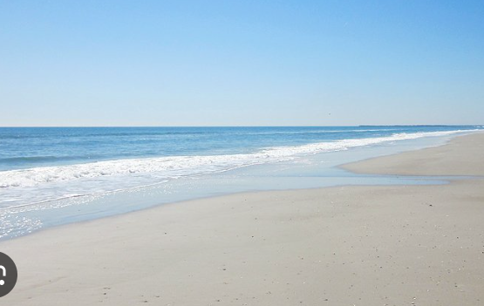

Slide 9
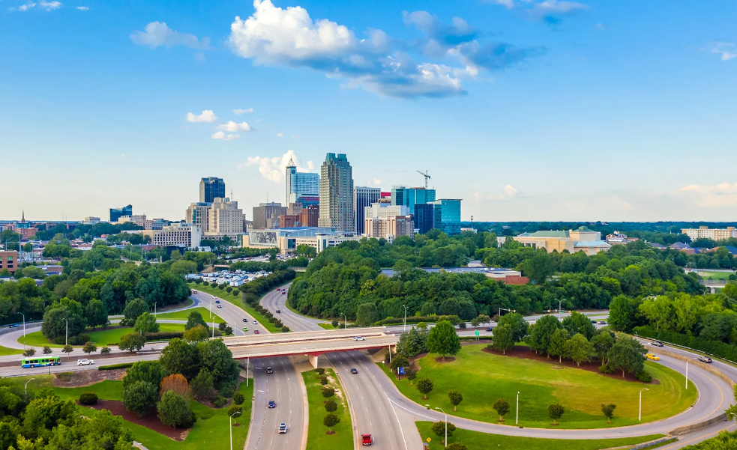

Slide 11
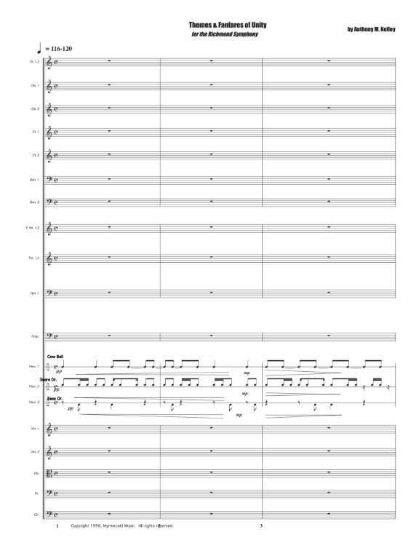
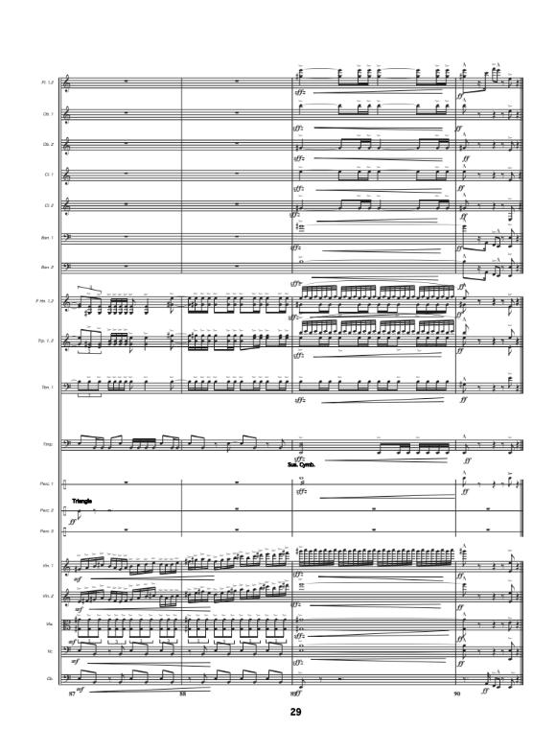

Slide 12
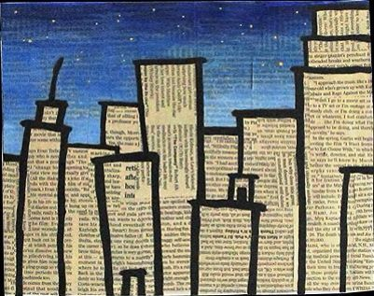
City Talk
Each student has one unpitched percussion instrument that can be carried while walking pulse
Students explore ways of playing their instrument and come to create one rhythmic phrase to play as an ostinato. Some echo work with patterns should precede this
Teacher taps one student; that student begins to play his/her instrument, moving throughout the space
Teacher continues to tap students, who in turn play and move
After teacher has tapped everyone, teacher then taps the person a 2nd time, stopping that player
Teacher continues until all are stopped
The challenge is to maintain your pattern and maintain the pulse. This can also be done with movement and or vocal sounds

Slide 13
We See Seashells!
We see seashells by the seashore
We see leaves in the trees
Travel from the shore to mountains
Take a trip to old NC!

Slide 14
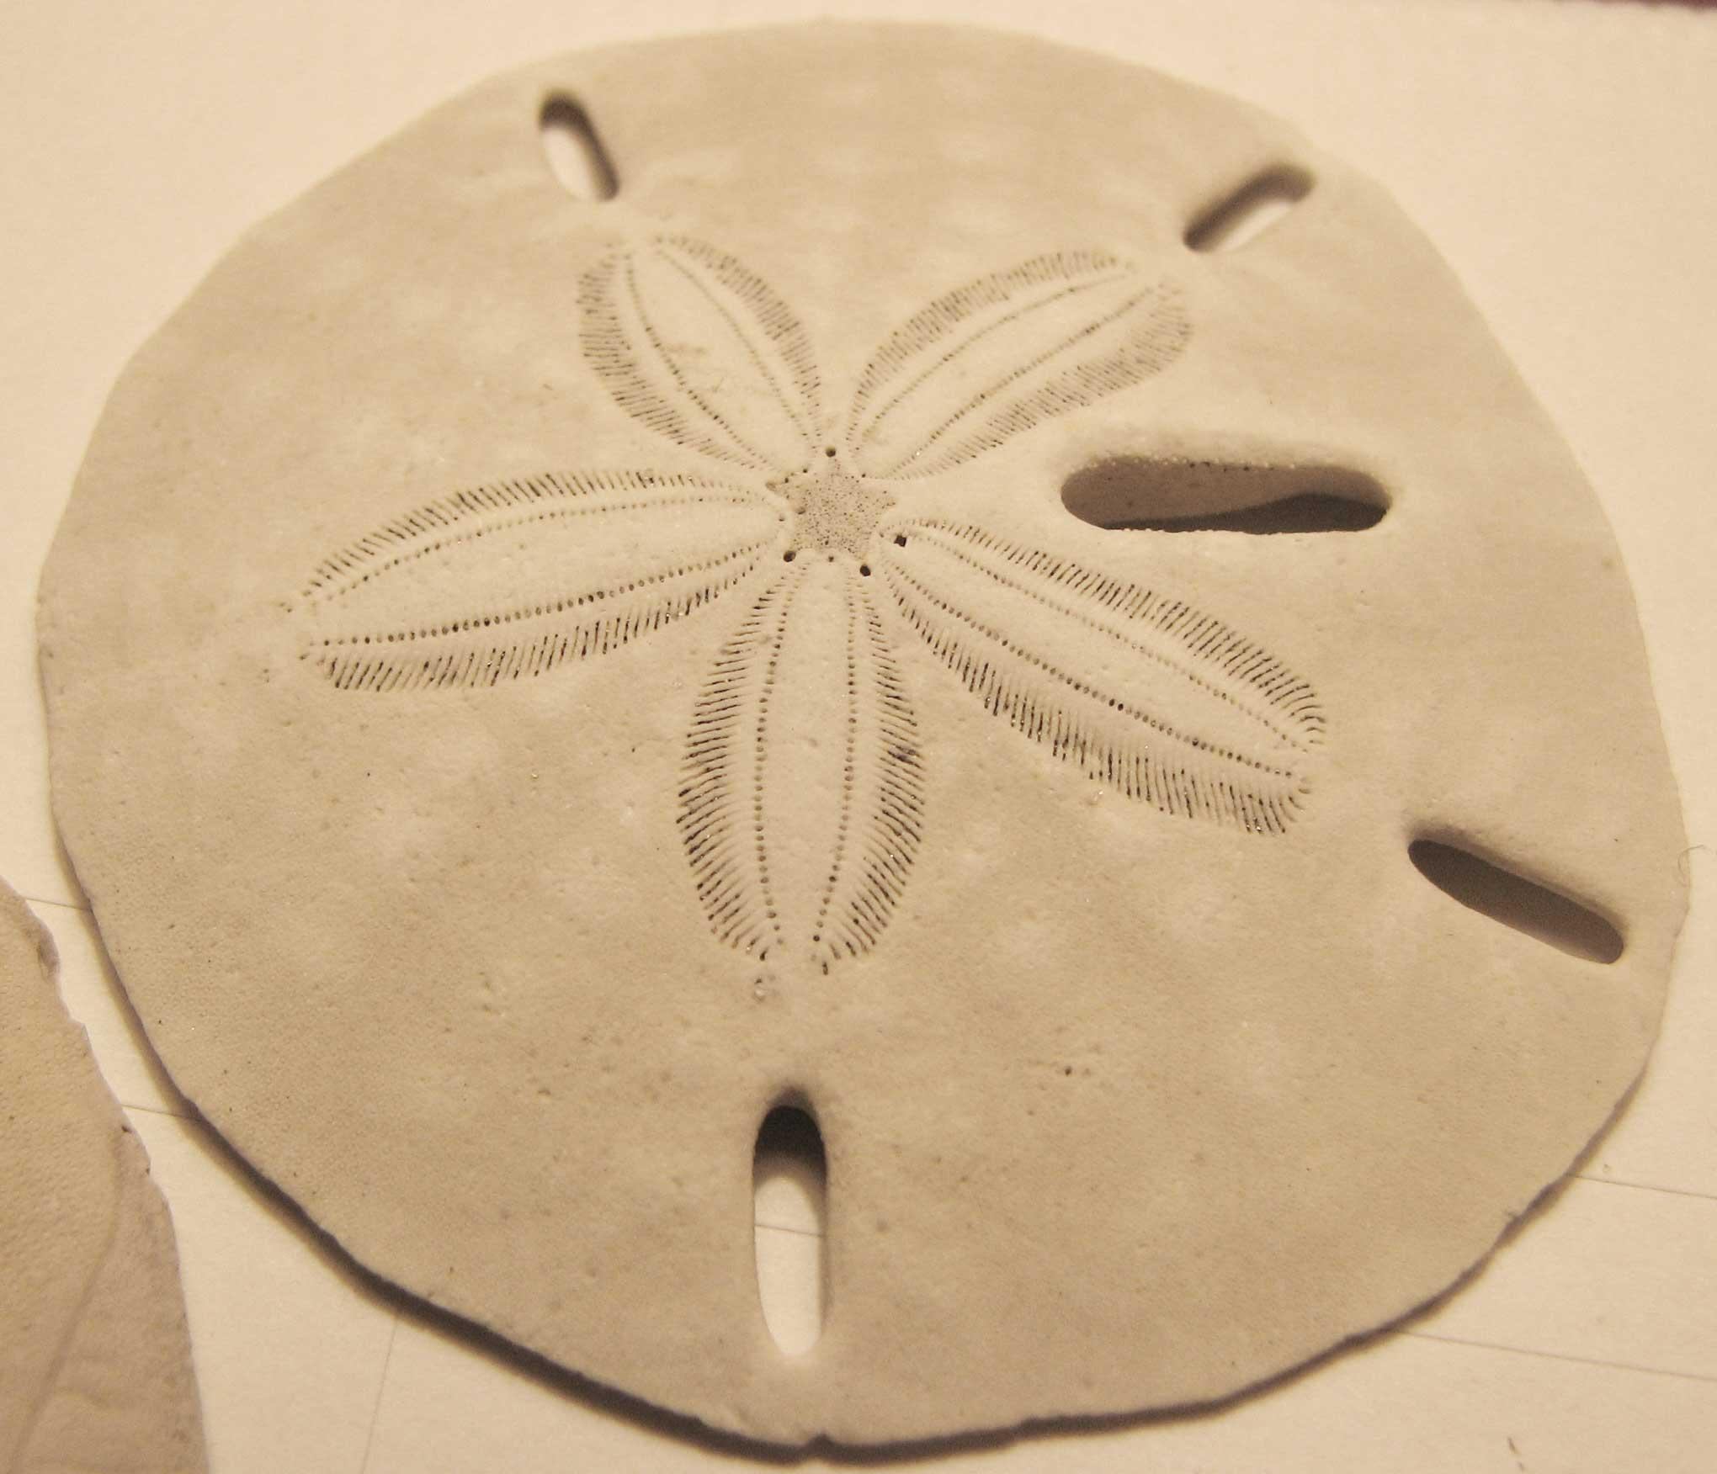
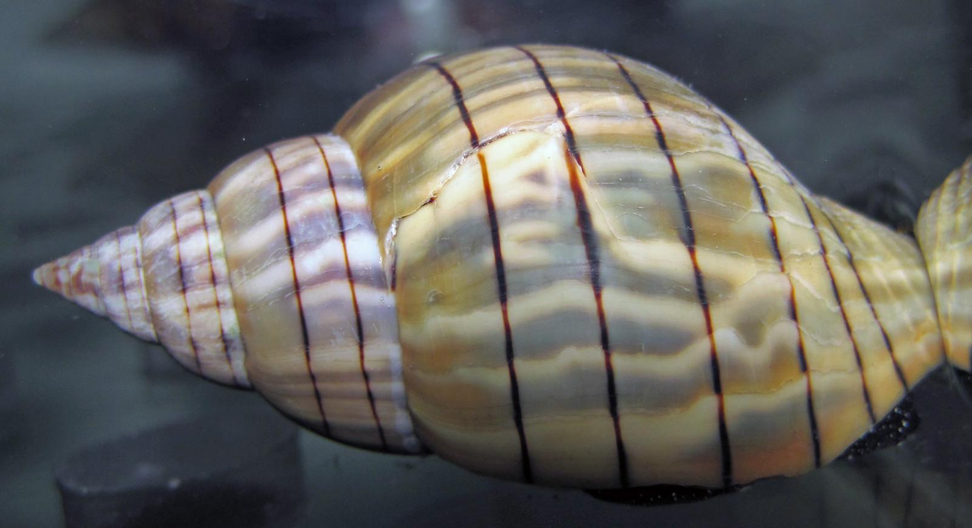
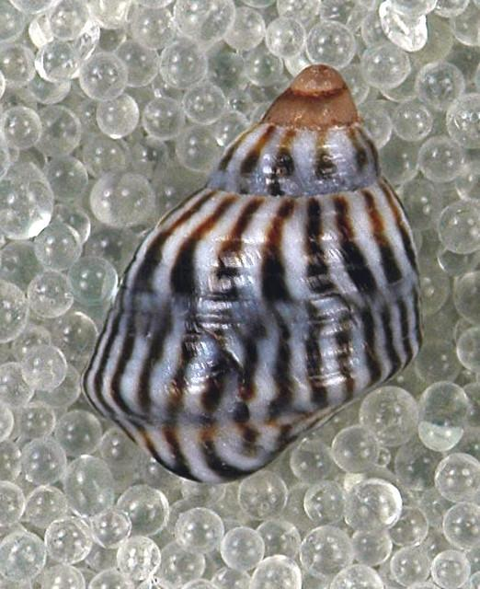
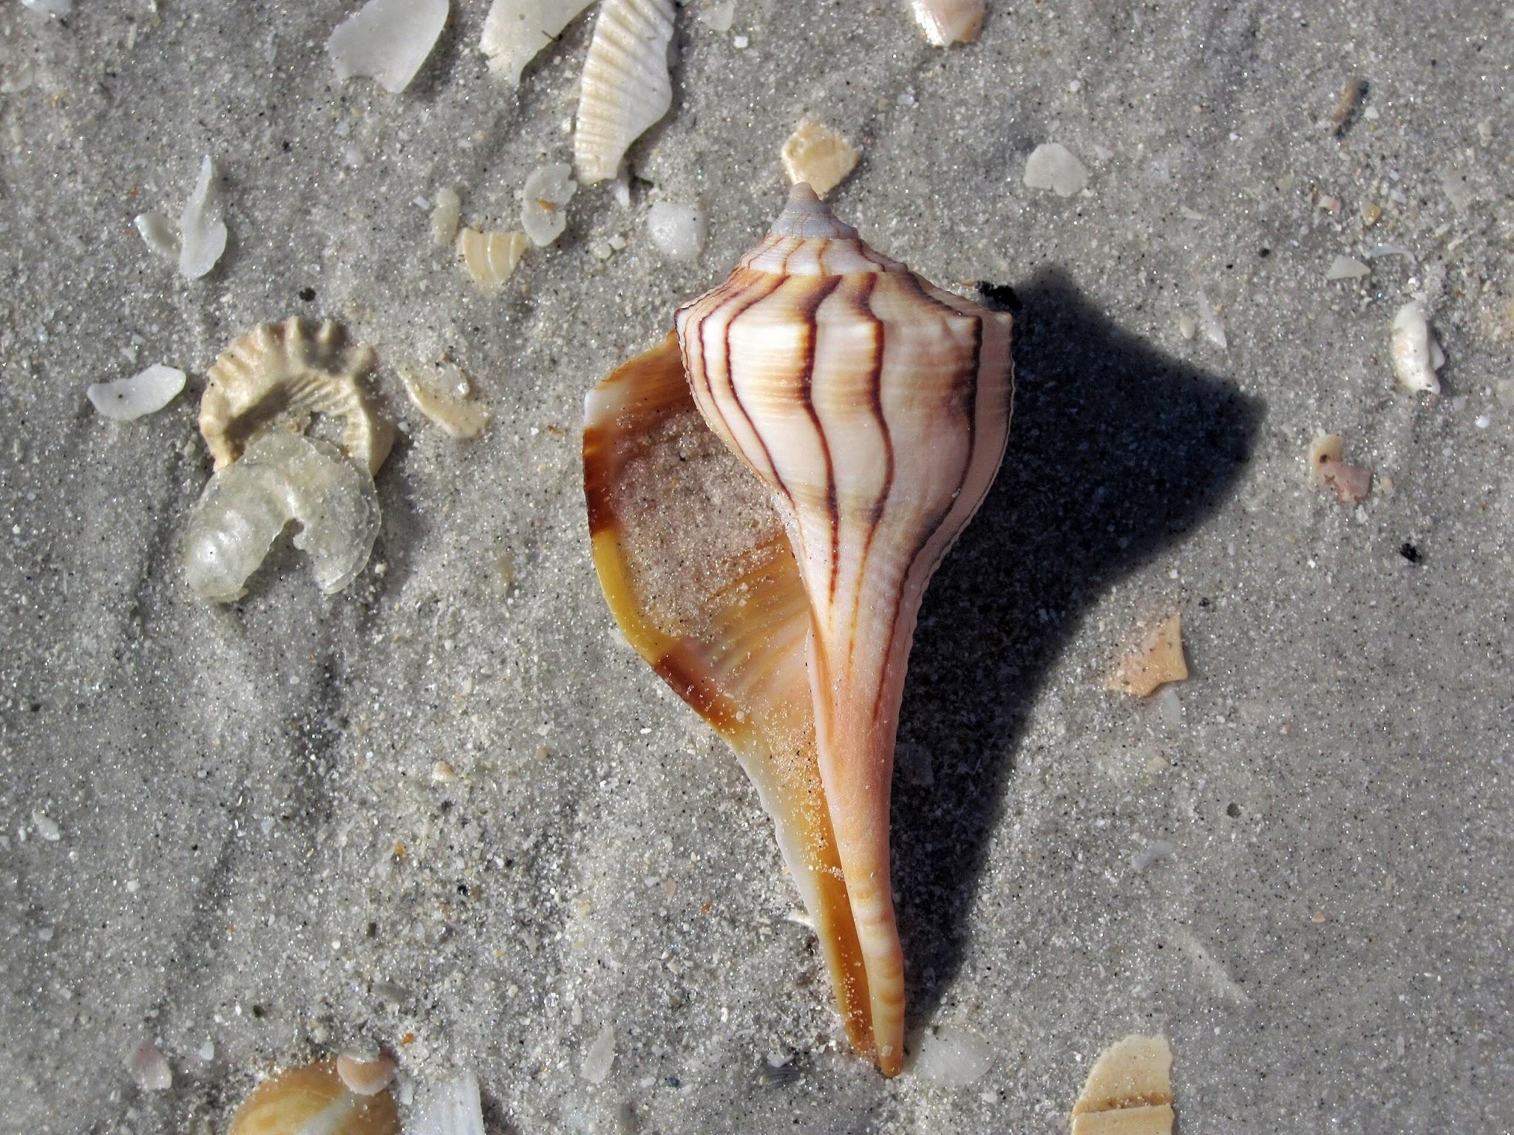
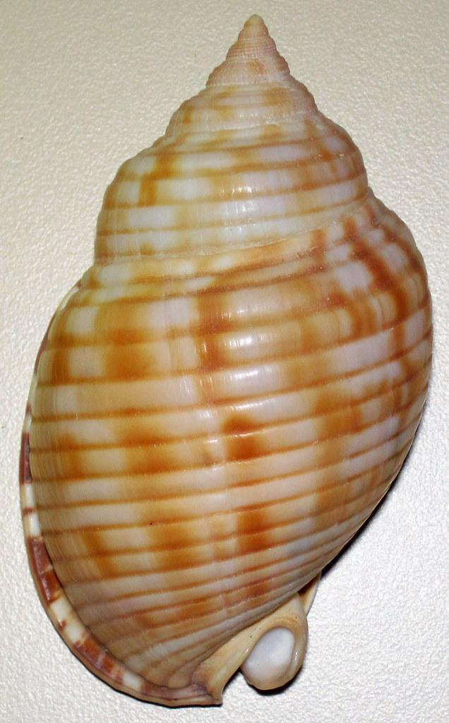
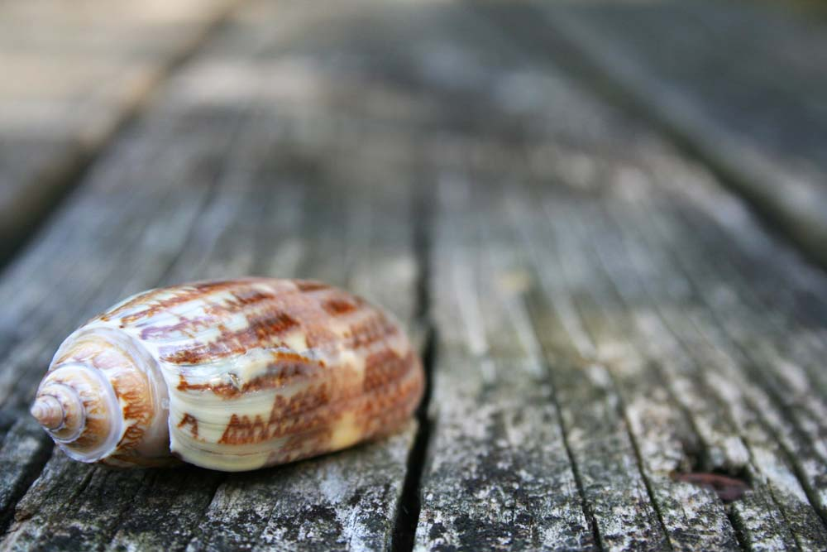
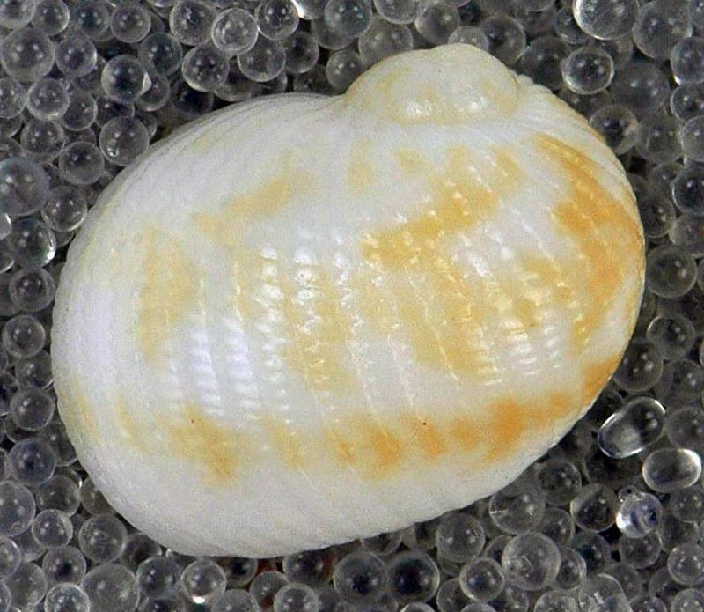
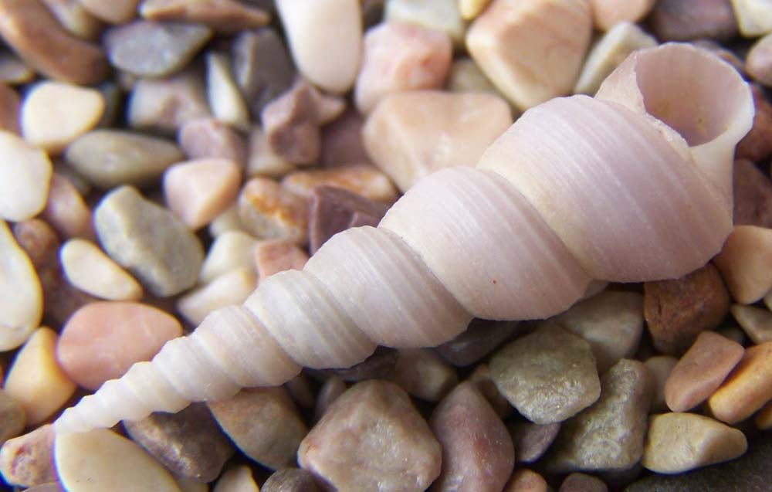
Sea Shells of NC
Keyhole Sand Dollar
Banded Tulip
Lightning Whelk
Periwinkles
Scotch Bonnet
Lettered Olive
Auger Shell
Moon Snail

Slide 15
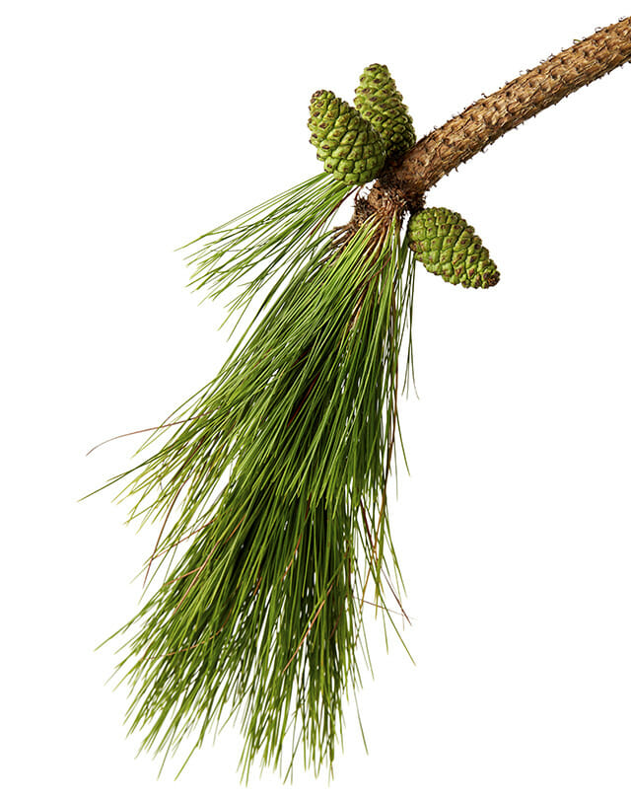

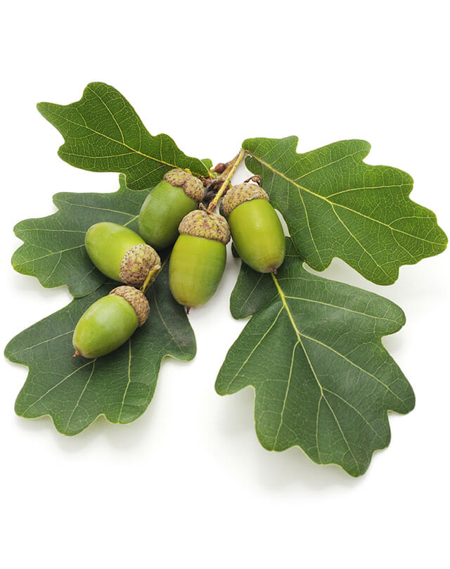



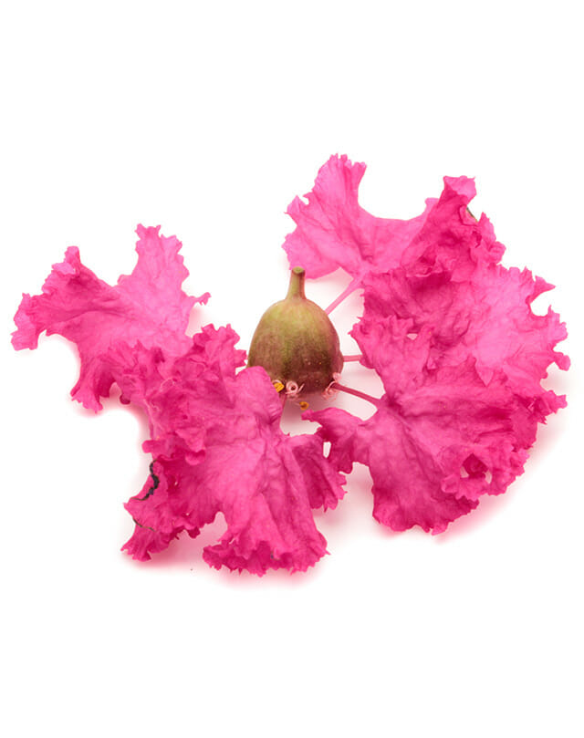
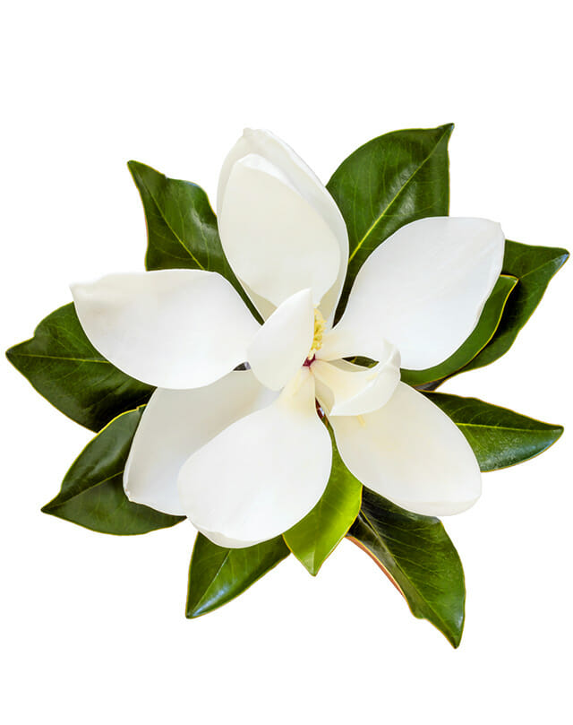
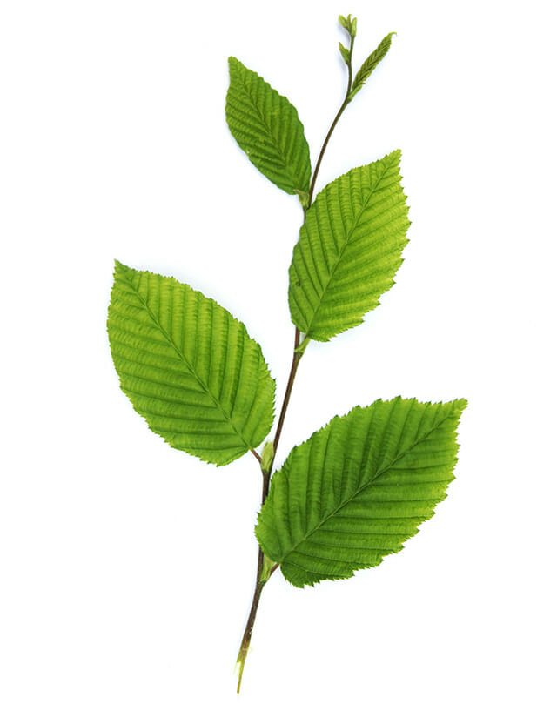
Leaves of NC
Loblolly Pine
Red Maple
Oak
Tulip Poplar
Sweet Gum
American Beech
Hickory
Crepe Myrtle
Magnolia

Slide 16





Building Bricks for Word Chains
Sweet Gum
Moon snail
Red Maple
Loblolly
Crepe Myrtle
Sand Dollar
Scotch Bonnet
Lightning Whelk
Auger Shell
Tulip Poplar
Banded Tulip
Periwinkles
Pine
Oak
Beech

Slide 17
“Despite our differences, we’re still not too far from each other in the long run.”
-Anthony Kelley

Slide 18
THANKS!
Do you have any questions?
Contact us
dena_byers@dpsnc.net
laurie@carolinatheatre.org

