Slide 1


Cheri Thomas
Efland Cheeks Global Elementary School
Orange County Schools
cheri.thomas@orange.k12.nc.us
“Ballet Music” from Aida
Giuseppe Verdi

Slide 2



Ballet Music
From Aida
by Giuseppe Verdi (1813-1901)
NC Symphony Education Concert
2025-2026
By Cheri Thomas, NBCT
Efland Cheeks Global Elementary

Slide 3
Lesson Resources (1 of 4)
Professional Recordings and Videos
Online recording (Begin @ 4:57)
Chicago Symphony Orchestra and Chorus, 1990
(All times listed for instrument and movement parts are noted from this recording.)
NC Symphony Recording
Video of Triumphal March and Ballabile by Metropolitan Opera House 1989
Total video length is 5:45; Ballabile begins at 1:31

Slide 4
Lesson Resources (2 of 4)
Play-Along Scores
Student Play-Along Score with Rhythm Reference Lines
Full Play-Along Score with Student Line, Student Rhythm Reference Line,
and Teacher Rhythm Reference Line

Slide 5
Lesson Resources (3 of 4)
Background, Characters, and Plot - Lessons
Background and Plot of Aida for Kids
Playing, Movement, and STEAM Lessons
(All 3 Lessons in 1 File)

Slide 6
Lesson Resources (4 of 4)
Pyramid Construction Theory
How the Pyramids Were Built
Here is one group’s copyrighted theory of how the pyramids were created, complete with details, measurements, schematics, and information about how one of the men tested the theory in his backyard.
Secret of the Pyramids Website
See the Projects section of the site for details
Secret of the Pyramids Construction Info Brochure

Slide 7
The Opera
Background and Plot of Aida for Kids

Slide 8

Egypt and
Ethiopia,
the two countries on the continent of Africa who were fighting in the opera Aida

Slide 9
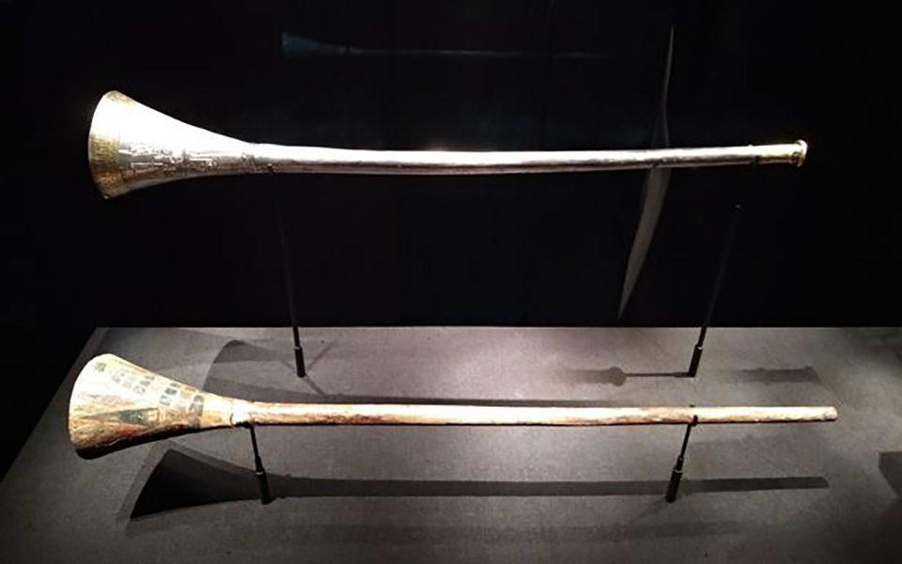
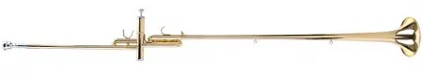
* Trumpets like the one Verdi would have designed to be used in Aida
* A trumpet like what was probably played when Aida premiered; now called an Aida Trumpet

Slide 10
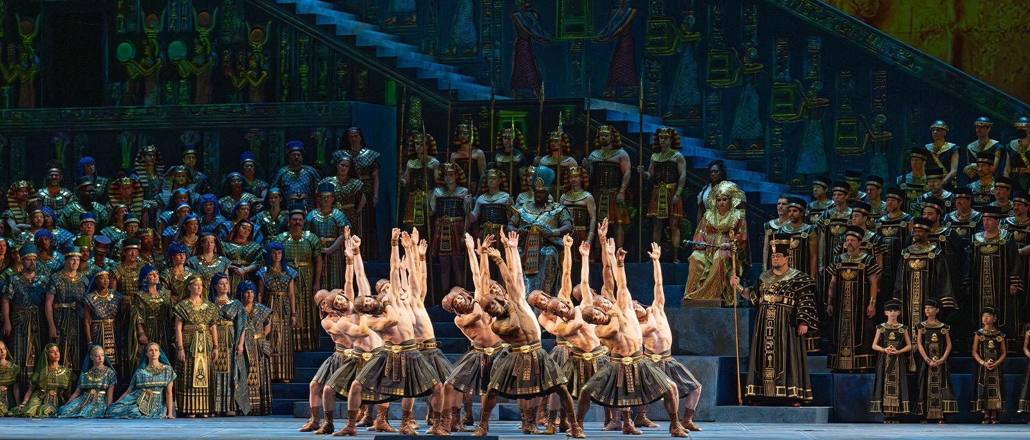
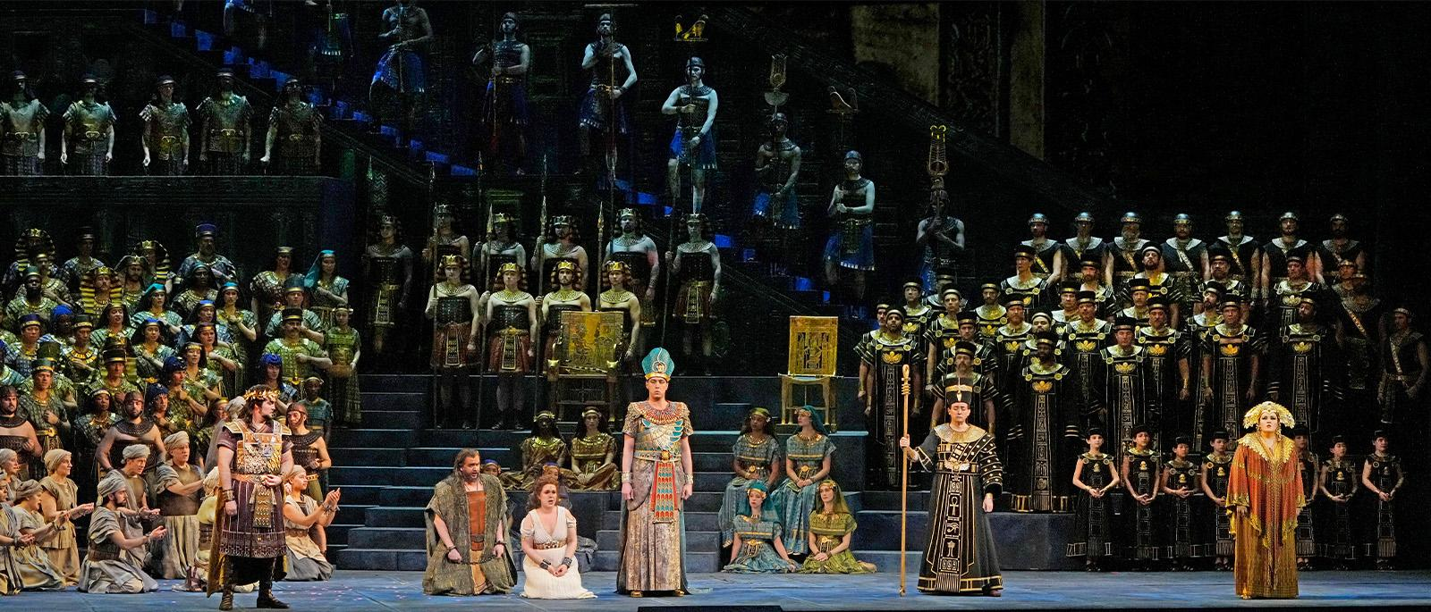
Two examples of a large cast in a performance of Aida.

Slide 11
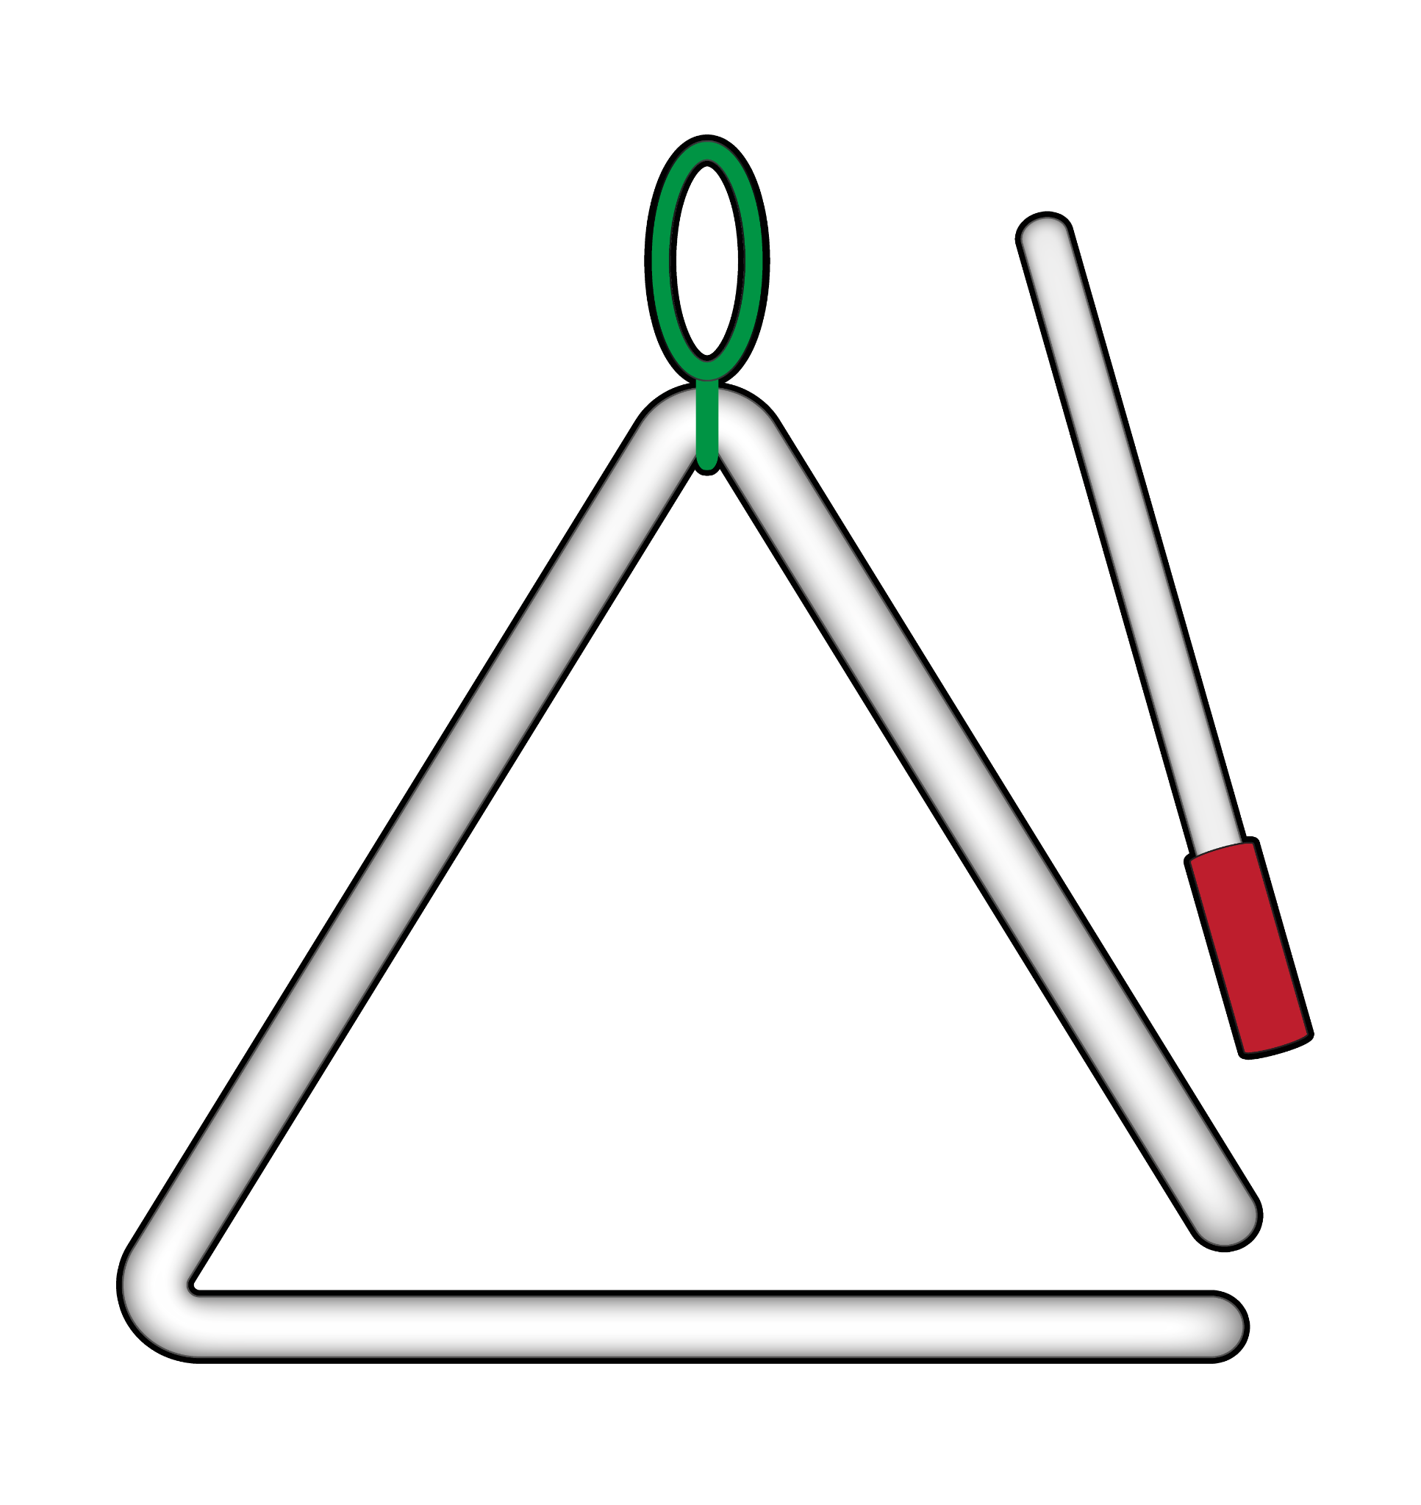
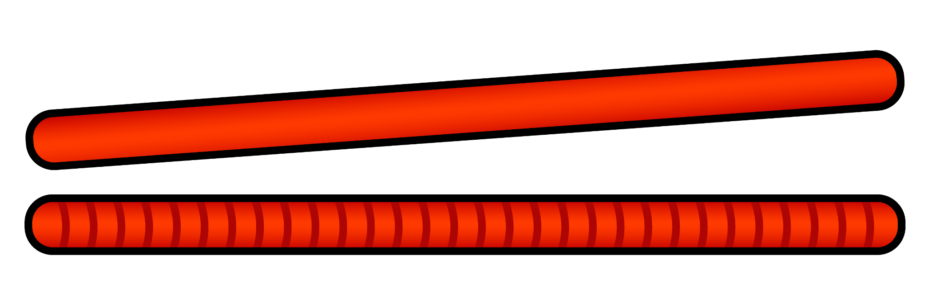
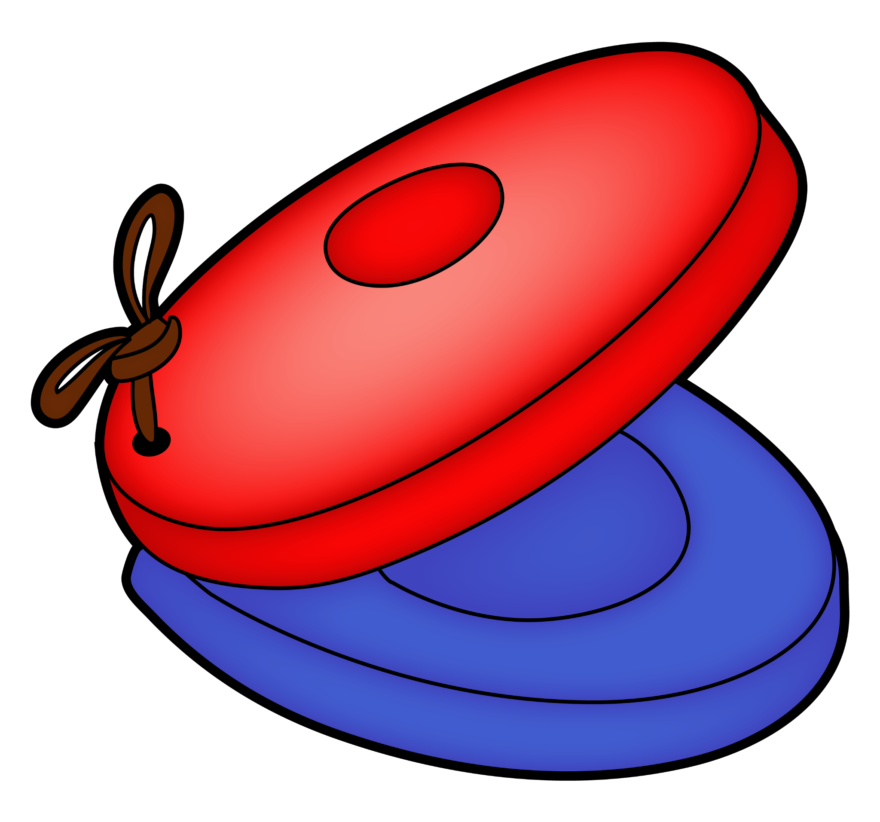
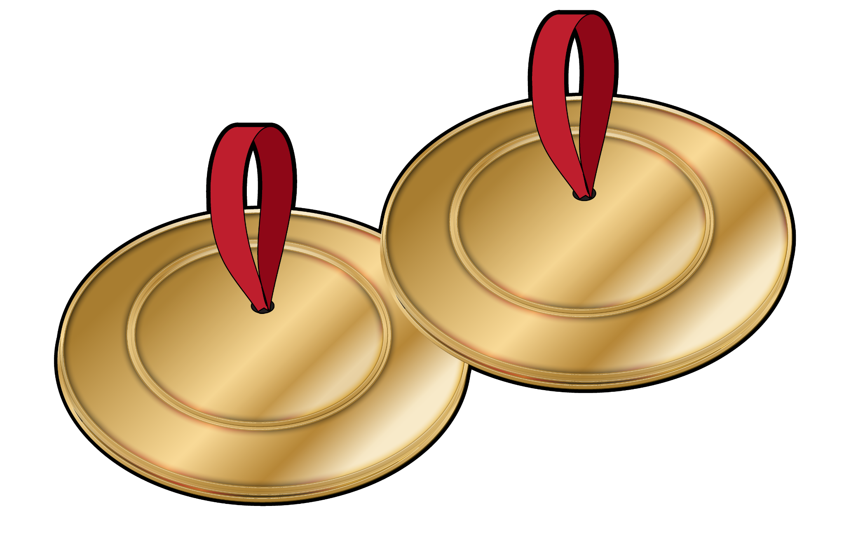
Let’s Play!
Rhythm Instrument Play-Along for
Ballet Music from Aida
Playing Lesson
Student Score with Reference Rhythms
Full Score with Student Line and Reference Rhythms and with Teacher Reference Rhythms

Slide 12

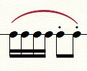




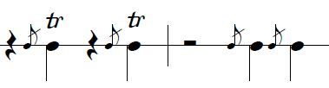
Rhythm Vocabulary (1 of 2)
Rhythm Figure | How it looks by itself | How it looks in our music | What it does | How it sounds (video time markers)
Staccato |  |  | Notes are short and detached | 5:04-5:10 and 7:12-7:18
Legato |  |  | Notes are smooth and connected | 6:03-6:16
Triplets |  |  | 3 even notes on 1 steady beat | 5:04-5:10
Grace Note |  |  | A very quick “extra” note (pitch) just before a melody note | 8:04-8:17

Slide 13



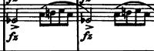
Rhythm Vocabulary (2 of 2)
Rhythm Figure | How it looks by itself | How it looks in our music | What it does | How it sounds
Trill |  |  | 2 pitches played very quickly or alternating very quickly before a melody note; trills can vary from short to very long | 8:04-8:17 and 7:03-7:12
Accent |  |  | Emphasis (stress) on a note so that it stands out more than other notes around it | 8:30-8:37
Sforzando |  |  | Sudden, strongest type of accent | 6:17-6:30

Slide 14
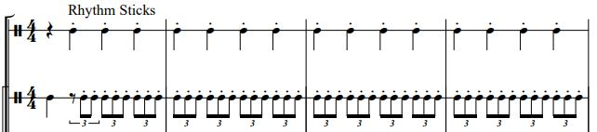
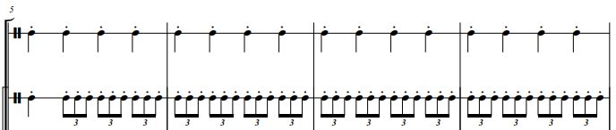
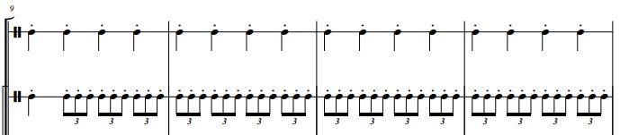
E

Slide 15
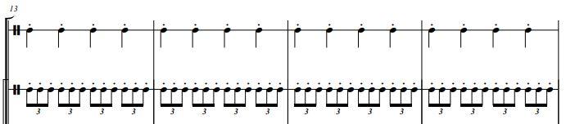
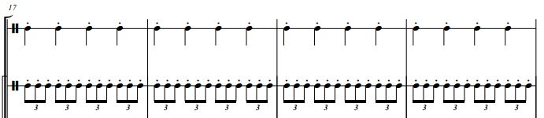
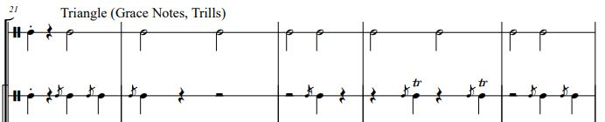
F

Slide 16
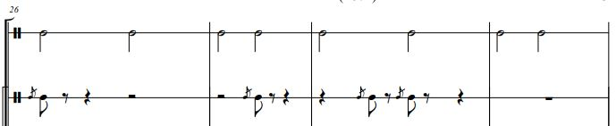
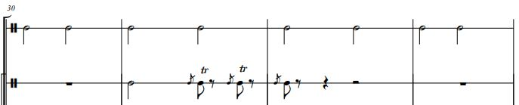
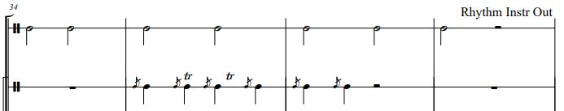
G
G

Slide 17
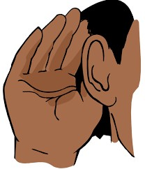
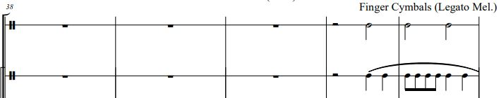
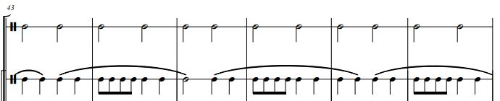
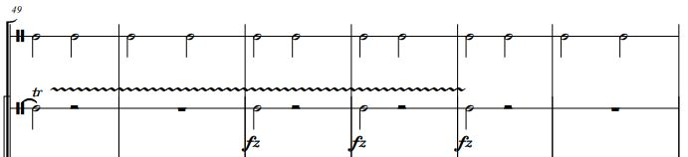

Slide 18
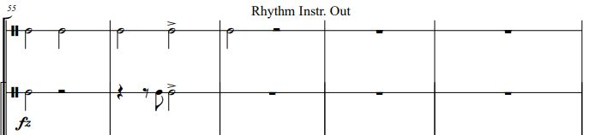
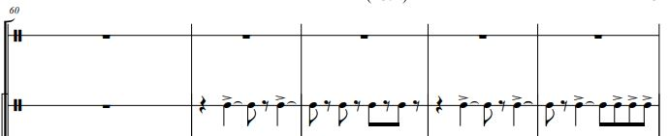
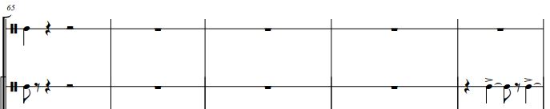
H

Slide 19
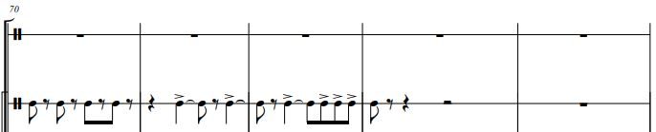
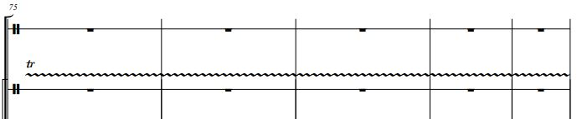
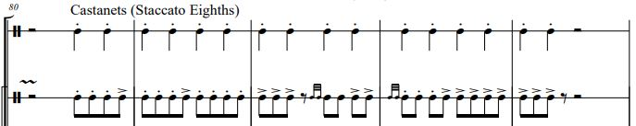
H-A
H-B

Slide 20
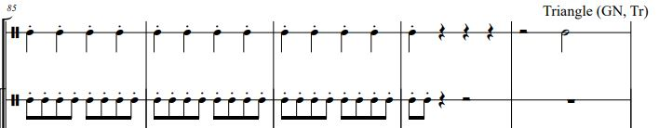
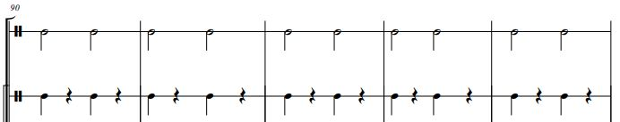
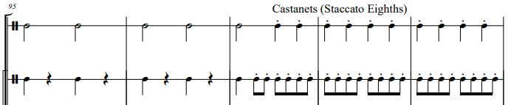
H-C
H-C

Slide 21
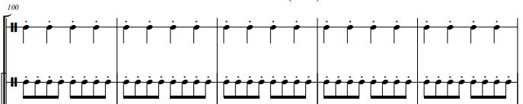
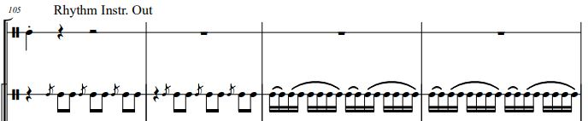
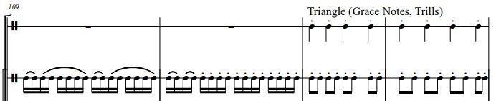
H-D

Slide 22
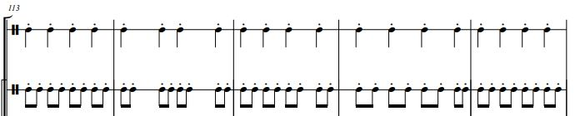
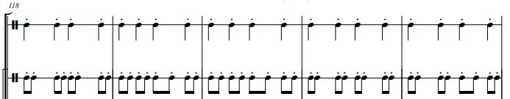
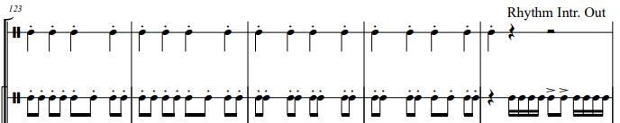
H-E-1

Slide 23
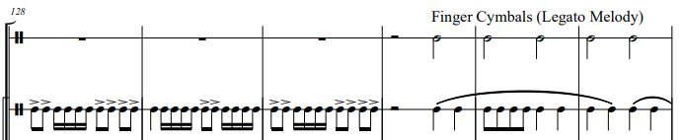
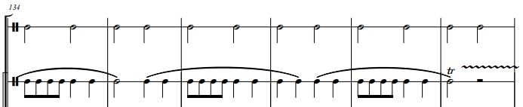
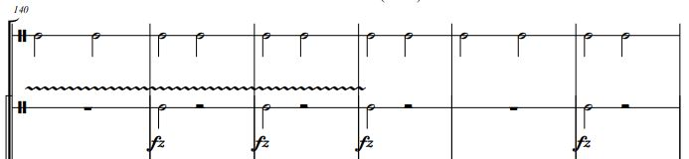

Slide 24
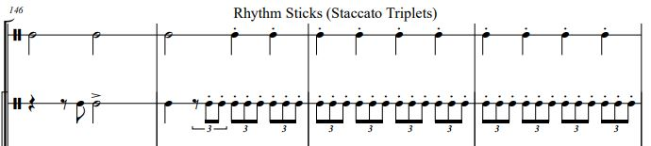
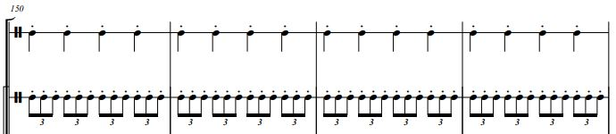
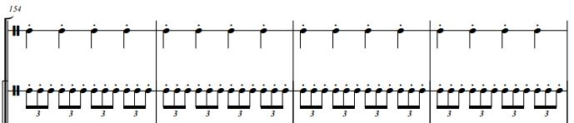
H-E-2

Slide 25
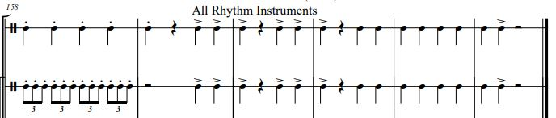

Slide 26
Simplified Student Play Along
m. 1-21
m. 57-80
m. 80-88
m. 21-37
m. 89-97
m. 37-41
m. 41-57
m. 97-105

Slide 27
Simplified Student Play Along
m. 147-159
m. 105-110
m. 111-127
m. 159-163
m. 127-131
m. 131-147

Slide 28
Let’s Move!
Parachute Ballet
Movement Lesson
NC Symphony Recording
Student Score with Reference Rhythms
Full Score with Student Line and Reference Rhythms and with Teacher Reference Rhythms

Slide 29
Simplified Student Play Along
m. 1-21
m. 57-80
Hold up
Circle, stepping lightly
Hold up - turn in place keeping 1 hand on chute, heavy step in place, repeat, gently ripple at waist through parts exchanging and long trills, heavy stepping
m. 21-37
Hold waist
Circle, Arc L arm out, then back to hold
m. 80-88
Hold straight arm down
Circle, stepping lightly arms straight down
m. 37-41
m. 89-97
Hold waist
Stationary, heavy stepping, L/R alternating
Hold waist
Circle, Arc L arm out, then back to hold
m. 41-57
m. 97-105
Hold waist
Circle smoothly, raising and lowering gently
Hold straight arm down
Circle, stepping lightly arms straight down

Slide 30
Simplified Student Play Along
m. 105-110
m. 147-159
Hold waist
Flip in place with rhythm, then ruffle in place
Hold up
Circle, stepping lightly
m. 111-127
Hold waist
Circle, Arc L arm out, then back to hold
m. 159-163
Hold waist
Move chute up & down to match rhythm
m. 127-131
Hold waist
Stationary, heavy stepping, L/R alternating
m. 131-147
Hold waist
Circle smoothly, raising and lowering gently

Slide 31
Let’s Build!
No-Touching Team Building
STEAM Lesson
See Lesson Resources 4 of 4 for Additional Information About Pyramids

Slide 32
Pyramid Building Facts for The Great Pyramid of Giza
Egyptian pyramids were built to be tombs so kings could be buried with gold and other treasure.
About 80 pyramids have been found in Egypt, but some are now only rubble.
The Great Pyramid was built for King Khufu in about 2550 bce.
About 100,000 workers spent about 20 years building the Great Pyramid.
2.3 million blocks of stone are stacked
471 feet (143 meters) high
Each of the blocks weighed about 2.5 tons.
The workers probably hauled them up a long dirt ramp.
Information from https://kids.britannica.com/kids/article/pyramid/353683

Slide 33
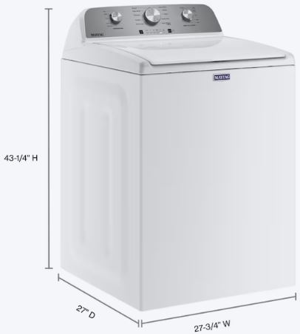
Pyramid Building Facts
The Great Pyramid of Giza
Average stone was sized 50” x 50” x 27”
That’s like 2 washing machines side-by-side, with something the height of a pencil stacked on top!

Slide 34


Pyramid Building Facts
The Great Pyramid of Giza
Average stone weighed 5,511 lbs.
That’s about the weight of a Toyota Tundra or Ford F-150 truck!

Slide 35
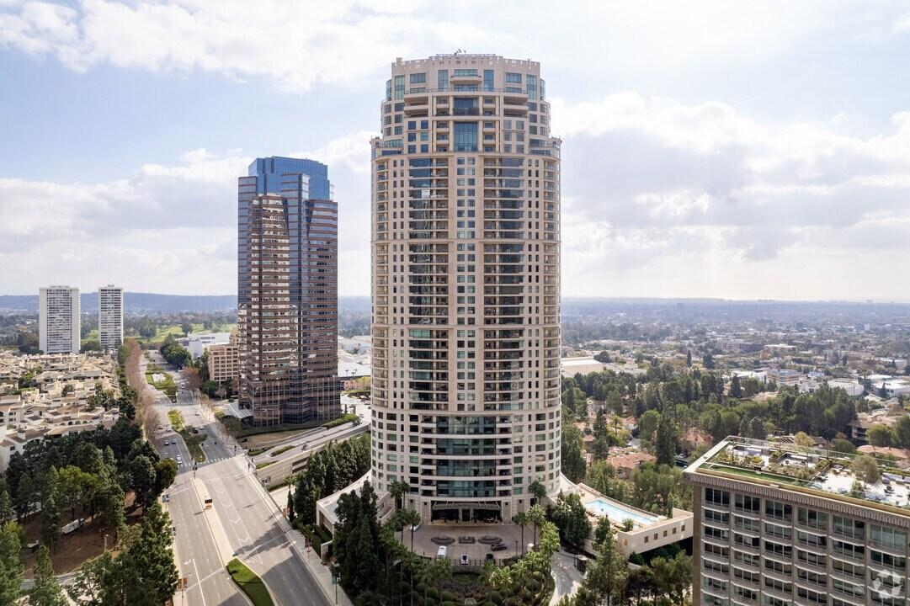
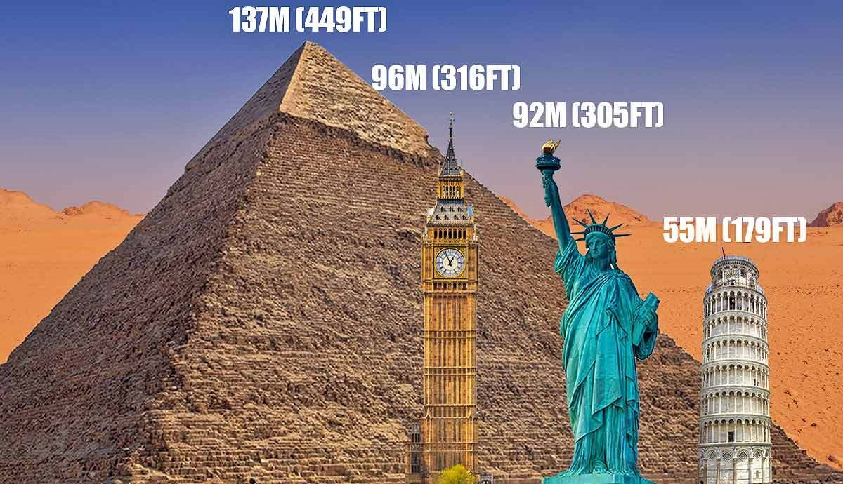
Pyramid Building Facts
The Great Pyramid of Giza
481.4 feet tall (like a 42-story building)
It was the world’s tallest man-made structure for thousands of years!
The Century Condominiums in Los Angeles, CA
481 ft. high 42 stories
Photo from thecollector.com
Erosion has made the pyramid shorter over 4,500 years

Slide 36
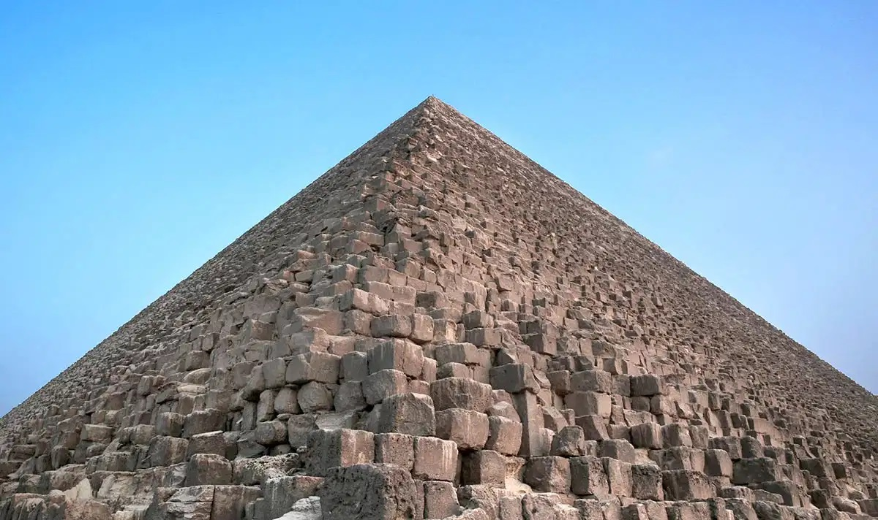
Pyramid Building Facts
The Great Pyramid of Giza
Detail of the side of The Great Pyramid of Giza

Slide 37

Your Turn!
Pyramid building required teamwork and ingenuity!
Groups of 3-4
Build a vertical structure as high as possible in the available time
Everyone on the team must help place every block
No one may touch the block with any part of their body while putting it in its place
You may use the strings, rubber bands, pipe cleaners, pencils, and paper to help you lift each block into place. Your group decides what works for you!

Slide 38
Your Turn!
Condensed Rules + Timer
Timer
Team Building Rules
No one may touch the blocks with any part of your body while it is being placed. | Use your tools to help you place the blocks.
Everyone on the team must place each block together. | Build your tower as tall as you can in the time allowed!

