Slide 1


John Pollock
Brooks Museum Magnet Elementary School
Wake County Public School System
“Starburst”
Jessie Montgomery

Slide 2
STARBURST
Jessie Montgomery

Slide 3
LESSON 1 SLIDES

Slide 4
Today’s Expectations
1 |  | Do your best!
2 |  | Stay on task.
3 |  | Embrace being uncomfortable.

Slide 5
What We Will Be Doing Today
1 | Introduction - What is form?
2 | Composer Time - Who is Jessie Montgomery?
3 | Listen and Guess - What is the form of Starburst?
4 | Movement - Create movements for each section
5 | Perform - Put it all together in a class performance!

Slide 6
01
Introduction

Slide 7
What is form?
Think - Pair - Share

Slide 8
Vocabulary
form | How different parts of a music composition are organized together.
Binary | Binary form is when a piece of music has two main parts. Often labeled AB.
Ternary | Ternary form is when a piece of music has three parts with one repeating. Often labeled as ABA.
Rondo | Rondo form is when a piece of music has a main part that returns often separated by new sections that are all different. Often labeled ABACA.
Theme and Variations | This form happens when a melody is repeated many times, but each time it is played differently. Often labeled AA¹A²A³

Slide 9
02
Composer Time

Slide 10
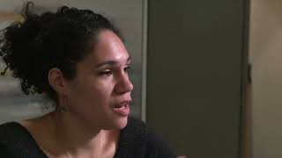

Slide 11
03
Listen and Guess

Slide 12
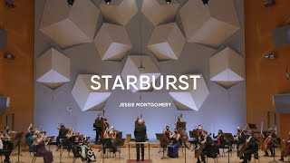
SECTION 1

Slide 13
SECTION 2

Slide 14
SECTION 3

Slide 15
SECTION 4

Slide 16
SECTION 5

Slide 17
SECTION 6

Slide 18
SECTION 7

Slide 19
04
Movement

Slide 20
FULL PERFORMANCE

Slide 21
Describe the Sections
A | ???
B | ???
C | ???
D | ???
E | ???

Slide 22
Movement Choices
A | ???
B | ???
C | ???
D | ???
E | ???

Slide 23
05
Perform

Slide 24
FULL PERFORMANCE

Slide 25
Congrats! You did it!

Slide 26
LESSON 2 SLIDES

Slide 27
Today’s Expectations
1 |  | Do your best!
2 |  | Stay on task.
3 |  | Embrace being uncomfortable.

Slide 28
What We Will Be Doing Today
1 | Review - What did we learn last time?
2 | Create Together - Let’s compose something together
3 | Create in Groups - Choose a form and rhythms in groups
4 | Listen and Guess - Listen to each group and guess their form choice
5 | Wrap Up - What did we learn about form?

Slide 29
01
Review

Slide 30
What do you remember about form and Starburst?
Think - Pair - Share

Slide 31
Vocabulary
form | How different parts of a music composition are organized together.
Binary | Binary form is when a piece of music has two main parts. Often labeled AB.
Ternary | Ternary form is when a piece of music has three parts with one repeating. Often labeled as ABA.
Rondo | Rondo form is when a piece of music has a main part that returns often separated by new sections that are all different. Often labeled ABACA.
Theme and Variations | This form happens when a melody is repeated many times, but each time it is played differently. Often labeled AA¹A²A³

Slide 32
02
Create Together

Slide 33
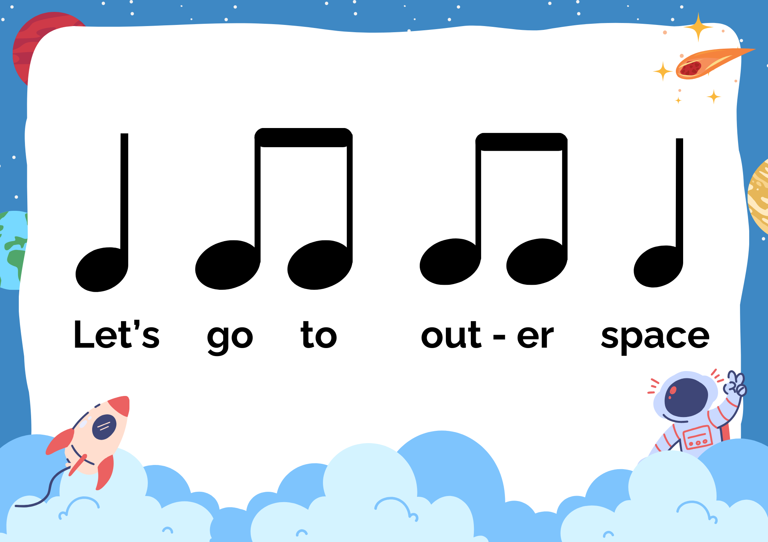
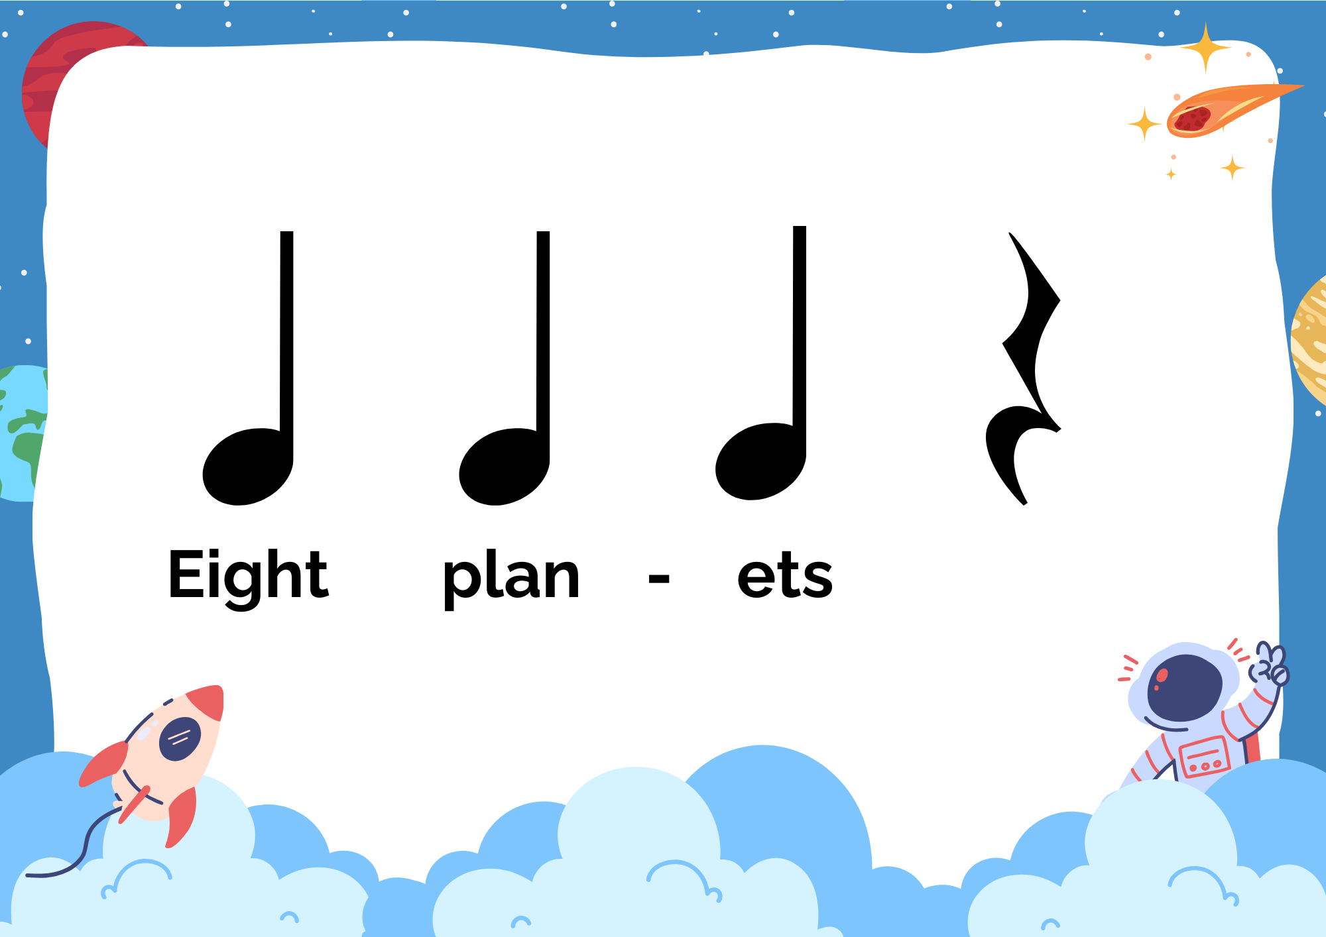
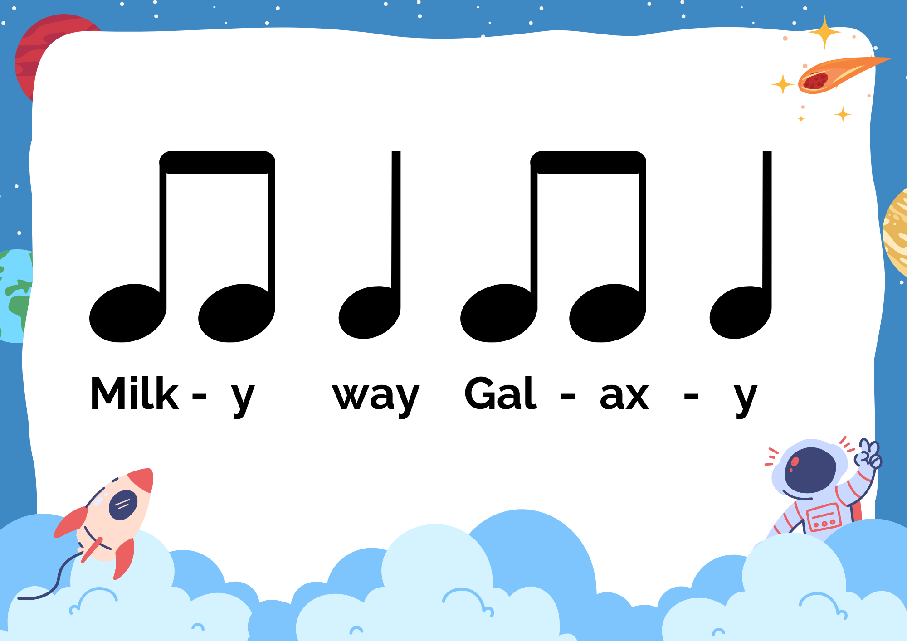
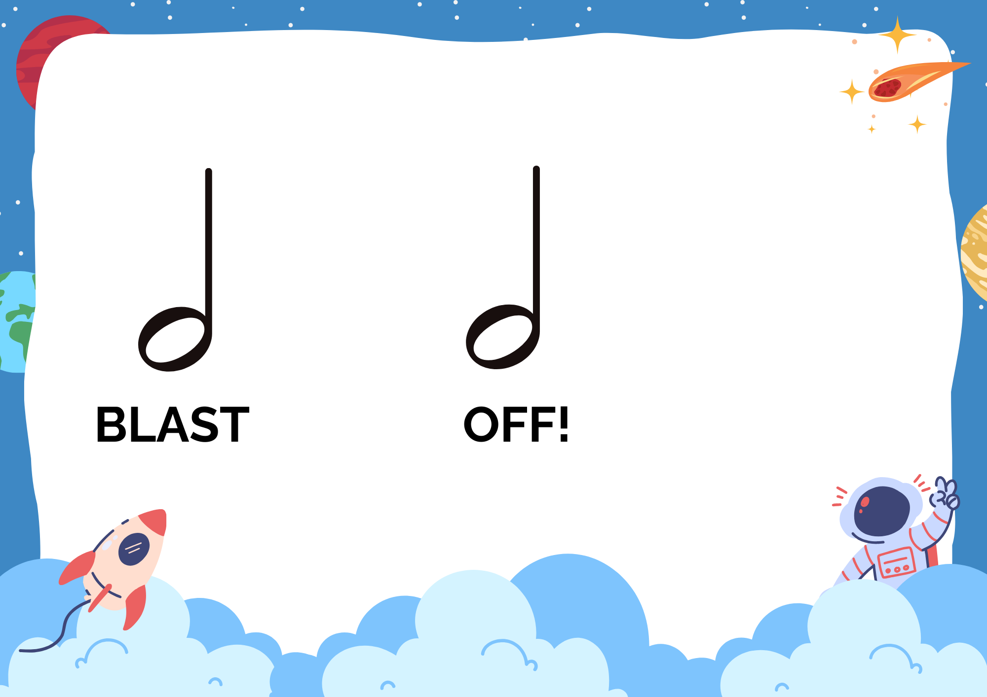
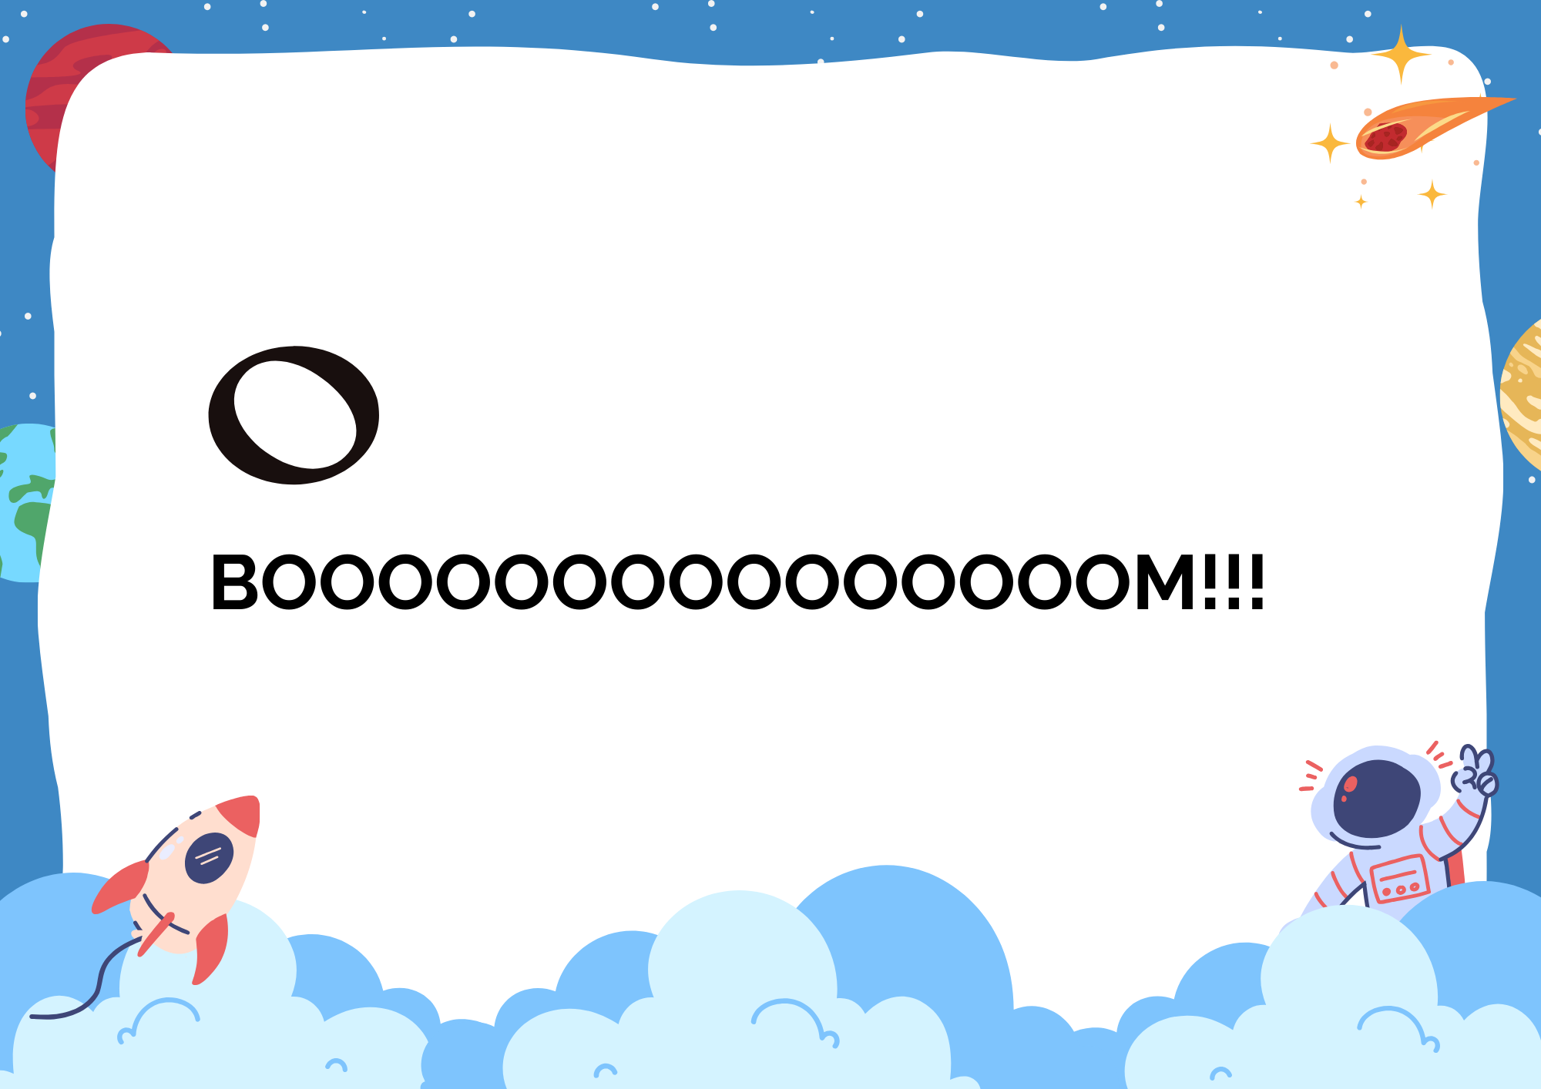
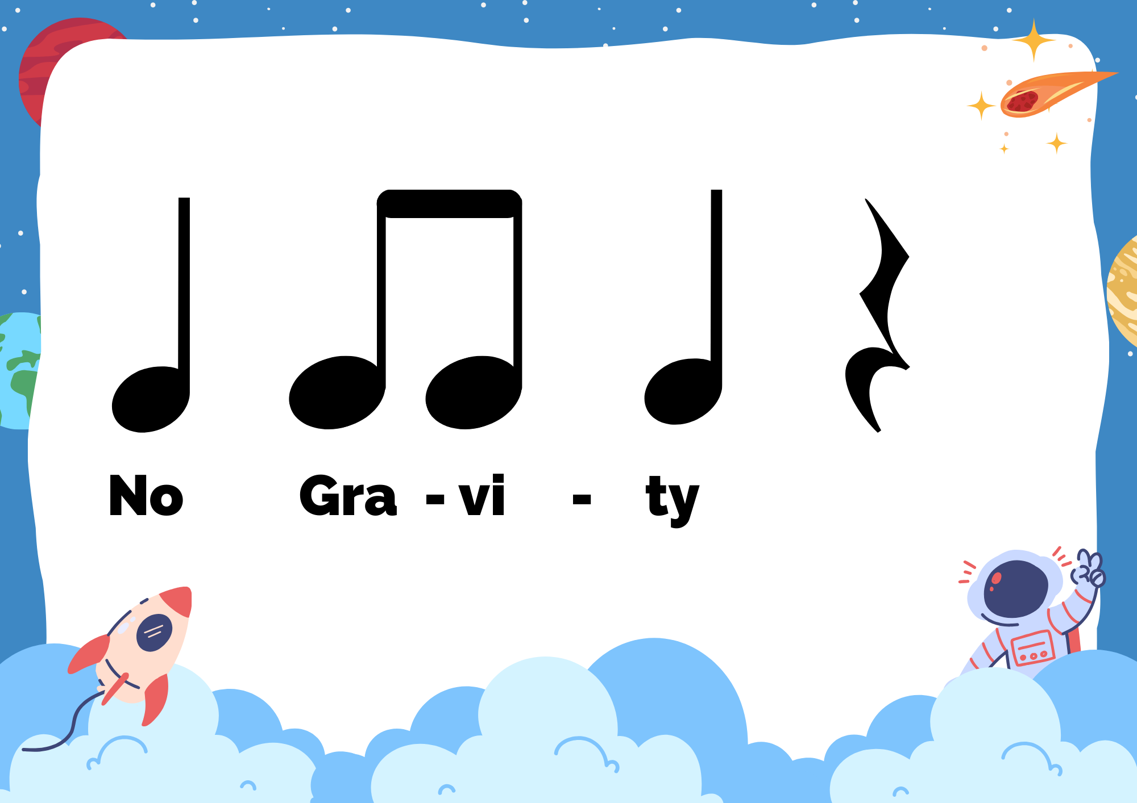
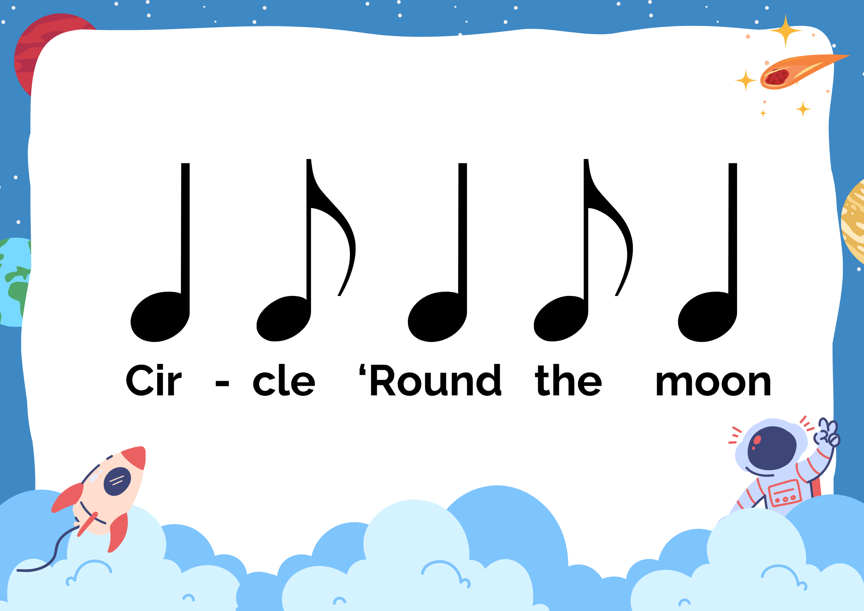
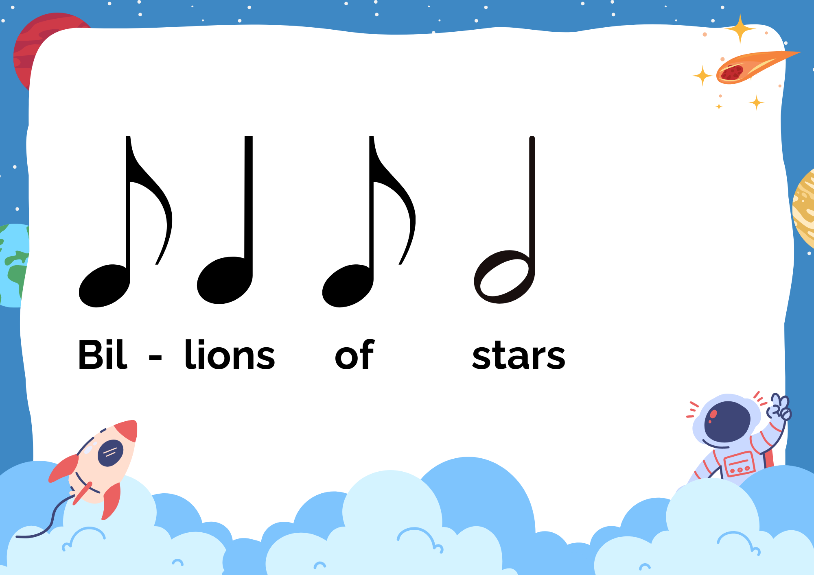

Slide 34
CHOOSE A FORM
1 | AABB
2 | ABAB
3 | ABBA
4 | ABAC

Slide 35
03
Create in Groups

Slide 36
Order of Completion
Step 1 | Choose a form.
Step 2 | Choose one rhythm for each section in your form.
Step 3 | Practice reading and clapping your rhythm with your group.
Step 4 | Add something to your composition: instruments, movement, scarves, body percussion, or a combination of two choices. Be creative!
Step 5 | Practice your entire composition with your group. Be ready to share your work wit the rest of the class!

Slide 37
CHOOSE A FORM
1 | AABA
2 | ABAB
3 | ABBA
4 | ABAC

Slide 39
04
Listen and Guess

Slide 40
05
Wrap Up

Slide 41
What is something new you learned?
What was your favorite activity and why?
What are you thoughts and/or feelings on the piece Starburst? Explain your answer.

