Slide 1

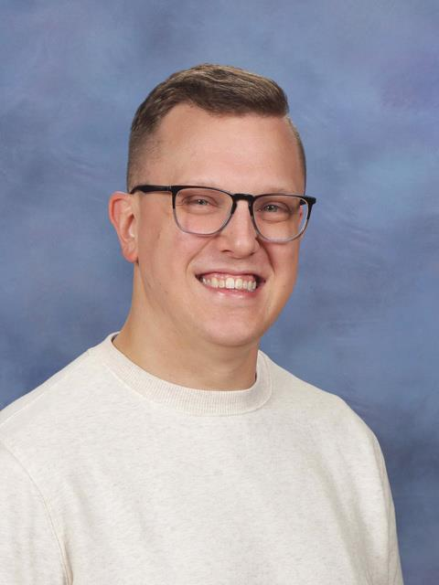
John Pollock
Brooks Museum Magnet Elementary School
Wake County Public School System
jpollock@wcpss.net
Symphony No. 8 “Unfinished” I. Allegro moderato
Robert Schubert

Slide 2
Unfinished Symphony: Movement 1
Franz Schubert

Slide 3
LESSON 1
SLIDES

Slide 4
Today’s Expectations
1 | Do your best!
2 | Be open to something new.
3 | Keep your body safe.
4 | Stay on task
5 | Be kind!

Slide 5
What Will We Be Doing Today?
1 | Introduction - What are dynamics?
2 | Composer Time - Who was Franz Schubert?
3 | Guided Listening - Figure out the dynamics!
4 | Movement Game - Challenge time!
5 | Wrap-Up - What did we learn today?

Slide 6
01
Introduction
What are dynamics?
(Think-Pair-Share)

Slide 7








Let’s Make It Rain!
Soft Rain
Rain
Heavy Rain
Thunder
Rub hands together
Snap your fingers
Pat Your Legs
Stomp on the signal

Slide 8





Dynamics of Rain Sounds
Soft Rain
Rain
Heavy Rain
Thunder
Piano
Mezzo-Piano/
Mezzo Forte
Forte
Fortissimo

Slide 9
02
Composer Time

Slide 10


Slide 11
03
Guided Listening

Slide 12

Dynamic Change!
Listen to a recording of Unfinished Symphony - Movement 1 and make the body shape for each dynamic:
p = small shape
mp/mf = medium shape
f = large shape
Keep your shapes simple as you will need to move quickly sometimes!

Slide 13
04
Movement
Game

Slide 14
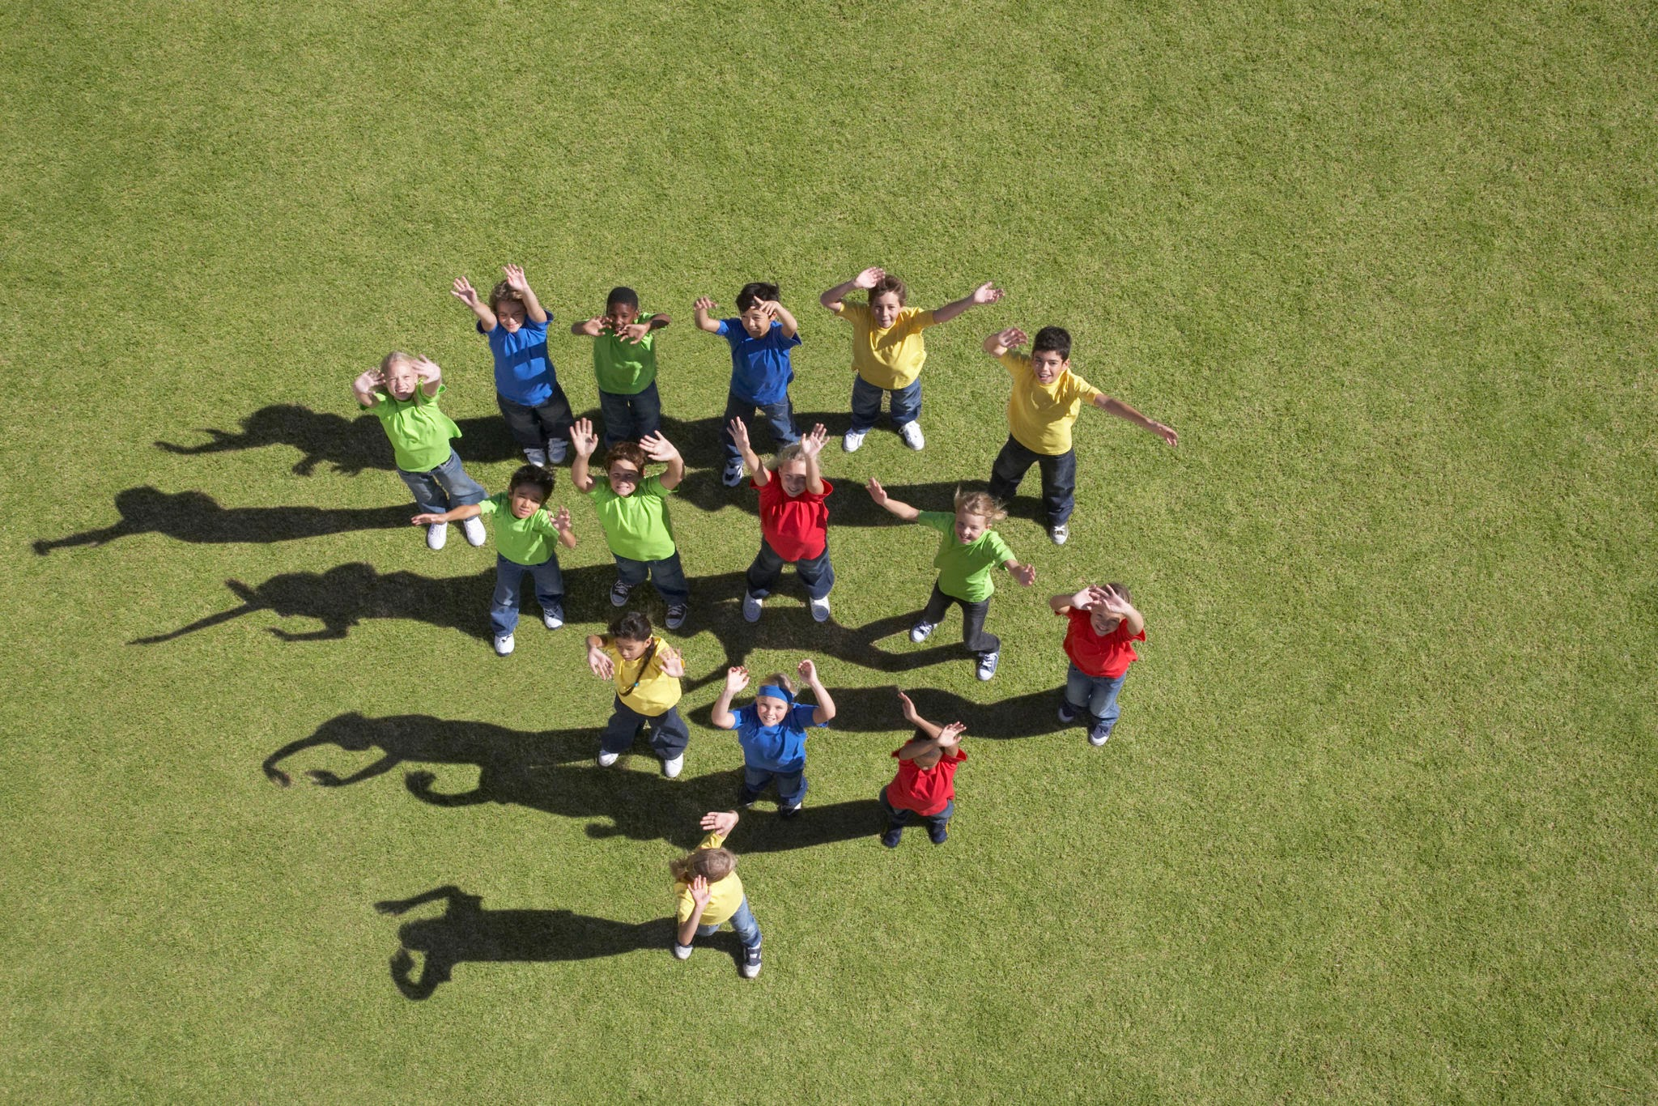
Dynamic Four Corners

Slide 15
05
Wrap-Up

Slide 16
LESSON 2
SLIDES

Slide 17
Today’s Expectations
1 | Do your best!
2 | Be open to something new.
3 | Keep your body safe.
4 | Stay on task
5 | Be kind!

Slide 18
What Will We Be Doing Today?
1 | Review - What do you remember?
2 | Composer Time - Why is it called “Unfinished”?
3 | Music Into Art - Create art with dynamics of music
4 | Gallery Walk - Present your artistic creations
5 | Wrap-Up - What did we learn today?

Slide 19
01
Review
What do you remember from last time about dynamics, Franz Schubert, and/or Unfinished Symphony?
(Think-Pair-Share)

Slide 20
02
Composer Time

Slide 21


Slide 22
03
Music Into Art

Slide 23
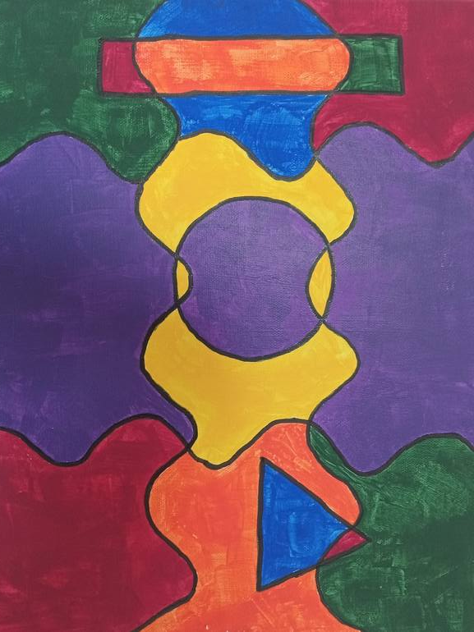
Make a Masterpiece!
Use the dynamic pattern of Unfinished Symphony to create your own piece of art to share with the class. Some tips:
Give each dynamic level a different characteristic. This could be size, color, shape, or a combination of things. Be creative!
Due to time, keep your art simple so that you can complete it in time!
You can put your pattern in the order of the music OR mix it up to create something special. The choice is yours!

Slide 24
04
Gallery Walk

Slide 25
05
Wrap-Up

Slide 26

Questions to Answer
What are dynamics?
What are your thoughts and feelings on Unfinished Symphony? Explain your answer.
Why do you think Schubert didn’t finish this symphony?

