Slide 1
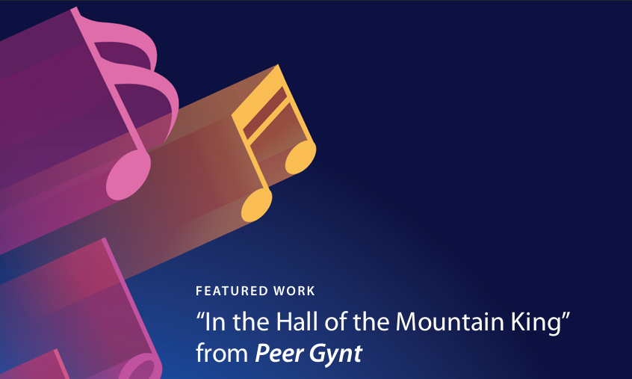

Melissa Coxe
Eastern Elementary
Pitt County Schools
coxem@pitt.k12.nc.us
“In the Hall of the Mountain King” from Peer Gynt
By: Edvard Grieg

Slide 2
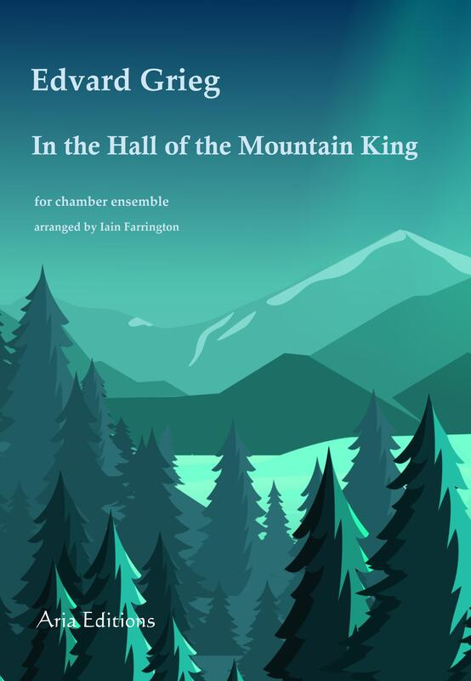
In the Hall of the
Mountain King
Presented by Melissa Coxe

Slide 3
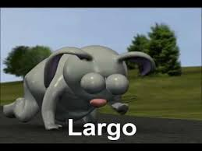
TEMPO
the speed of the music

Slide 4
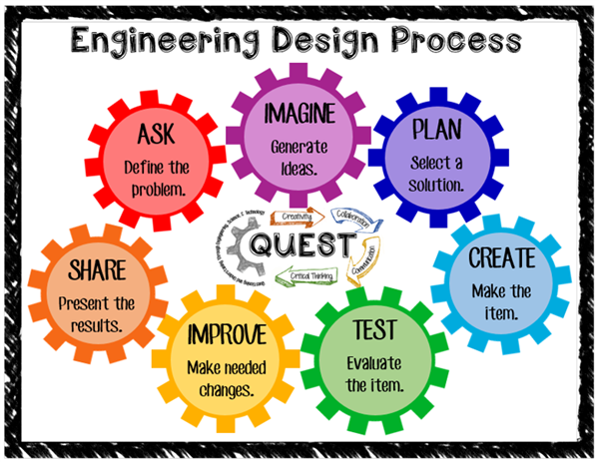
STEAM Activity
Create a cave like you imagine from In the Hall of the Mountain King using found materials.
Materials:
Paper, pencil, cardboard, glue sticks, construction paper, scissors, paper tubes, straws, paper tubes, masking tape, plastic cups, ruler, and markers

Slide 5
Process
Listen to In the Hall of the Mountain King, and sketch/plan how you think the cave would look using these lines for the tempo
Adagio - longest, smoothest line maybe dark
Allegro - shorter lines
Presto - shortest, jagged line
Compare with your group to create one plan for your group to create a maze or cave using the provided materials.
Create a cave OR a gravity powered marble run that starts adagio and ends presto.

Slide 6
Extension STEAM Activities
Students record their marble run with a voice over narration of Peer Gynt’s story.
Collaborate with your Art teacher to illustrate and design characters from the story.

Slide 7

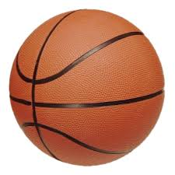
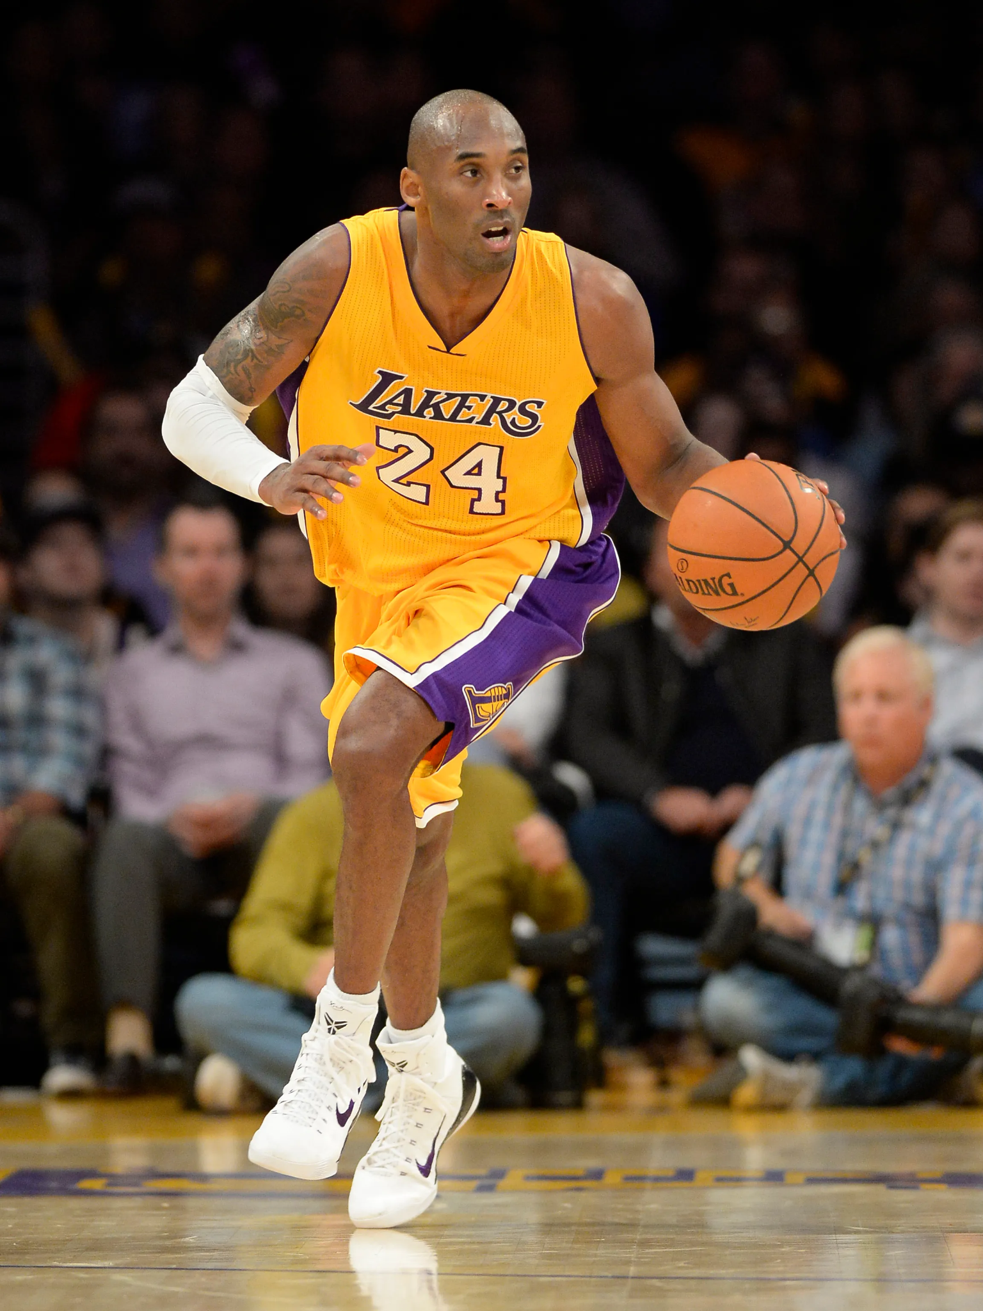
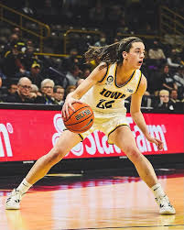
Accelerando
120
125
130
140
150
155
165
Use this metronome to help you stay on the steady beat as you dribble the basketball

Slide 8
Fun Facts
Originally composed as incidental music for Henrik Ibsen's play Peer Gynt
In the Hall of the Mountain King is from the sixth scene of Act 2
Grieg composed 26 pieces for Peer Gynt, but during his lifetime it was never performed in its entirety
Grieg did not like the music for the trolls realm. “I came up with something for the Mountain King’s hall that I literally can’t bear to listen to. It reeks of cow pies, exaggerated Norwegian provincialism and trollish selfishness!”

Slide 9
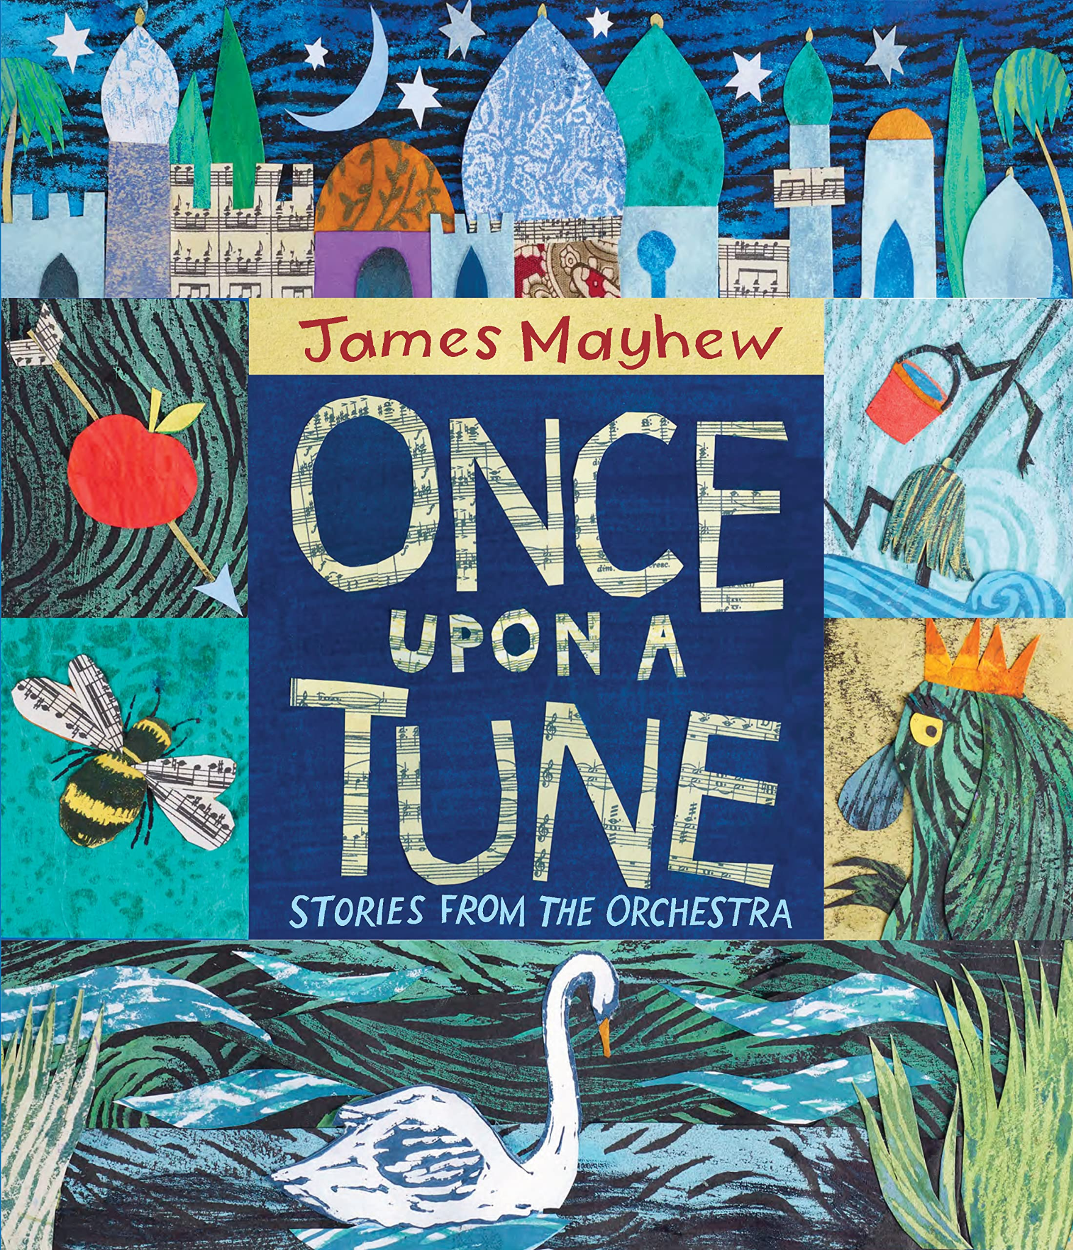
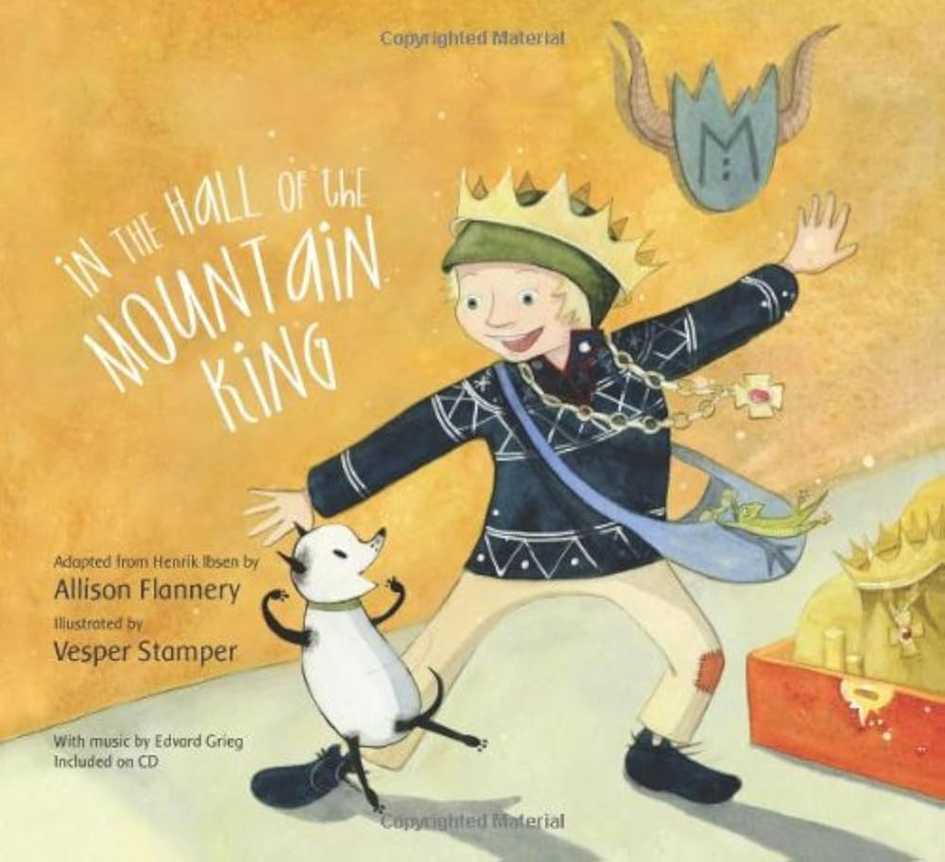
Read Alouds

Slide 10
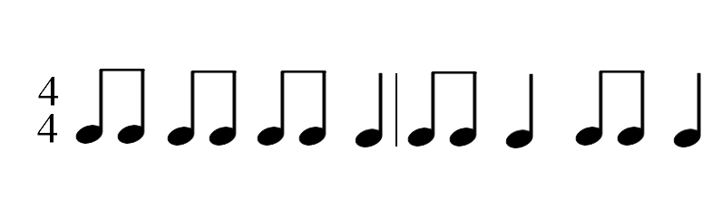
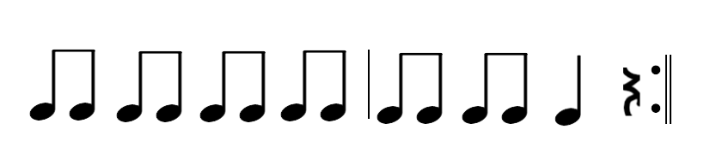
Movement Activity 1
I am walk-ing ve - ry slow, ve - ry slow, ve - ry slow,
I can tip toe qui - et - ly, qui - et - ly, qui - et - ly,
I am stomp-ing ve - ry loud, ve - ry loud, ve - ry loud,
I am walk-ing ve - ry fast, ve - ry fast, ve - ry fast,
I am walk-ing ve - ry slow I’m sneak-ing all a - round.
I can tip toe qui -et- ly with- out mak-ing a sound.
I am stomp-ing ve - ry loud I’m mak- ing lots of sound.
I am walk-ing ve - ry fast I’m mov-ing quick-ly now.

Slide 11
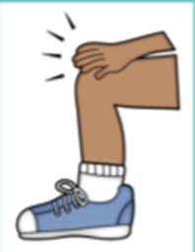

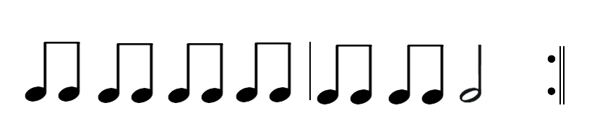
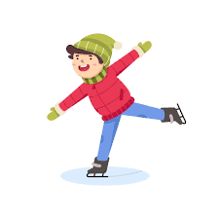
Movement Activity 2

Slide 12



Movement Activity 2
=
=
=

Slide 13
orchestra version
Trolls
version

Slide 14
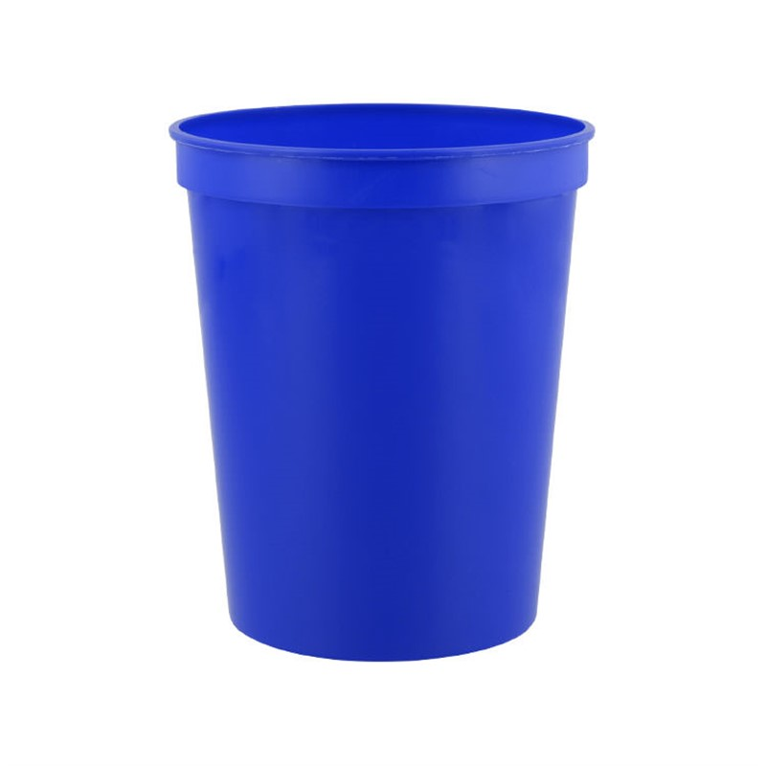
Cup Activity
Tap tap clap up down 3x
Tap up switch
—----------------
Coda (2:15)
Cup up and down 2x
tap the rhythm on top of cup (repeat)
Cup up and down through the end of the piece
Video Example

Slide 15
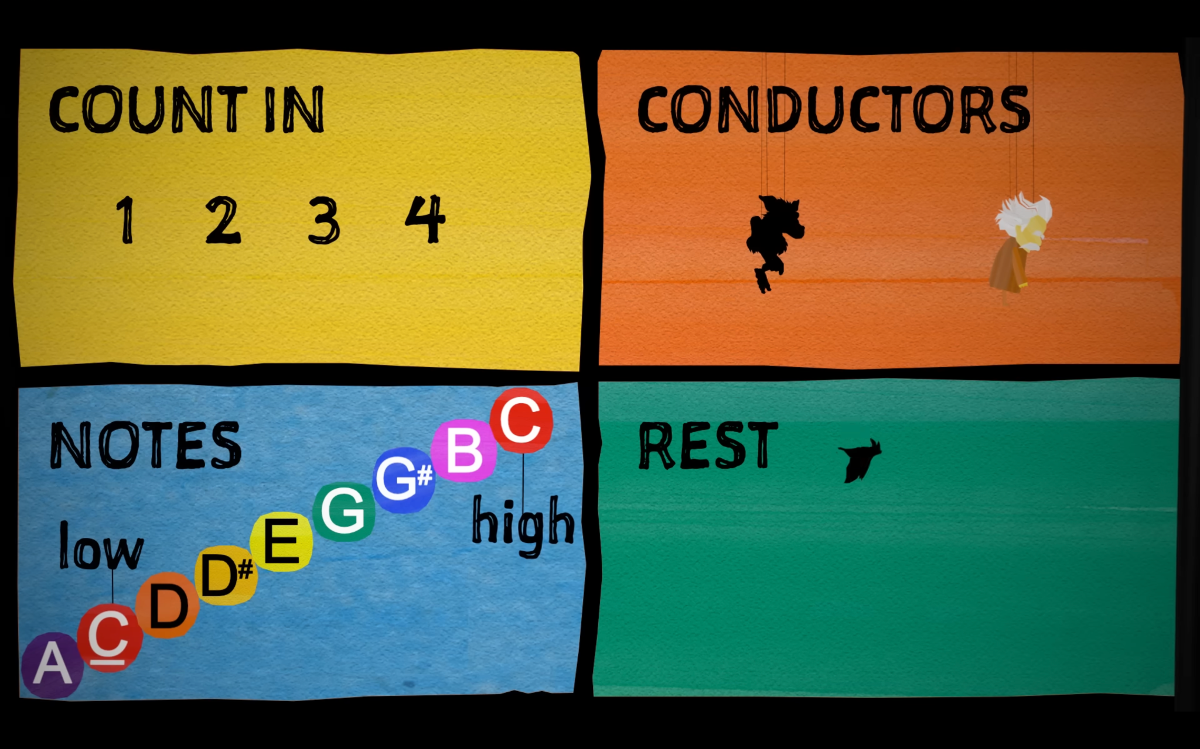
Boomwhacker Activity
You will need the following boomwhackers

