Slide 1


Stephanie Sanders
Barton Pond Elementary
Wake County Public School System
ssanders@wcpss.net
“The Star-Spangled Banner”
Arr. John Stafford Smith

Slide 2

The Star-Spangled
Banner
The U.S. National Anthem
Musical Element: Introduction

Slide 3
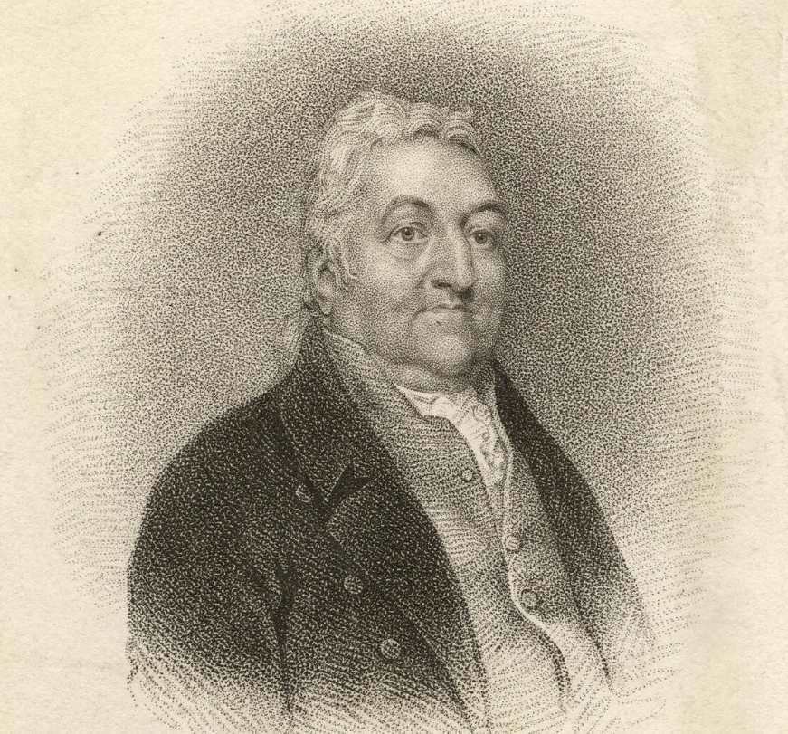
History of the Song
John Stafford Smith (1750-1836)

Slide 4
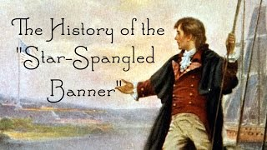
History of the Song

Slide 5

National Anthem Performance

Slide 6
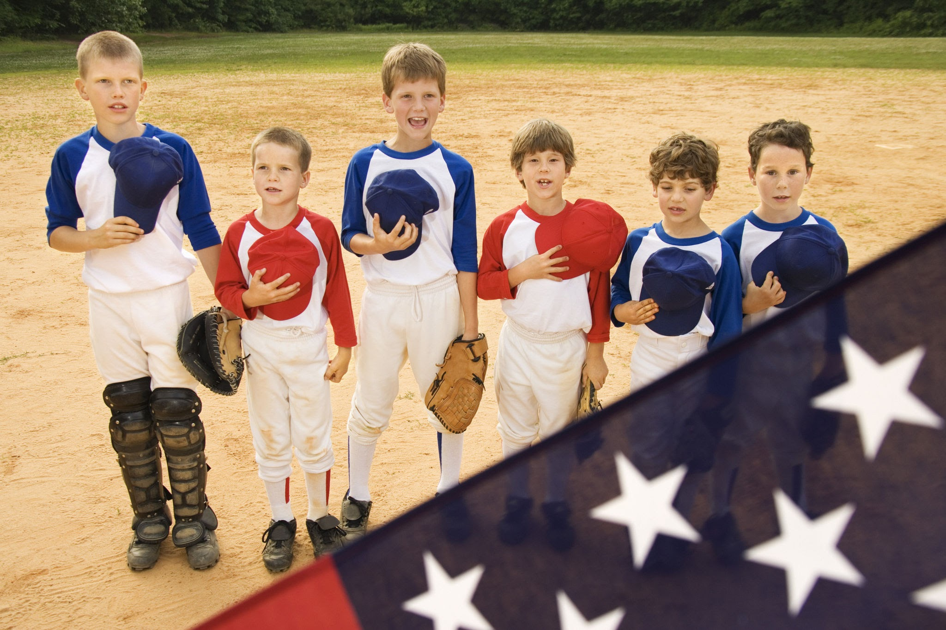
Activity # 1: Personal Anthems

Slide 7
Activity # 1: Personal Anthems
Give each student a pencil and a piece of paper.
Have them write their own personal anthem to the tune of “Row, Row, Row Your Boat”.
Sample: “I am Stephanie and I like to sing, I like to drum, I like to hum, percussion is my thing.”

Slide 8
Activity # 1: Personal Anthems
If students get done early, have them work on “The Star-Spangled Banner” word search.
When all students have finished their anthem, teach a group of students the “Row, Row, Row Your Boat” Orff arrangement.
Have students share their anthems with the class with the Orff arrangement.

Slide 9
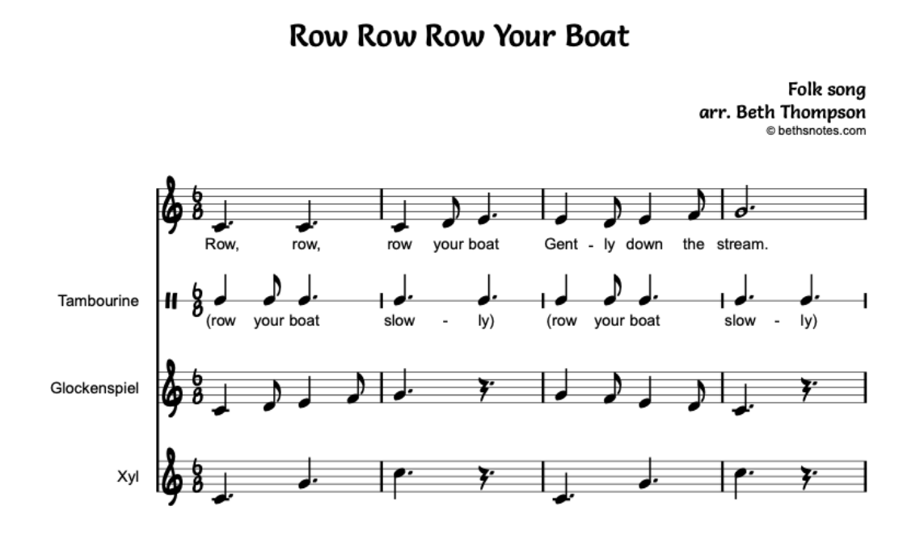

Slide 10
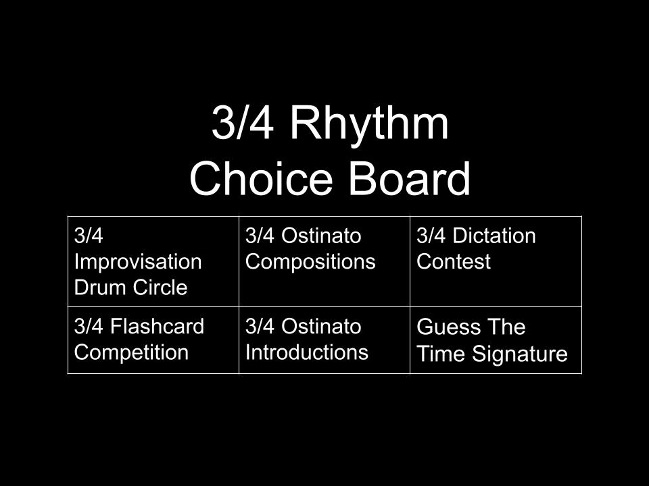
Activity #2

Slide 11
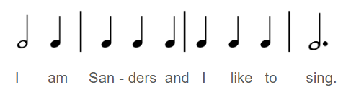
Rhythm Choice Board:
3/4 Ostinato Introductions
Ask students to compose a rhythmic ostinato in 3/4 time that can be used to introduce themselves.

Slide 12
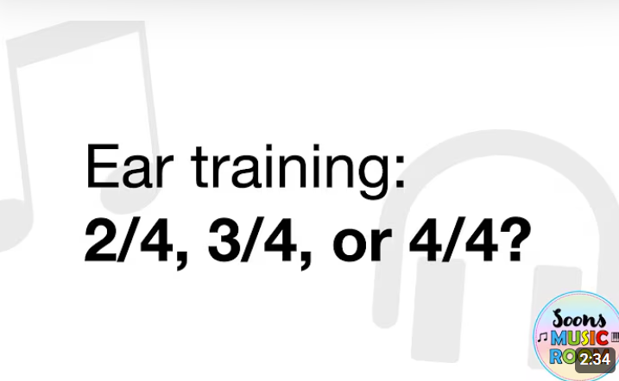
Rhythm Choice Board: Guess the Time Signature
Ask students to listen to the musical excerpts in the following video and correctly identify the time signature as 2/4,3/4, or 4/4 for each excerpt.

Slide 13

Rhythm Choice Board:
3/4 Improvisation Drum Circle
Ask students to sit in a drum circle.
Have each student improvise a 2-bar rhythmic ostinato in 3/4 time to accompany a recording of “The Star-Spangled Banner”.

Slide 14

Rhythm Choice Board:
3/4 Ostinato Compositions
Have each student compose a 2-measure ostinato to be played along with “The Star-Spangled Banner”.”.

Slide 15
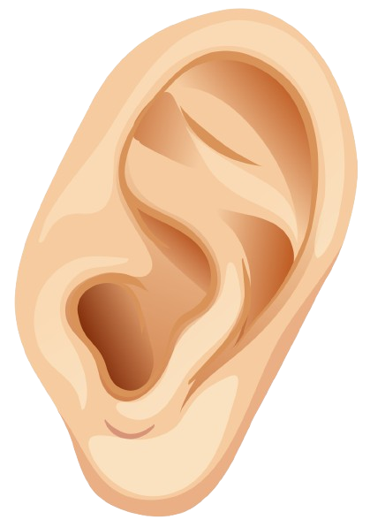
Rhythm Choice Board:
3/4 Rhythm Dictation Test
Clap 2-measure rhythms in 3/4 time that include beamed eighth notes, quarter notes, half notes, dotted half notes, and sixteenth notes. Have students correctly dictate what they heard.

Slide 16
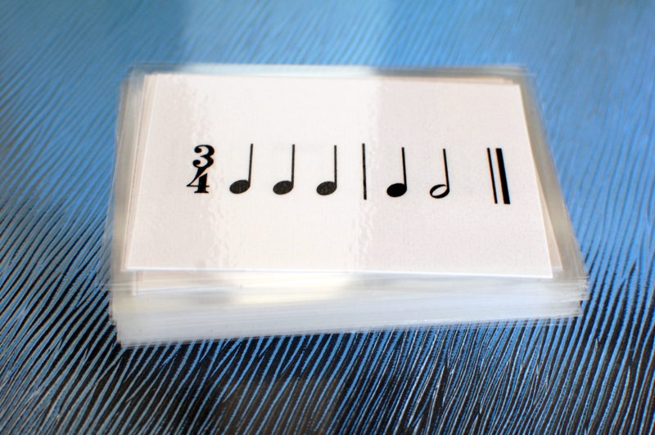
Rhythm Choice Board:
3/4 Flashcard Competition
Show each team a flashcard of a rhythm in 3/4 time.
If one person on the team plays the rhythm correctly on an unpitched classroom instrument, the team gets a point. If the rhythm is played incorrectly, a point will not be awarded.

Slide 17

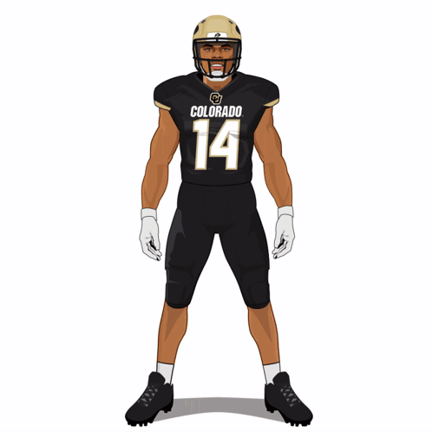
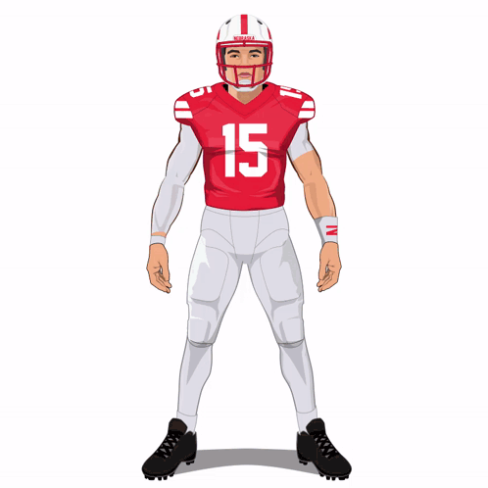

Slide 18
Activity Instructions
Watch the biographical videos and Super Bowl performances of three singers.
Fill out the performance comparison chart while listening to the performances.
Choose the performance that you like best.
Write a 5 sentence paragraph explaining why your prefer the performance over the others using musical terms.
Vote for your favorite performer on your device.

Slide 19

Biography: Carrie Underwood

Slide 20
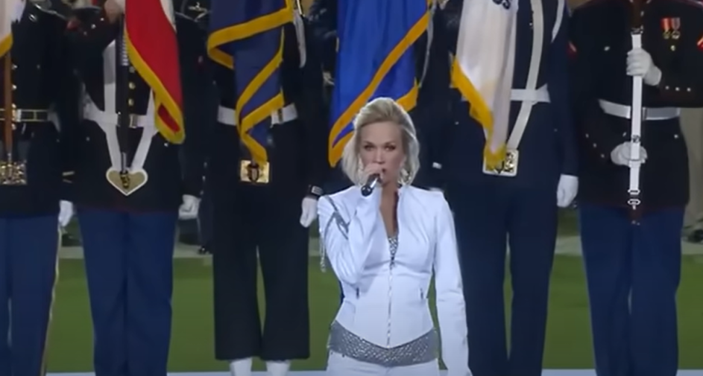
Super Bowl Performance: Carrie Underwood

Slide 21
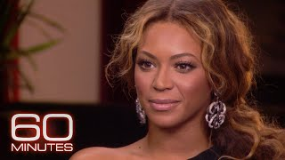
Biography: Beyoncé

Slide 22
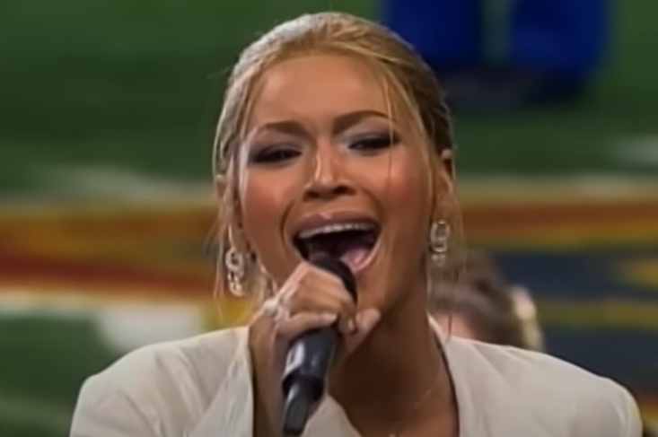
Super Bowl Performance: Beyoncé

Slide 23
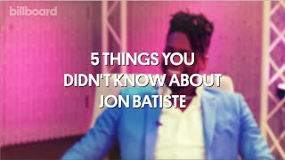
Biography: Jon Batiste

Slide 24
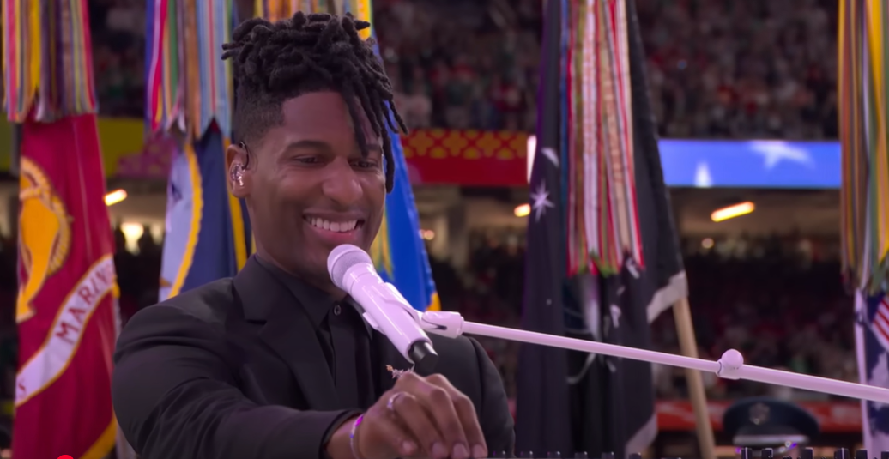
Super Bowl Performance: Jon Batiste

Slide 25
Essay Response: Which Performance Did You Like Best?
On your worksheet, write a 5-sentence paragraph about your favorite national anthem performance using musical terminology.
Share your response with the class.

Slide 26
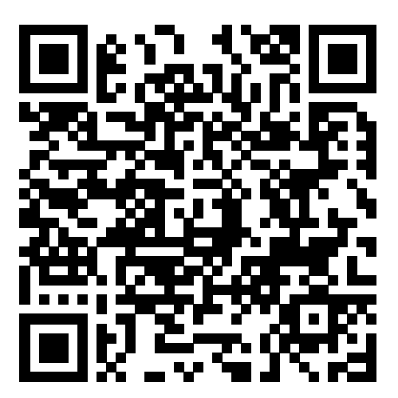
It’s Time to Vote!
Instructions: (1) Scan the QR code or Access the following code through Super Bowl Idol assignment in the Quaver app: https://PollEv.com/multiple_choice_polls/B8hDEog6XNIqLZ0tgUC5y/respond
(2) Click “Skip”
(3) Vote on your favorite performance.

Slide 27
Works Cited
“American Idol”. Digital Image. 4 May 2025. https://imgflip.com/i/8pn67u.
Billboard. “Here Are Five Things You Didn't Know About Jon Batiste, Billboard”. YouTube, uploaded by Billboard, 21 Aug. 2023, https://www.youtube.com/watch?v=xoFMRzrMnys.
“Carrie Underwood: Before American Idol, BIO Shorts, Biography”. YouTube, uploaded by Biography, 6 Apr. 2022, https://www.youtube.com/watch?v=i-2pvJBbnCo.
Cole, Matt. “A Human Ear on White Background Free Vector”. Vecteezy. 23 May 2018. https://www.vecteezy.com/vector-art/302059-a-human-ear-on-white-background.
Free School. “The History of the Star-Spangled Banner for Kids: Francis Scott Key and Fort McHenry-Free School”. YouTube, uploaded by Free School, 2 Jul. 2016, https://www.youtube.com/watch?v=Umg8v6DLZjs.
Icon Ade. “The Rhythmic Beat of African Drums Free Photo”. Vecteezy. 8 June 2023. https://www.vecteezy.com/photo/30626591-the-rhythmic-beat-of-african-drums.
Lyte, Eliphalet Oram. “Row, Row, Row Your Boat”.Arr. Beth Thompson. https://www.bethsnotesplus.com/. August 2013. https://www.bethsnotesplus.com/wp-content/uploads/2024/11/Row-Row-Row-Your-Boat.pdf

Slide 28
Works Cited
Morin, Joy. “Rhythm Flashcards”. Color in My Piano. 2 July. 2012. https://colorinmypiano.com/downloads/rhythm-cards/.
NFL. “Jon Batiste Sings the National Anthem at Super Bowl LIX”. YouTube, uploaded by NFL, 9 Feb. 2025, https://www.youtube.com/watch?v=Gid1pYSOCZs.
Othq8. “Beyoncé Performing The Star-Spangled Banner USA National Anthem Live at Super Bowl XXXVIII 2004”. YouTube, uploaded by Othq8, 2 Mar. 2025, https://www.youtube.com/watch?v=OhrrGu2rcZ4.
Slovak Radio Symphony Orchestra, Peter Breiner. “National Anthem The Star-Spangled Banner Music Only Instrumental with Lyrics. Get Mp4 in description”. YouTube, uploaded by Bill Hughes, 25 Oct. 2016, https://www.youtube.com/watch?v=axhcsRWOOT8.
60 Minutes. “How Beyoncé’s Career Began”. YouTube, uploaded by 60 Minutes, 30 Jan. 2025, https://www.youtube.com/watch?v=cdYerrf_GIEm.
Soons Music Room. “Time Signature Ear Training-Clap the Beats”. YouTube, uploaded by Soons Music Room, 23 May 2021. https://www.youtube.com/watch?v=EoSZ1yhxgqA.

Slide 29
Works Cited
SportsManias. “A Cartoon Drawing of a Nebraska Football Player Wearing Number 15”. Tenor. 22 October 2024. https://tenor.com/view/sports-sportsmanias-panini-collectibles-who-do-you-collect-gif-1939739184240343735.
SportsManias. “A Football Player Wearing a Black Jersey With the Number 14 On It”. Tenor. 9 October 2024. https://tenor.com/view/sports-sportsmanias-emoji-animated-emojis-panini-gif-15074702958429733728.
Thinkstock Images. “Young Baseball Players Holding Caps in Front of American Flag-Stock Photo”. Digital Image. Getty Images, Getty Images Holdings. 22 November 2007.Web. 26 May 2025. https://www.gettyimages.com/detail/photo/young-baseball-players-holding-caps-in-front-of-royalty-free-image/78054597.
Tuấn Nghĩa Cao (CN). “National Anthem-Carrie Underwood [Super Bowl 2010]”. YouTube, uploaded by Tuấn Nghĩa Cao (CN), 28 Sept. 2012, https://www.youtube.com/watch?v=IoSPFoV-6VU.

