Slide 1
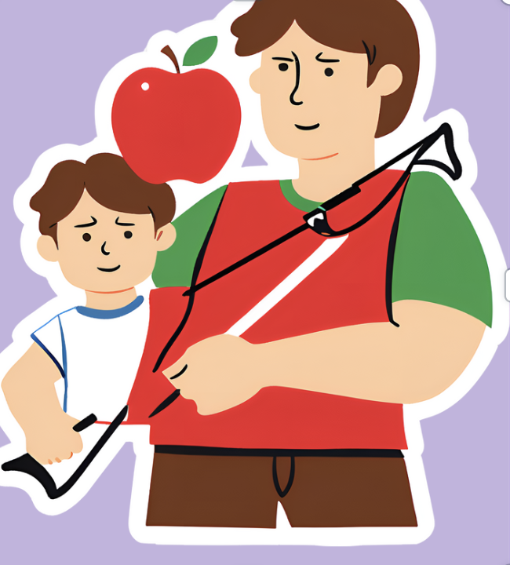
Choice Board for the
Overture to William Tell
ENTER
by
Gioachino Rossini
Activities designed and curated by Amy Evers, Chapel Hill-Carrboro City Schools

Slide 2
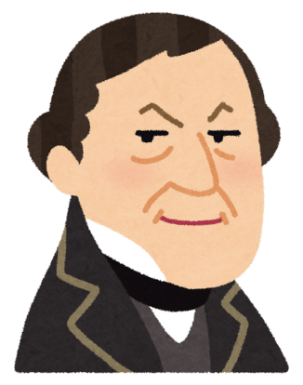
Guided Listening Activities
Rossini Biography
S.T.E.A.M. Lesson
Rhythm
Tap Along
Index
Oh, The Drama!

Slide 3
Guided Listening Activities
Rossini Biography
S.T.E.A.M. Lesson
Rhythm
Tap Along
Index
Oh, The Drama!

Slide 4
GUIDED LISTENING ACTIVITIES
Performance
by
NC Symphony
Flashlight Fun
Movement
Main Menu
Form

Slide 5
Guided Listening

Slide 6
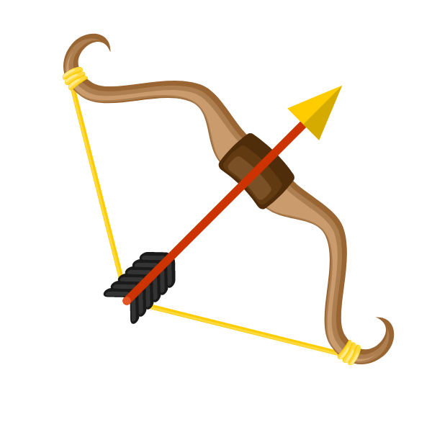
Form - how the sections of a piece of music are put together, the structure.
Next
FORM GUIDED LISTENING LESSON PLAN

Slide 7
Word Wall
Overture - an orchestral piece at the beginning of an opera, suite, play, oratorio, or other extended composition.
Form - how the different sections of a piece of music are put together.
Introduction - a brief beginning.
Interlude - a brief section in a piece of music, in between to larger sections.
Coda - a special ending. Coda means “tail” in Italian.
Next
Notes:
What Goes Here?
Key Vocabulary Words
Focus on a few
Write the vocab word in bold
Write a short definition
include pictures if relevant
Make additional slides if needed
Move this slide to alternate position as needed
Delete if not needed

Slide 8
Introduction
A
B
Interlude
A
C
D
C
B
Interlude
A
Main Menu
Guided Listening
CODA

Slide 9
Main Menu
RED, WHITE AND BLUE SCARVES

Slide 10
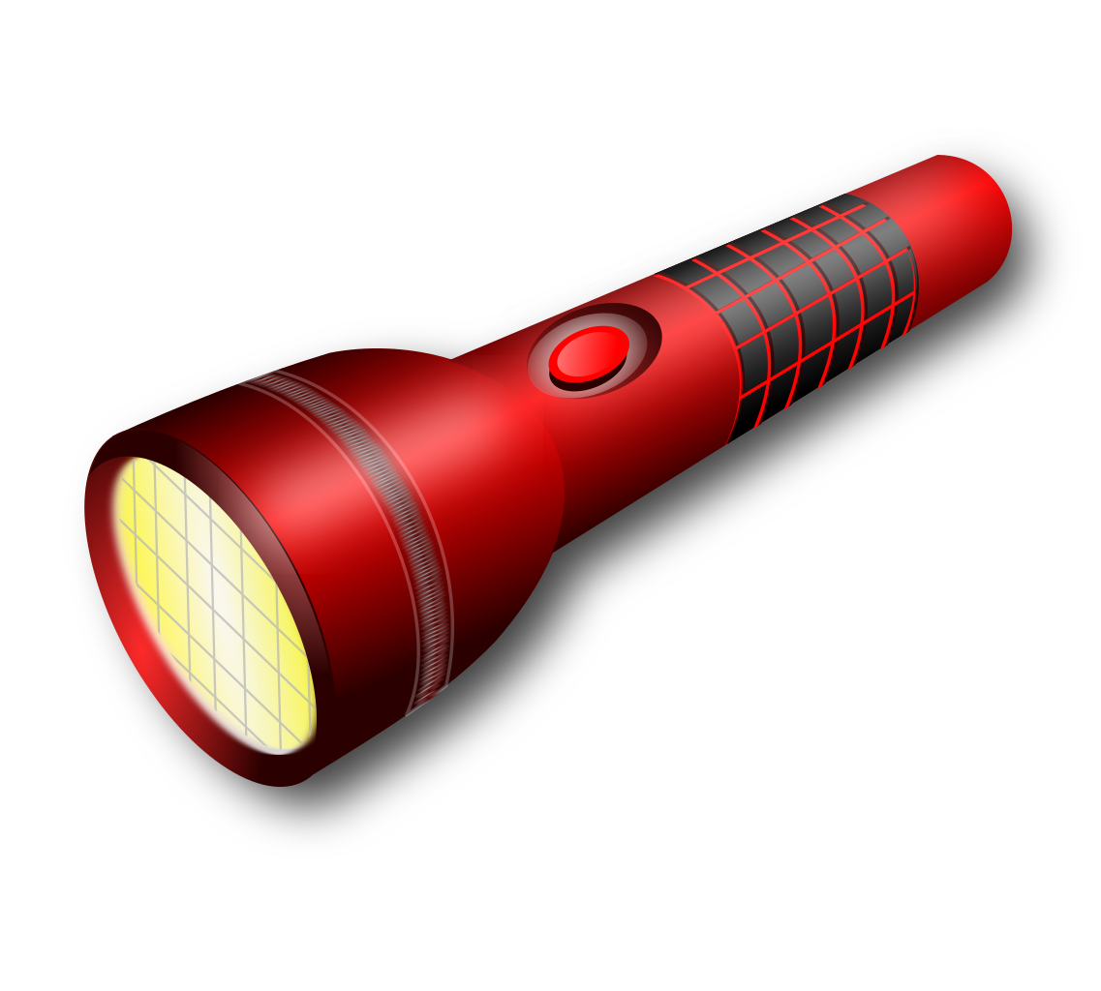
FLASHLIGHT FUN
Paint with Light
Materials:
30* Small Flashlights *Enough for your class size.
Colored Permanent Markers (ex. Sharpies)
Recording of William Tell Overture
Process:
Prepare flashlights: Color lenses of the lights.
Prepare classroom: Make classroom as dark as possible and create seating areas.
Prepare Students: Listen to the Overture, Safety first, group students, go over flashlight procedures.
Detailed Teacher Tips
Next

Slide 11
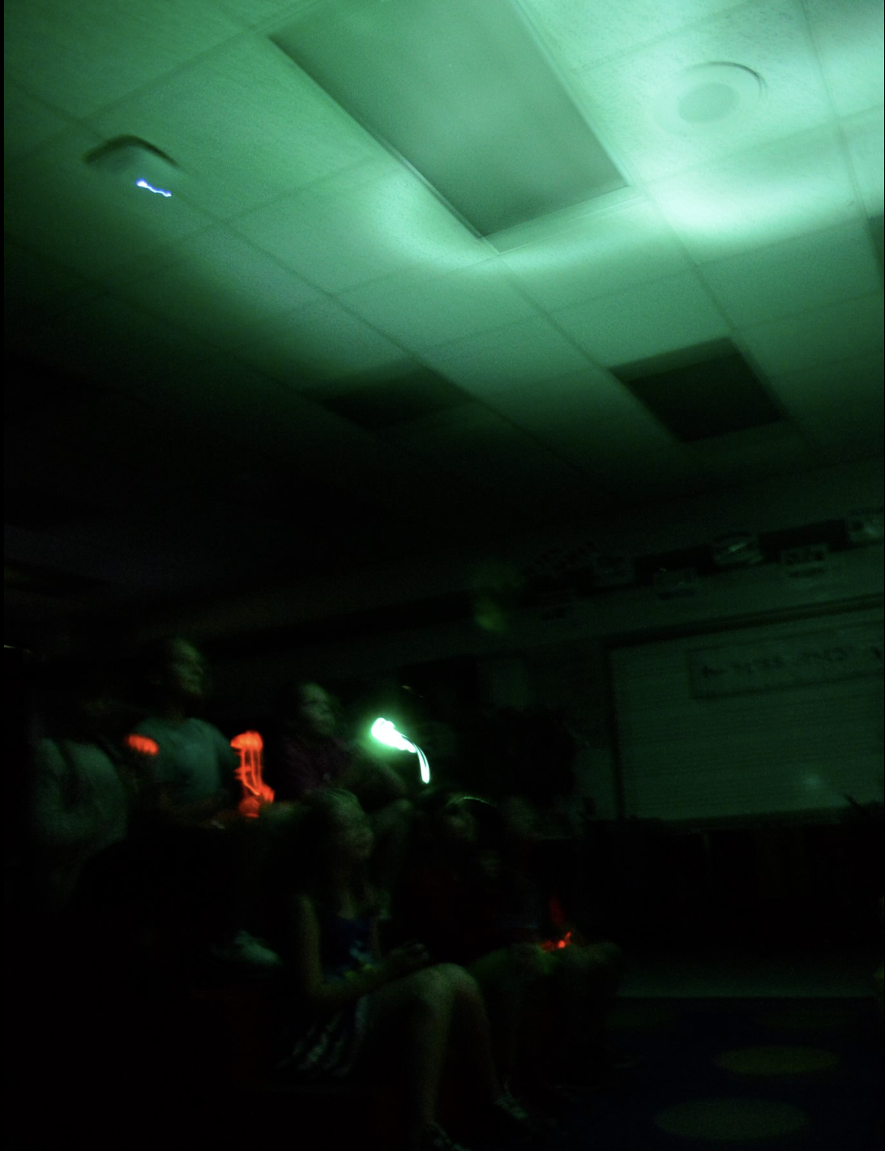
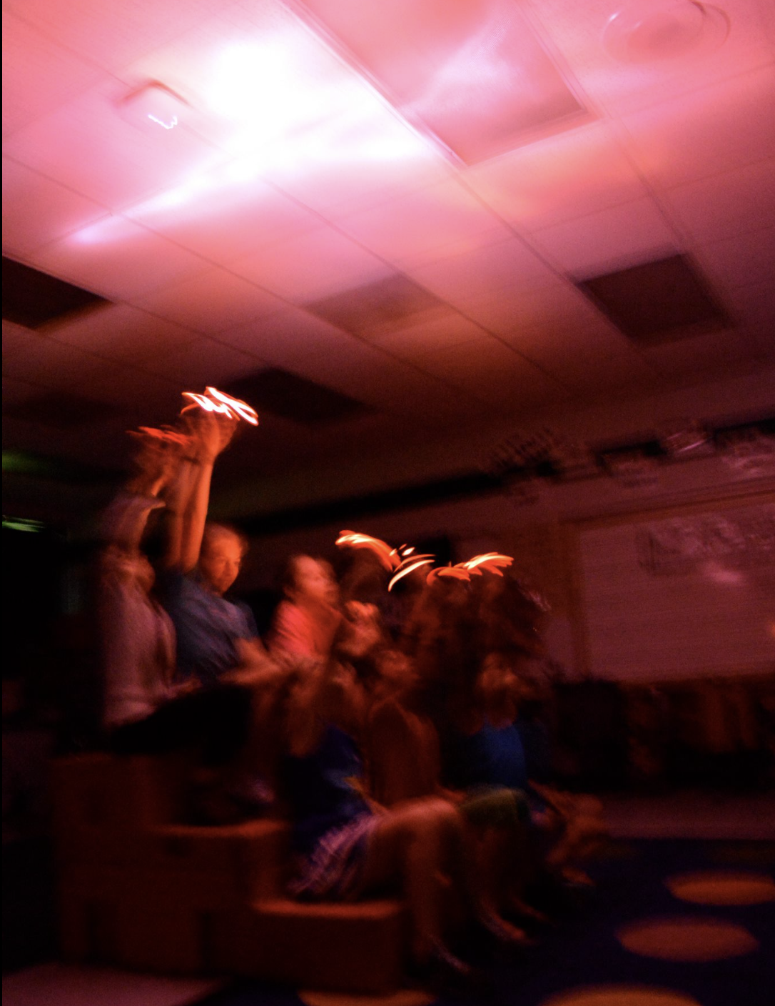
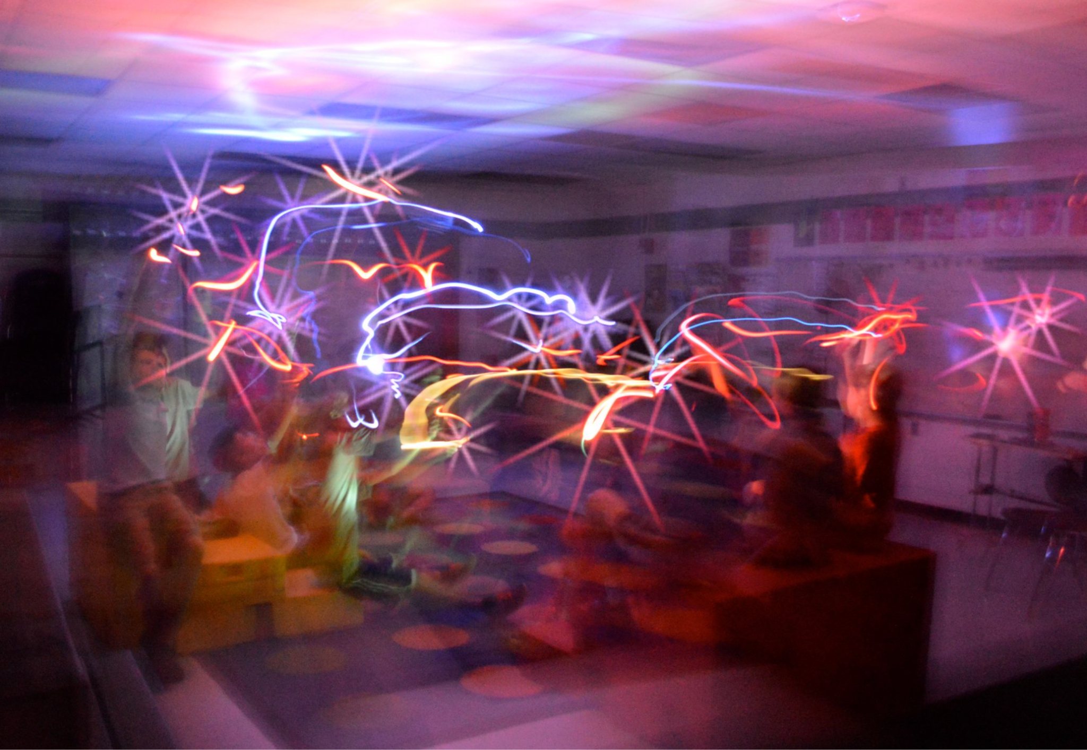
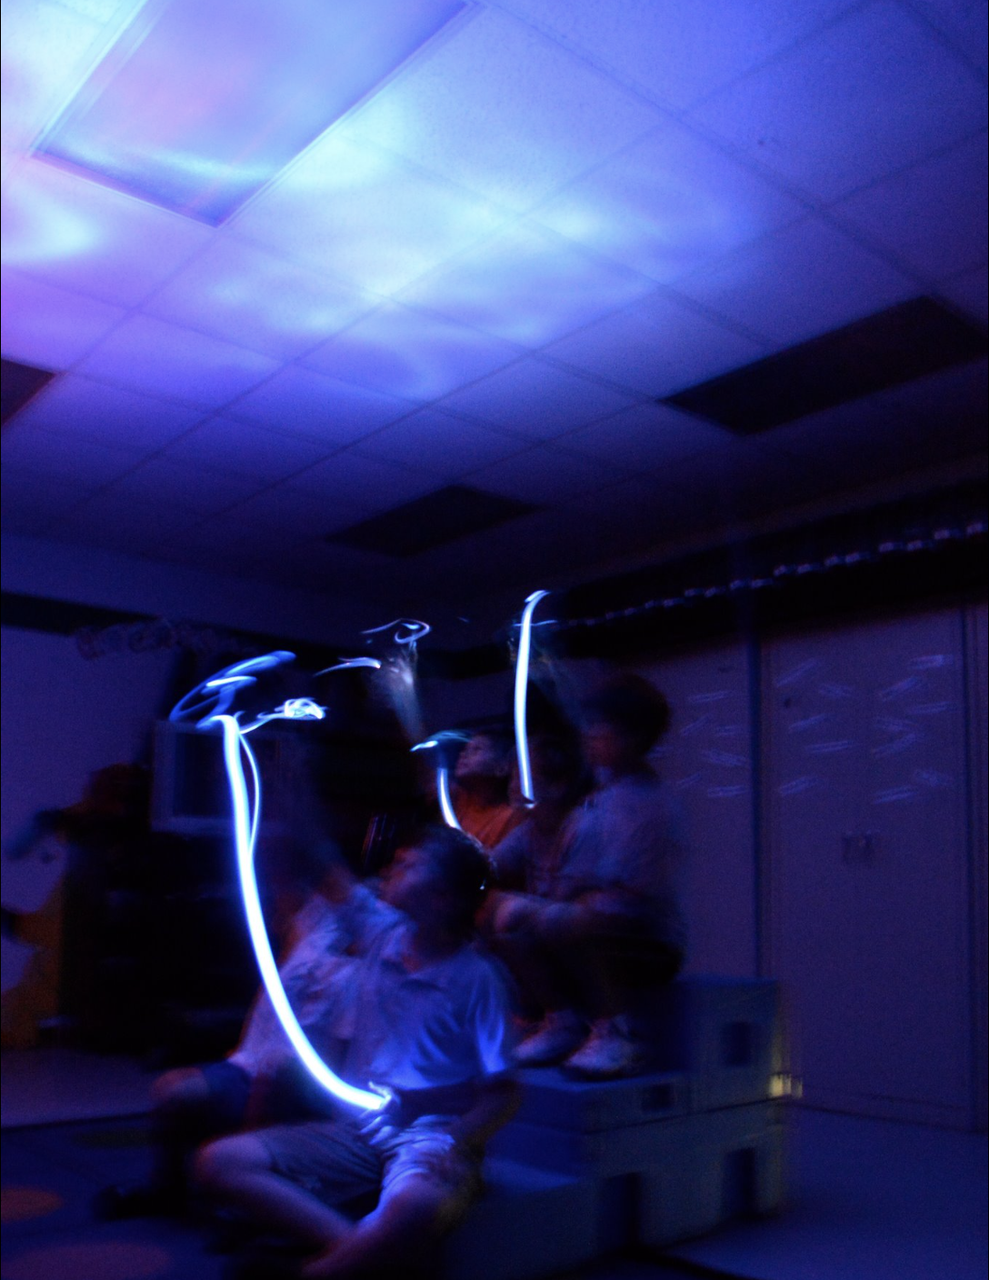
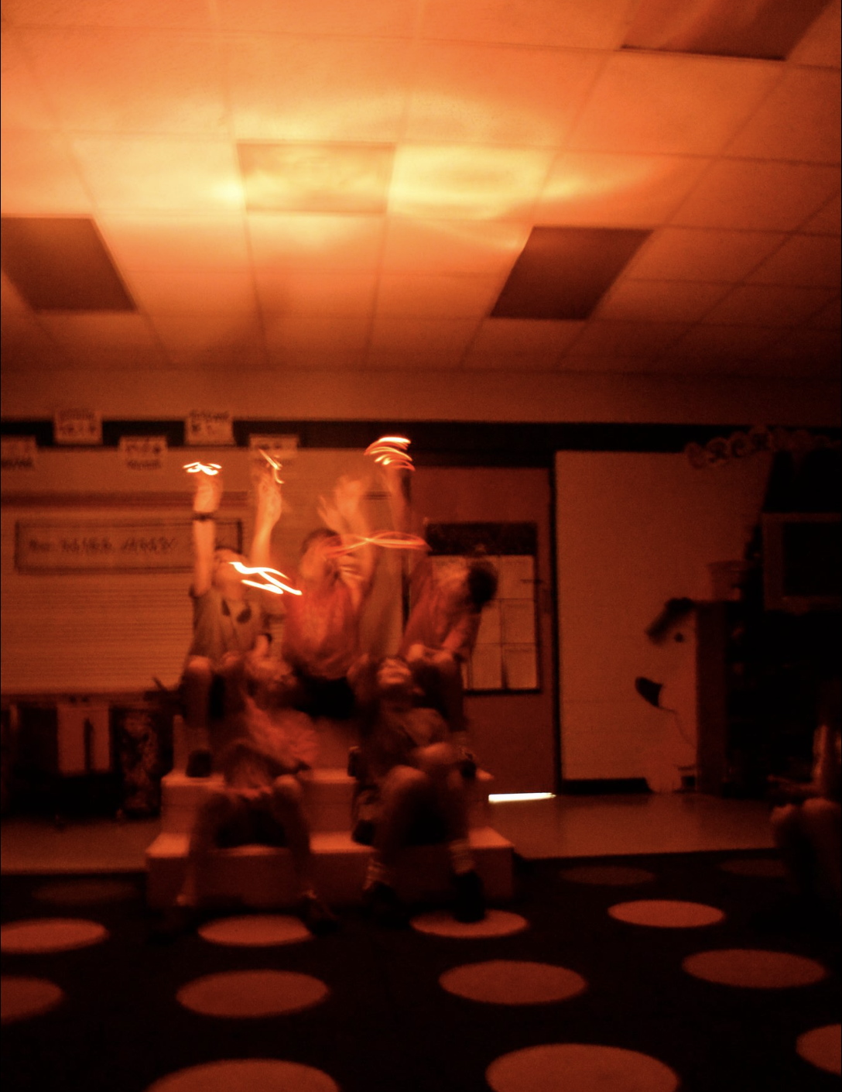

Slide 12
Main Menu
FLASH LIGHT FUN OR COLORED SCARVES

Slide 13
Main Menu
S.T.E.A.M. Lesson
Make Your Own Crossbow
Next

Slide 14
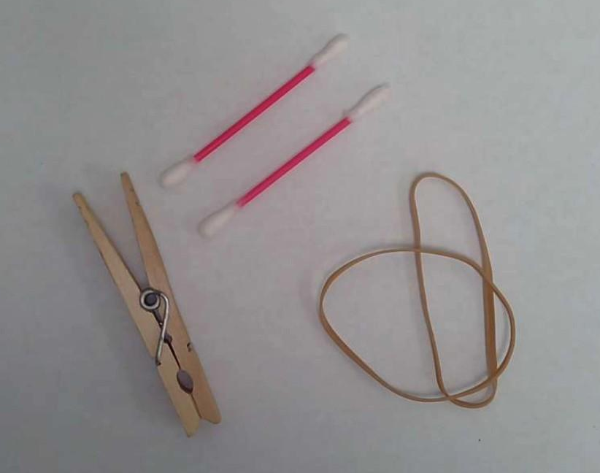
MAKE YOUR OWN CROSSBOW
MATERIALS:
(1)Clothes Pins (Wood or Plastic)
(2)Rubber Bands
(2)Cotton Swabs (ex. Q-Tips)
Main Menu
MAKE YOUR OWN CROSSBOW PLAN AND SCHEMATICS
Next

Slide 15
MAKE YOUR OWN CROSSBOW
STEP #1:
Remove the Cotton from the swabs.
Main Menu
Next

Slide 16
MAKE YOUR OWN CROSSBOW
STEP #2
Place one swab into the spiral of the clothespin spring.
Main Menu
Next

Slide 17
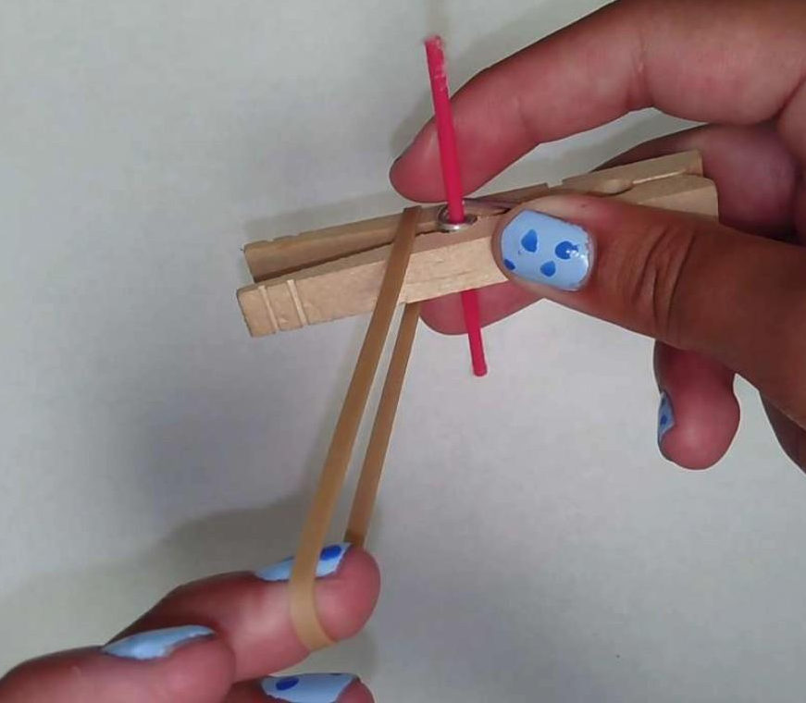
MAKE YOUR OWN CROSSBOW
1
STEP #3
Wrap one of the rubber bands around the back of the clothespin and the cotton swab, not too tightly.
2
3
Main Menu
Next

Slide 18
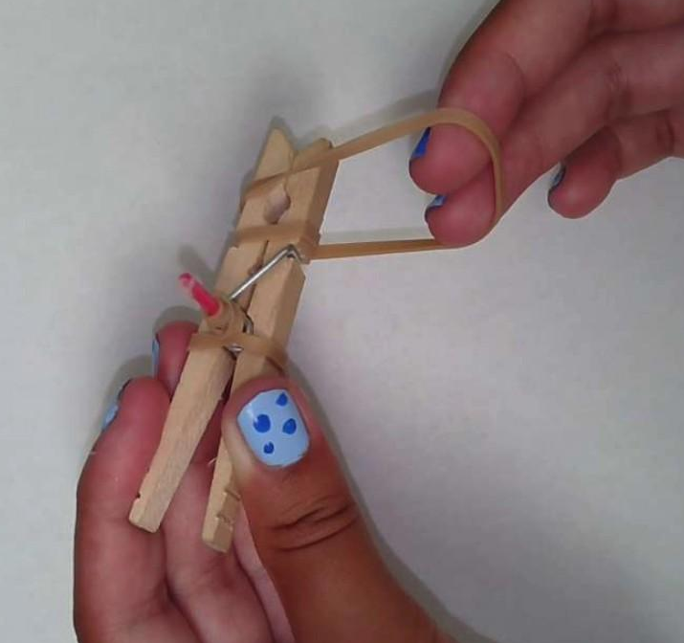
MAKE YOUR OWN CROSSBOW
STEP #4
Wrap the second rubber band around the front of the clothespin, again not too tightly.
Main Menu
Next

Slide 19
MAKE YOUR OWN CROSSBOW
STEP #5
Using the rubber band that is wrapped around the back of the swab, stretch the top of the band and place it into the “mouth” of the pin.
Main Menu
Next

Slide 20
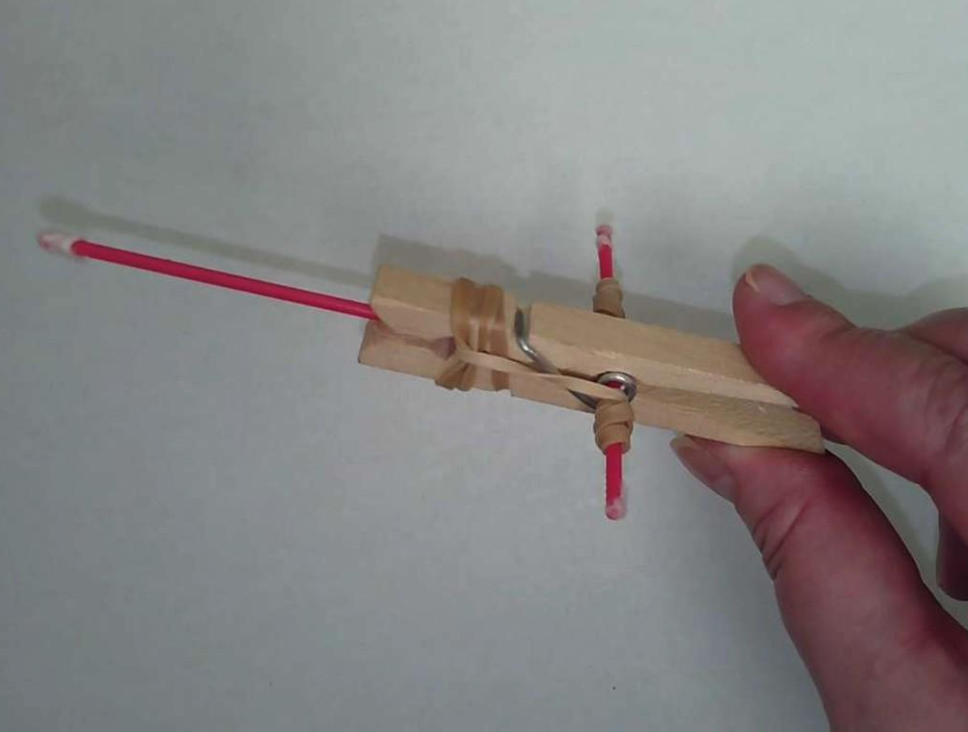
STEP#6
Open the pin and using the second swab (this is your arrow) push it gently against the interior rubber band as far as you can, and while still holding the swab close the pin shut.
Main Menu
Next

Slide 21
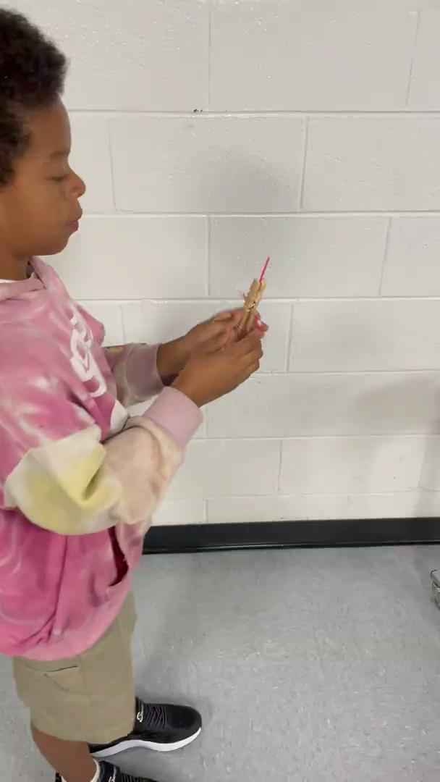
Here is a video of my friend Davis firing his crossbow.
Main Menu

Slide 22
Gioachino Rossini
(1792-1868)
Main Menu
Next

Slide 23
The Life of Gioachino Rossini:
A Summary from the English National Opera (Edited)
Gioachino Rossini was born in Pesaro, on the Adriatic coast of Italy in 1792. He was an only child to parents Giuseppe Rossino – a trumpeter and horn player, and Anna Guidarini, a seamstress by trade but later becoming a singer.
Rossini’s father was imprisoned at least twice, leaving much of Gioachino’s upbringing to his mother Anna, it was when he was six that Anna embarked on a professional singing career in comic opera with some considerable success. As a result of this, Rossini spent his entire childhood in and around the theatre with singing and playing coming naturally to him.
When the family moved to Lugo in 1802, Rossini began studying music with a local priest and was inspired by his collection of Mozart and Haydn. A quick learner, by the age of 12 Rossini had composed six sonatas and two years later he joined Bologna’s Philharmonic School and composed his first opera. Initially, Rossini studied singing, violin, horn, and harpsichord and often sang in public to earn money. Eventually, Rossini gave up singing to focus on conducting and composition, supported by his parents Rossini moved to Venice which was the main operatic center in northeastern Italy.
Main Menu
Next

Slide 24
The Life of Gioachino Rossini, continued
After 39 operas in 19 years, Rossini felt with William Tell he had reached not only the culmination of his career but also a natural resting point, and therefore retired from operatic composition. He did not stop composing altogether; he continued to compose smaller, often sacred works.
Rossini’s health complications were also a factor in his choice to retire at the age of 37 as he suffered from both physical and mental illness. He was also profoundly affected by the death of his mother Anna, followed by the death of his father and wife, Colbran. By the 1850s his mental and physical health had significantly deteriorated.
In 1855, Rossini returned to Paris for medical care and for a time recovered well and began composing again. As a man of significant wealth and fame known for his humor, he established an internationally renowned gathering of musicians. He wrote more than 150 compositions for these gatherings, referring to them as the ‘sins of old age’.
In November 1868, at the age of 76, Rossini died following an unsuccessful operation. His funeral service was a grand affair with more than 4000 people in attendance.
Main Menu

Slide 25
Tap Along
Main Menu
Next

Slide 26
Main Menu
TAP ALONG LESSON PLAN
Next

Slide 27
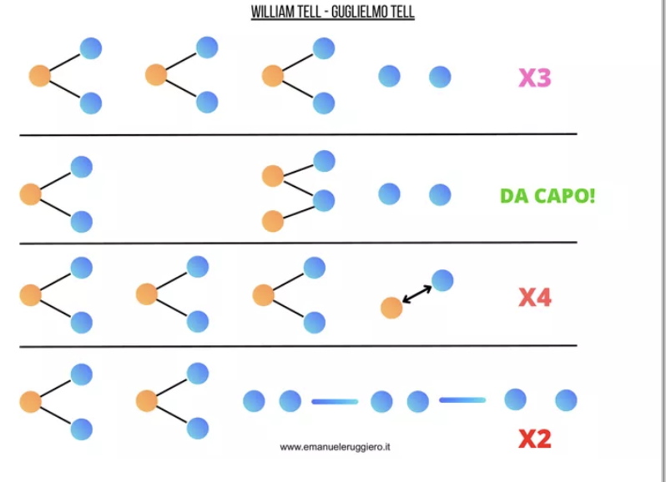
Next

Slide 28
Main Menu
Next

Slide 29
NAME:___________________
COLOR #1
COLOR #2
2
2
2
3 x
1
1
1
2
2
2
2
2
2
2
1
1
DA CAPO
2
2
1
2
2
2
2
4 x
1
1
1
1
2
2
2
Next
2
2 x
1
2
2
2
2
2
2
2
2
2

Slide 30
NAME:___________________
COLOR #1
COLOR #2
Alternate Version (LH)
2
2
2
3 x
1
1
1
1
1
2
2
2
2
1
1
2
DA CAPO
1
2
2
2
2
2
1
4 x
1
1
1
2
2
2
2
Next
2
2 x
1
1
1
1
1
1
1
1
1
2

Slide 31
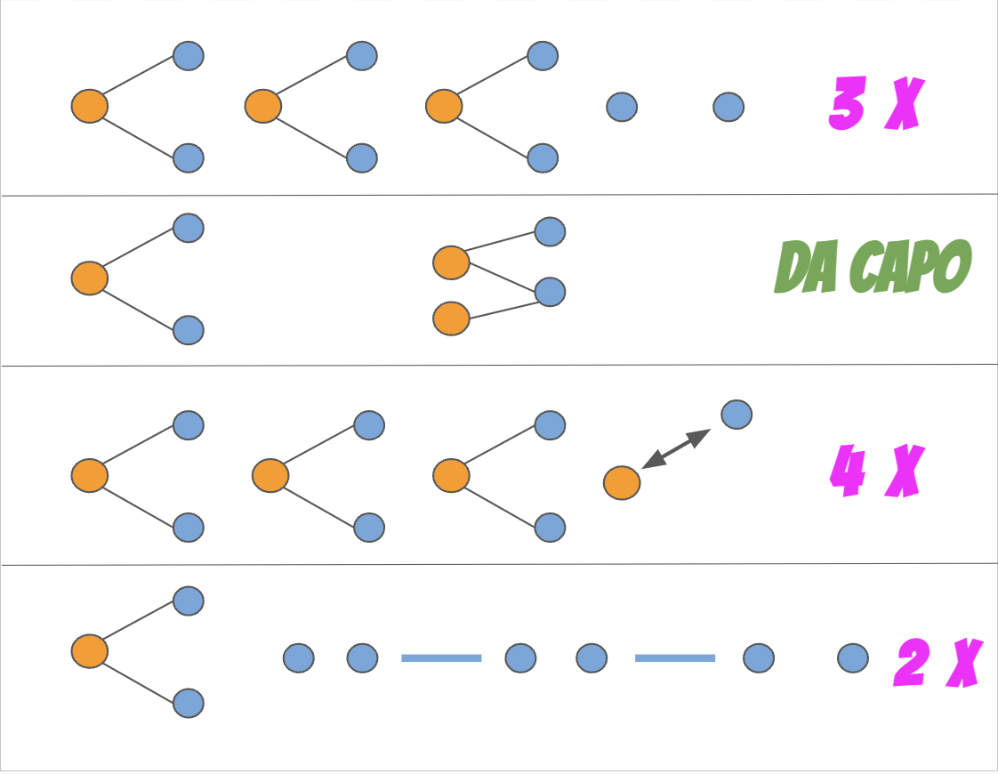

Slide 32
Oh, The Drama!
Main Menu
Plot Summary
From The Irish National Opera
Act It Out (Readers Theater)

Slide 33
William Tell adapted from a Swiss folktale
[Setting: A busy marketplace in Altdorf, Switzerland]
William: Come my son. I have sold the cowhides. Now we must buy the things your mother has asked us to get.
Albert: Yes Father. And what about a toy for little Lewis?
William: You are a good boy to remember your little brother.
Officer: Stop, man! Why do you not salute the cap of your king?! [The officer points to a pole. On top is a cloth cap. It belongs to the Austrian king, who has conquered Switzerland.]
William: I love my country. But I refuse to honor the Austrian king, who forces suffering upon my people.
Officer: Then I’ll arrest you as a traitor! What is your name?
William [standing tall]: William Tell.
Officer: And this is your son? [looks to a nearby soldier] Soldier! Tie the boy to that tree over there!
Next

Slide 34
William: Leave him be! He is only a child!
Officer: I hear you are a famous shot. Perhaps you can shoot an apple on top of your son’s head? If so, I will let you go free.
William: Never you villain! I would rather die than risk hurting him. Now let him go and take me to jail!
Officer: You will both die unless you shoot the apple as I say.
William: Stand still, my brave boy. I promise I’ll not hurt you. [He shoots, then falls to his knees, sighing with relief.]
Soldier: The apple is split in half! That was a fine shot!
Officer [frowning]: I did not believe anyone could make that shot. I suppose I must honor my word and set you free.
Next

Slide 35
1. Which detail from the drama shows that Albert is kind? (RL 4.3)
He goes with his father to the marketplace.
He wants to get a toy for his little brother.
He trusts his father to save him.
He reminds his father about the items his mother needs.
2. Read these lines from the play:
“I hear you are a famous shot. Perhaps you can shoot an apple on top of your son’s head? If so, I will let you go free.”
What do these lines show about the officer? (RL 4.3)
He keeps his promises.
He is loyal to the king.
He is cruel and unfair.
He likes playing games.
3. Describe the character of William Tell. Support your answer with traits and specific details from the play. (RL 4.3)
Main Menu

Slide 36
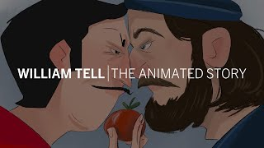
Main Menu

Slide 37
Printables
Additional Activities
Sources
Index
Main Menu

Slide 38
PRINTABLES IN GOOGLE DOCS
Index
FORM GUIDED LISTENING LESSON PLAN
TAP ALONG LESSON PLAN
TAP ALONG B&W
MODIFIED B&W TAP ALONG LH
MAKE YOUR OWN CROSSBOW PLAN AND SCHEMATICS
READERS THEATER SCRIPT
PRINTABLES IN PDF FORMAT
FORM GUIDED LISTENING LESSON PLAN
TAP ALONG LESSON PLAN
TAP ALONG B&W PDF
MODIFIED TAP ALONG B&W LH PDF
MAKE YOUR OWN CROSSBOW PLAN AND SCHEMATICS
READERS THEATER SCRIPT
Main Menu

Slide 39
Other Activities and Videos
Line Rider Race
Liszt’s Arrangement for Piano Solo
Graphic Score Video
Rhythm Stick Game
Cup Play Along
Vocalese Arrangement by Julie Eschliman
Main Menu

Slide 40
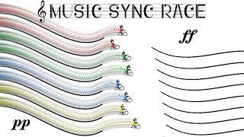
Next

Slide 41
Next

Slide 42
Next

Slide 43
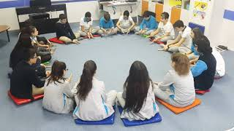
Next

Slide 44
Next

Slide 45
Next

Slide 46
Sources
Artie Almeida www.artiealmeida.com
(Activities from Workshop on September 9, 2005: Central Carolina AOSA)
Emanuele Ruggiero www.emanueleruggiero.it
The Irish National Opera www.irishnationalopera.ie
The English National Opera www.eno.org
Main Menu
A.I. was used to create some of the images in this presentation.

Slide 47
Amy Evers
Music Teacher
Chapel Hill-Carrboro City Schools
Chapel Hill, NC
aevers@chccs.k12.nc.us
Main Menu

