Slide 1
“America the Beautiful”
Melody
Presentation by
Dr. Amanda Hoke

Slide 2
Resources
America the Beautiful
https://www.loc.gov/item/ihas.200000001/
https://www.npr.org/2019/04/04/709531017/america-the-beautiful-american-anthem
Notes:
I will not go over history, but here are some resources for you to view if you wish. Today I will focus on the text and how it relates to the melody by showing you two movement-based lessons. I will focus on the first verse for time’s sake, but really all the activities can be used for both verses!

Slide 3
Lesson #1
Melody Scramble
OBJECTIVE: Students will learn the melody of “America the Beautiful” by exploring its rhythm, pitch, and melodic contour.

Slide 4
North Carolina Standards (non-revised)
3.ML.2.1 Interpret rhythm patterns, including notes and rests in 3/4 and 4/4 meter signatures.
3.MR.1.2 Use musical terminology when describing music that is presented aurally.
4.ML.2.1 Interpret rhythm patterns, including whole, half, dotted half, quarter, and eighth notes and rests in 2/4, 3/4, and 4/4 meter signatures.
4.ML.2.2 Interpret through voice and/or instruments simple pitch notation in the treble clef in major keys.
5.ML.2.1 Interpret rhythm patterns, including whole, half, dotted half, quarter, dotted quarter, eighth, and sixteenth notes and rests in 2/4, 3/4, 4/4, and 6/8 meter signatures.
5.ML.2.2 Recognize pitches on the treble and bass staves, including ledger lines, in order to understand the continuum of standard pitch notation.

Slide 5
Process
Melody Scramble
Materials you will need
North Carolina Symphony Education Concert video
“America the Beautiful Notation”
Melodic/Lyrics Matching cards

Slide 6
America the Beautiful
Listen!
1
Melody Scramble
Listen to “America the Beautiful” - connect (H.E.R. next slide)
Here are some ideas from Victoria Boler on “creative listening - you can use divergent and convergent listening. Start with divergent, open ended questions, then move to convergent, music specific questions.
What does this music make you think of?
What do you notice about this music that no one else might notice?
Can you tap the steady beat?
Have students prepare for activity by using bodies, hands, wands, andscarves to follow the pitch of the music by ear
Notes:
The focus is to get as many active listens in as possible. Here are some ideas for active listening.

Slide 8
America the Beautiful
Say, then Clap the rhythm of the words
2
Melody Scramble
Speak “America the Beautiful” for or with students (next slide)
Ask students to listen while you clap the rhythm.
Scaffold. Focus on the rhythm. Clap beginning, inner hear second part of phrase for every phrase while speaking words. Ask students what they notice about the rhythm of each part of the phrase. [it is the same].
Show the notation [optional]. Have students say or clap the rhythm using preferred rhythm syllables.
Extension: Split the class into two groups. Have one group tap the rhythm only while the other group sings the melody only. Switch roles so the students tapping the rhythm are now singing
Notes:
The words are always the trickiest part of the symphony songs for me. My students often struggle, so I try to come up with ways to give them multiple changes to learn the words. Guide audience through presentation as if you were teaching. If time, do the extension

Slide 9
O beautiful for spacious skies,
For amber waves of grain,
For purple mountain majesties
Above the fruited plain!
America! America!
God shed His grace on thee,
And crown thy good with brotherhood
From sea to shining sea!

Slide 10
America the Beautiful
SIng - melodic contour
3
Melody Scramble
Discuss melodic contour of each phrase. Use the notecards presentation in CANVA to break down individual phrases getting ready to do the melody scramble.
Have students sing while tracing the pitch with their fingers, wands, or whatever you choose!. As melody goes higher, the notation on staff goes higher as well.
Point out key patterns for students, including the cadence at the end (rhythm and melodic), the chorus section, etc.
Optional: Have students read the absolute pitch or solfege.
Notes:
Teach audience WITHOUT TEXT PAINTING. Pass out wands to a few people in audience to try out.

Slide 11
America the Beautiful
Text Painting
4
Melody Scramble
Some of the melodic contour shows the meaning of the lyrics: text painting.
For example…
Phrase 2: The melodic leap on “A - bove,” uses pitch (from low to high) to describe the mountains towering above the fruited plains.
Phrase 3: “A-mer-i-ca…” the large leap in melody and use of exclamation points in the lyrics show expansiveness, emphasis, and grandeur.

Slide 12
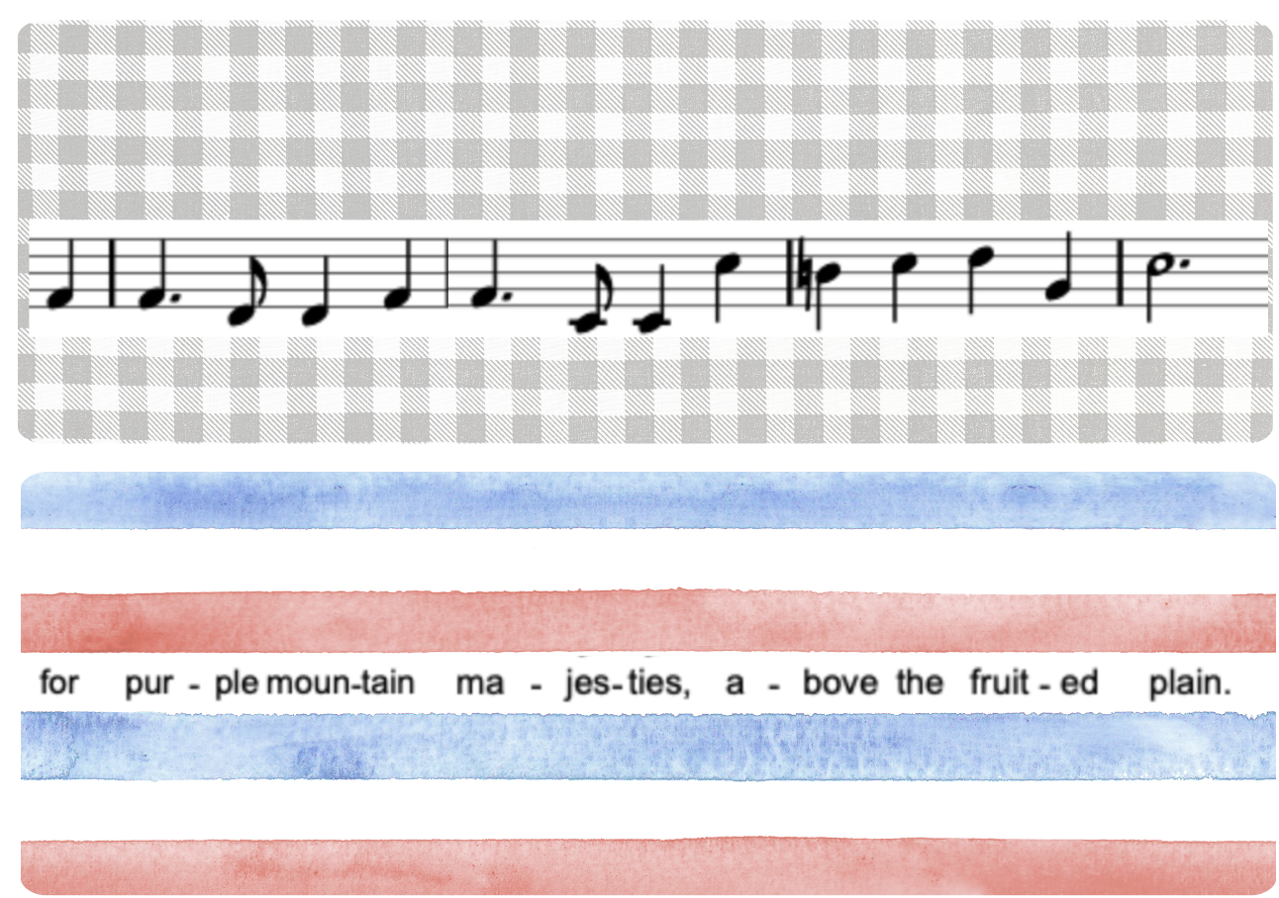

Slide 13
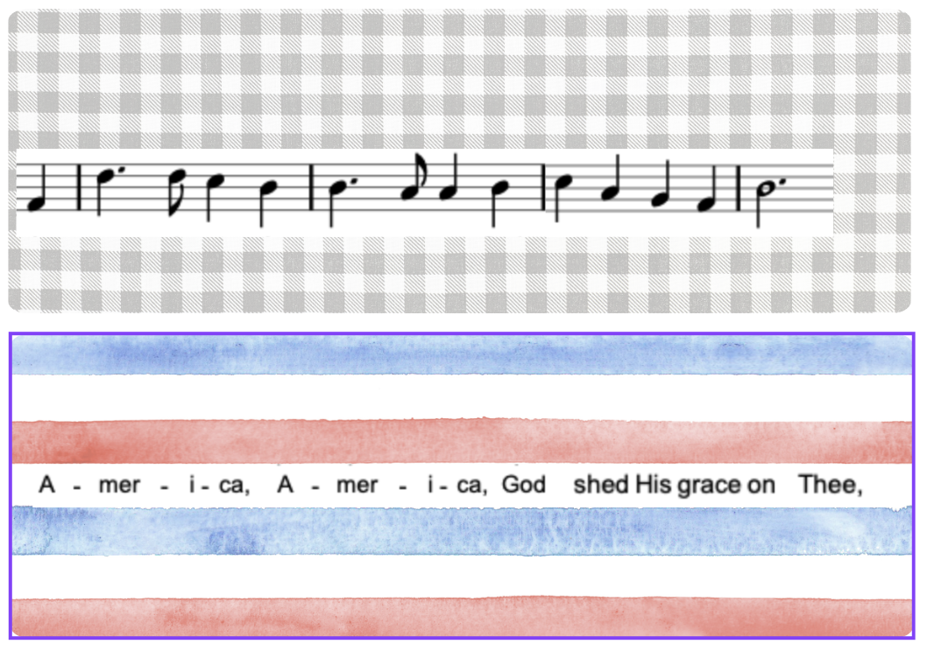

Slide 14
America the Beautiful
GRoup students
4
Melody Scramble
Have students work in 8 groups of 2-4 depending on size of class. Pass out cards.
4 of the groups will have the staff notation (the red notecards)... “seaweed”
These students will find one spot in your classroom and stay there.
The OTHER 4 groups will have the corresponding lyrics without the notation “fish.” These groups will move around the room trying to find the staff notation that matches their lyrics.
Notes:
Now it’s time for the scramble. After doing all the preparation activities and scaffolding with the cards, my students were ready to put things together. Call up at least 8 people from audience.

Slide 15
America the Beautiful
Match!
5
Melody Scramble
Remind students to use their knowledge of rhythm, melodic contour, and text painting to find their matching group.
Have students inner hear the melody.
For an extra challenge, set a timer to see how long it takes!
An optional final step is to “unscramble” the 4 groups in the order of the song. Have students stand with their groups, in order of the song, and sing their phrases as it appears in the song.
Teacher tip: You may want to scaffold this exercise and have students match lyrics/notation as a whole class before dividing into groups.
Notes:
https://teach.classdojo.com/#/classes/66a0e9f326d155a08d91dc86/points timer

Slide 16
Lesson #2
“America the Beautiful” Tableau
OBJECTIVE: Students will use a tableau activity to strengthen their understanding of the melody of “America the Beautiful.”
Notes:
Ask audience who has used Tableau, Give definition: according to google AI, it’s a A collaborative activity where students create a still picture without speaking to communicate a concept.. I saw Tableau at Kodaly Nat conference by Sarah Trotter Tullock presenting, and fell in love with it, and started using Tableau in my classroom to help students bring out expressive elements of music. It helps them understand the text better. I love how they take ownership of the music as well.

Slide 17
North Carolina Standards (non-revised)
3.MR.1.2 Use musical terminology when describing music that is presented aurally.
4.MR.1.1 Illustrate perceptual skills by moving to, answering questions about, and describing aural examples of music of various styles and cultures.
5.MR.1.2 Use music terminology in explaining music, including notation, instruments, voices, and performances.

Slide 18
Process
Tableau
Materials you will need
North Carolina Symphony Education Concert video
Brainstorm sheet (optional)

Slide 19
Process
Tableau
Teacher tip: This activity uses tableau, a comprehension teaching strategy where students create a “living picture” that communicates (without talking!) the meaning of a concept.
Students will set a tableau to “America the Beautiful” by deconstructing the song’s expressive melodic elements and lyrics. Students will display the meaning of “America the Beautiful” by using physical poses, gestures, and facial expressions rather than communicating with words.
Note: Students should have a working knowledge of the “America the Beautiful” before starting this project. See Activity #1 to introduce or deepen understanding of the song.
Notes:
Here is a little more about tableau. As a side note, I will say that I allow students to move a little, as you’ll see in my video.

Slide 20
America the Beautiful
Brainstorm
1
Tableau
Show notation. Brainstorm the meaning in the lyrics of “America the Beautiful” and how they might be connected to the melody of the song. Present the lyrics in 4 phrases. Use the notecards to show phrasing. Possible guided brainstorm responses may include:
Point out idioms usage in song: “Sea to shining Sea,” … “purple mountain majesties” Pikes Peak in Colorado
Imagery of natural landscapes
Notes:
You may need to go over some of the vocabulary with students and talk with them about what certain words mean and as a class come up with ways how to show it.

Slide 21
America the Beautiful
Practice (optional)
2
Tableau
Give possible ways to show meaning through body poses.
Example: Phrase 2: Have two students stand together, one student makes their body into a mountain standing over the other student as a plain.

Slide 22
America the Beautiful
Create!
3
Tableau
Set a timer for 5 minutes or less.
Have students work together and set their own tableau for their phrase of “America the Beautiful.”
Once the timer goes off, have students set the stage with their tableau. Play the North Carolina Symphony recording of “America the Beautiful” and video record each group in order of appearance. Watch the video with students!

Slide 23
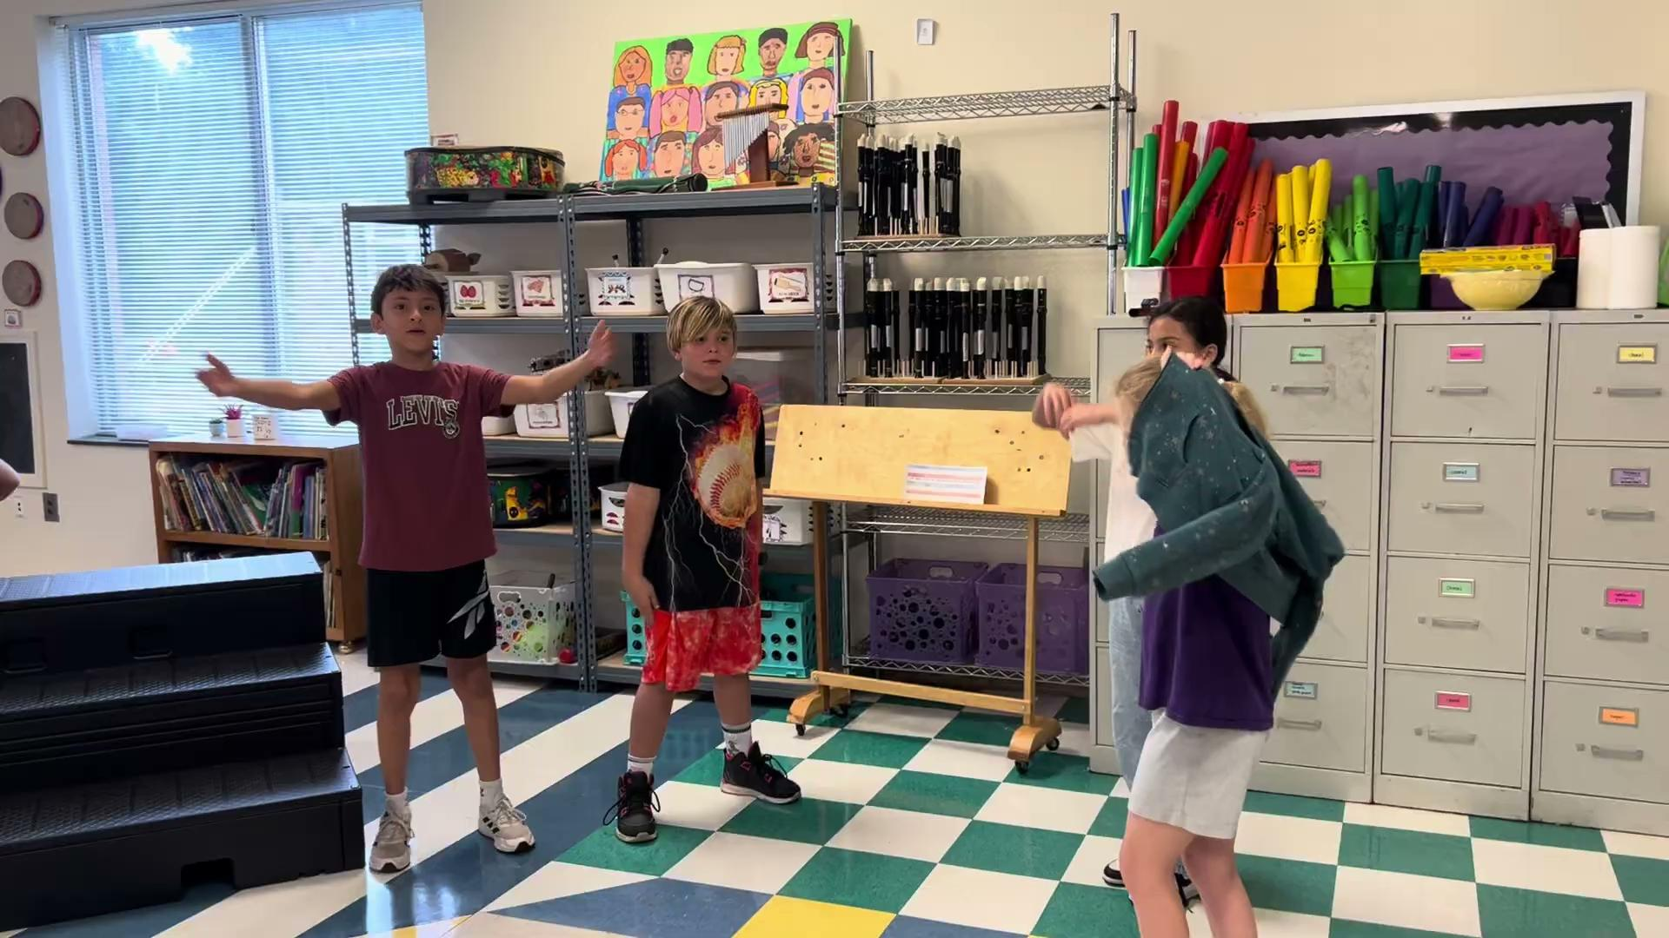

Slide 24
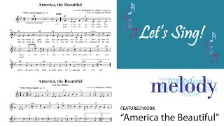

Slide 25
Questions?

Slide 26
THANK YOU
Dr. Amanda Hoke
amanda.hoke@nhcs.net
New Hanover County Schools
My School Website
My Personal Website

