Slide 1
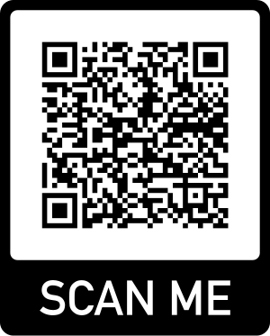
Texture
Haydn’s “Surprise” Symphony
Activity 1
Activity 2
Activity 3 (STEAM)
https://tinyurl.com/NCStexture2024
asullivan6@wcpss.net

Slide 2
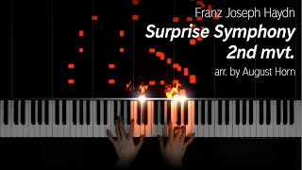
Introducing the “Surprise” Symphony
Turn-and-Talk with 1-2 people about your responses

Slide 3
Rhythm Texture Experiments
Break into small groups and create a short rhythmic pattern
Experiment with playing alone, playing together and layering different sound
Choose the pattern you like the best
Be prepared to share
Take Turns allowing each group to share their rhythm
Did everyone play the same exact pattern or did different people play different patterns?
Time to layer Textures as a class
Try layering 2-3 different groups’ rhythms at the same time
Build until all of the groups are playing their rhythms at the same time
Compare and Contrast
Did any groups have very similar patterns?
Did any groups “stand out” as being very different?

Slide 4
Day 2- Monophony, Homophony, or Polyphony? Let’s sing these songs together
Row Your Boat
Row, row, row your boat
Gently down the stream
Merrily, merrily, merrily, merrily
Life is but a dream.
Are You Sleeping?
Are you sleeping? Are you sleeping?
Brother John, Brother John
Morning bells are ringing, morning bells are ringing
Ding ding dong, ding ding dong.

Slide 5
Do you think we sang monophonic, homophonic or polyphonic?

Slide 6
Homophonic Improvisation
Play your boomwhacker in any rhythm you want while we sing.

Slide 7
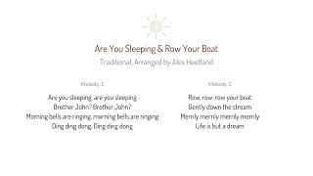
Polyphonic Partner Songs

Slide 8
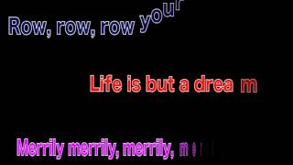
Polyphonic Round

Slide 9
Create your own graph to show monophonic, homophonic and polyphonic texture

Slide 10
Day 3- Monophonic Melodies in Chrome Music Lab
Listen to the example melody
Create your own melody in Chrome Music Lab Songmaker
Share your song link in the Google Form

Slide 11
Finished? Try creating a Homophonic or Polyphonic texture to your melody and include them in the Google Form.
Homophonic Examples
Example 1
Example 2
Polyphonic Examples
Example 1
Example 2

Slide 12
Finished Early? Listen to each others’ melodies and name 3 stars (I love that you…) and a wish (I wish you had…)

