Slide 1
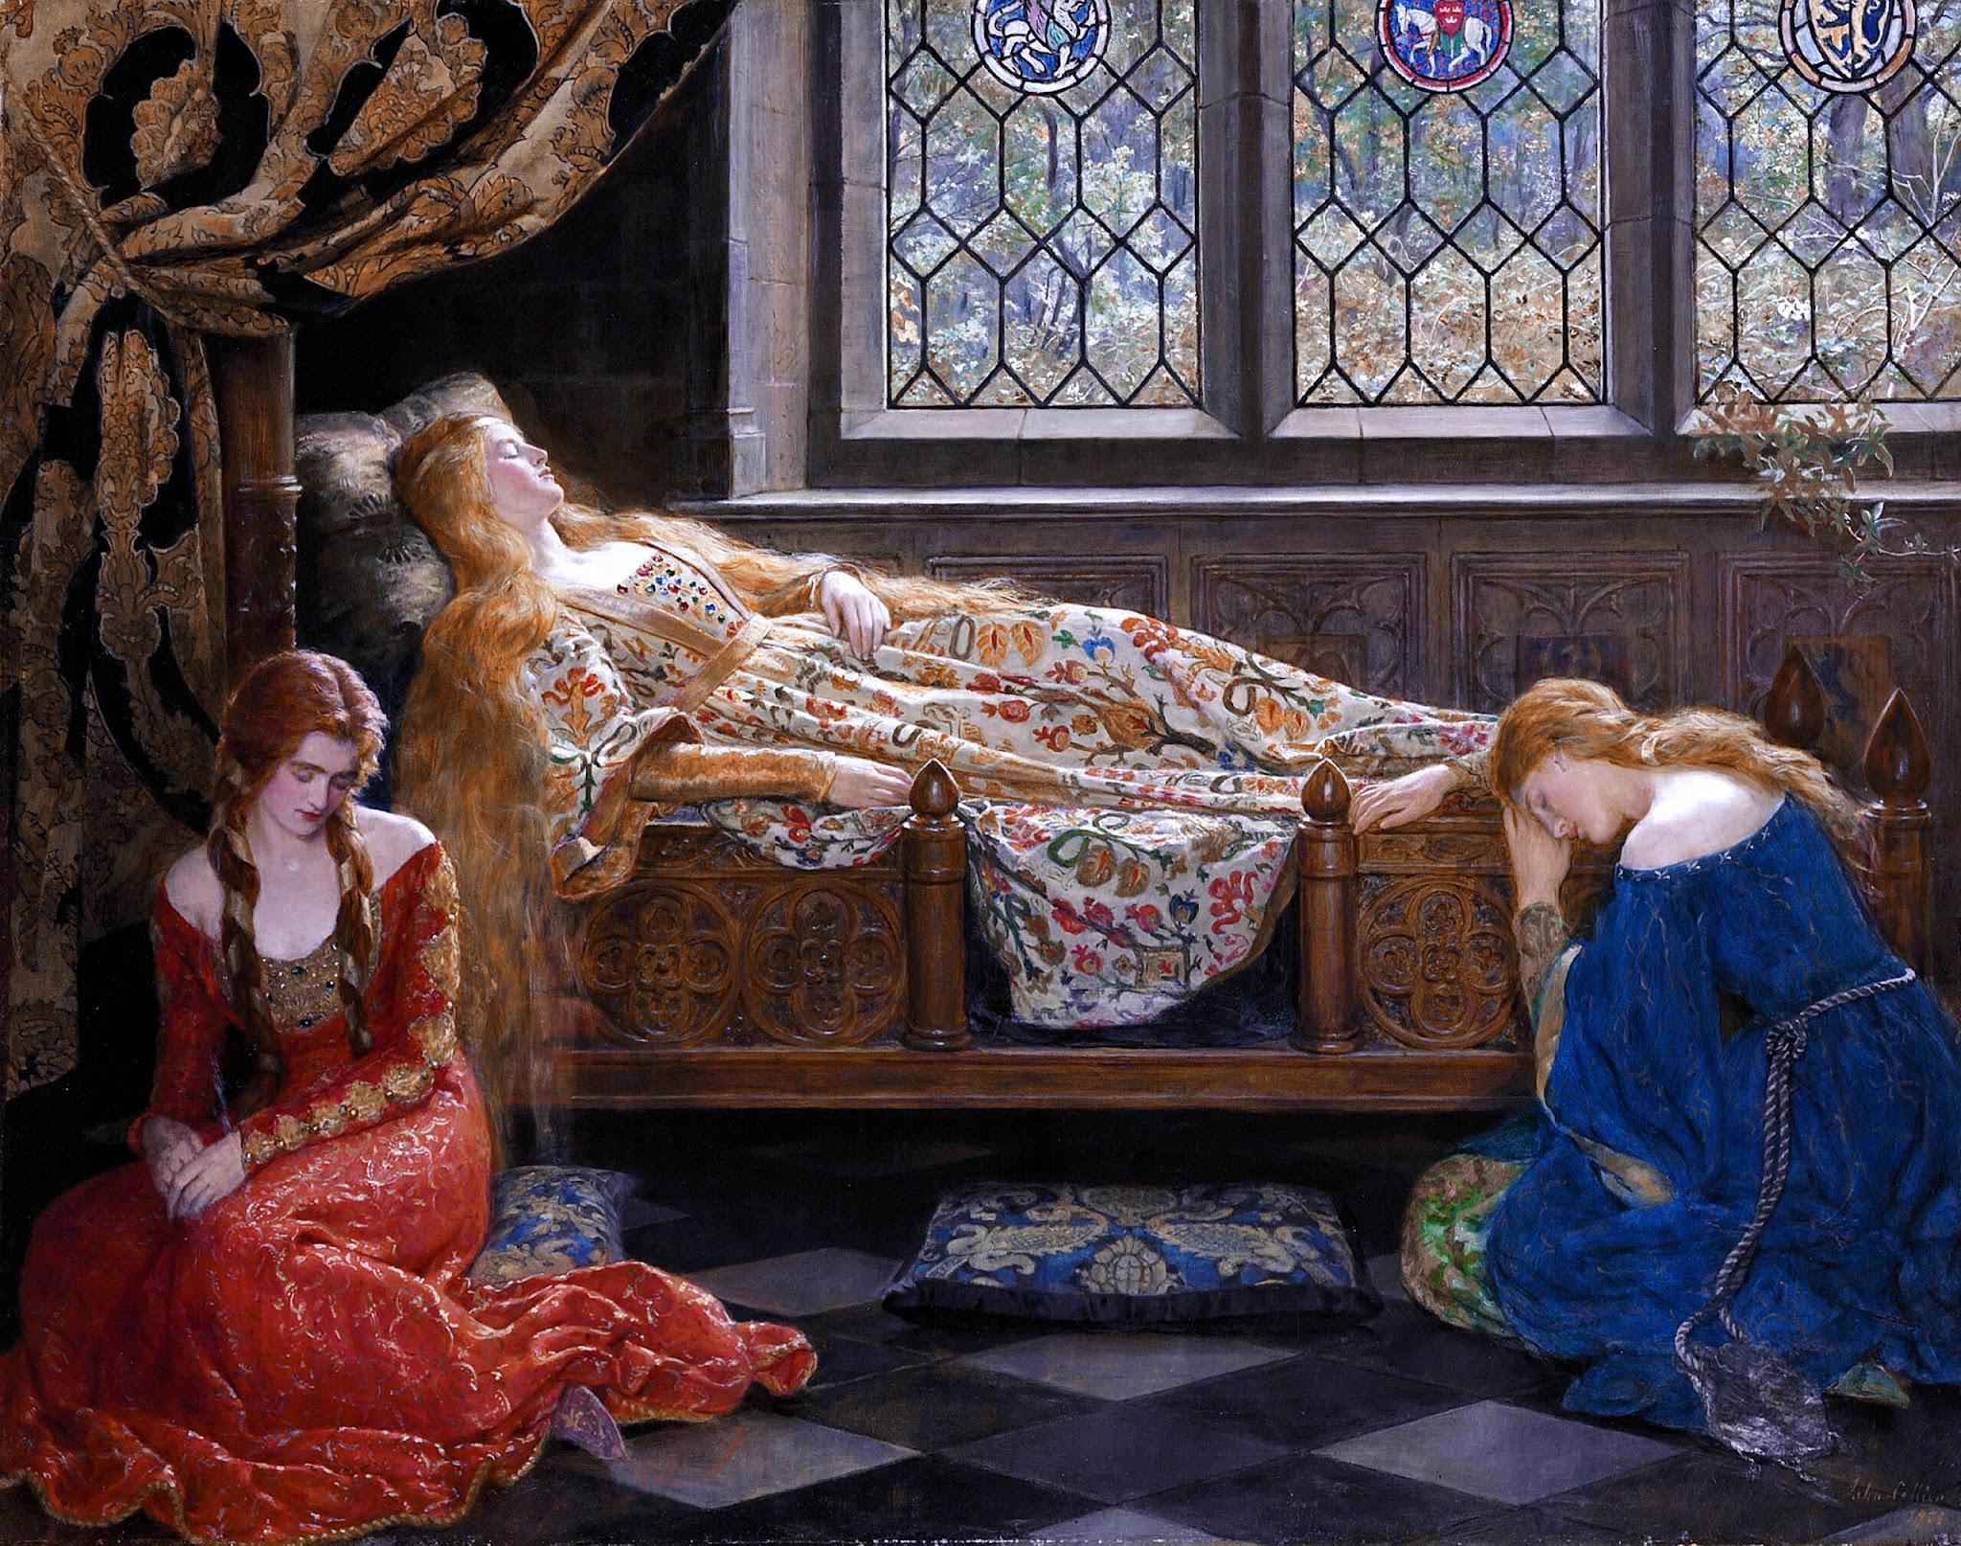
Form
Tchaikovsky’s Waltz from
The Sleeping Beauty Suite
Activity 1
Activity 2
Activity 3(Steam)
https://tinyurl.com/NCSform2024
asullivan6@wcpss.net

Slide 2
Day 1: What is a Waltz? Turn-and-Talk
Let’s listen and sing along.
Notes:
https://www.youtube.com/watch?v=jgtMVCLp6bg

Slide 3
It’s Time to Play Time Tag
Time Tag
Student with scarf or pool noodle is “it.”
If you get tagged, you are now “it.”
You can only move on the strong beat.
Step 1- Practice moving on the strong beat in ¾ time
Step 2- Demonstrate how/where to tag and which “zones” are off-limits
Step 3- Two student volunteers come up to teach the class how to tag and pass off the scarf/noodle
Step 4- TIME TO PLAY
Variations- You can play like “infection (when tagged you’re it too), freeze tag, elimination, capture the flag, etc…

Slide 4
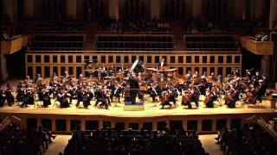
S.Q.U.I.L.T.
Super
QUIET
Uninterrupted
Listening
Time

Slide 5
Let’s Mingle- find a partner or 2
Find one or two people to take turns sharing what instruments you heard.
When the teacher says “Mingle,” find 1 or 2 new people to share what place does this song make you think about.
When the teacher says “Mingle,” switch and share what event does this make you think of.
When the teacher says “Mingle,” switch and share how the piece changes throughout the song.
When the teacher says “Mingle,” switch and answer how does the piece make you feel
When the teacher says “Mingle,” switch and answer if there was anything else you noticed about the waltz.

Slide 6
The Sonata Rondo Form Listening Map

Slide 7
Parachute Dance Scarf/Plastic Bag Dance
Introduction and Conclusion- Rustle the parachute to try to bounce the beach ball off.
Section A- sway right, left, right, left, arms up, arms down. (repeat 4 times)
Section B- raise arms up and down, try to keep the beach balls on the parachute
Section C- create the mushroom (or just move in a circle)
Introduction and Conclusion- Rustle your bag or scarf as fast as you can.
Section A- sway right, left, right, left, throw scarf/bag up in the air and catch it. (repeat 4 times)
Section B- play “keep it up in the air” or volley the beach ball(s) or balloons
Section C- join “hands” by grabbing the other end of your neighbors’ scarves/bags and rotate around the circle.

Slide 8
Day 2- Compose a Rhythm in Sonata Rondo Form
What is 3/4 Time?
How do we conduct in 3/4 Time?
3
1
2

Slide 9
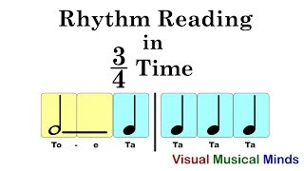
3/4 Rhythm Read Along (reviewing how to play different rhythms)

Slide 10
Composing a Rondo Rhythm in 3/4 Time
Step 1- Choose 3 different Rhythm Cards.
Step 2- Determine which card is A, B, and C
Step 3- write the A rhythm 4 times on one white board
Step 4- write the B rhythm 4 times on the second white board
Step 5- write the C rhythm 4 times on the third white board
Step 6- Practice playing your white board rhythms in Rondo Form (ABACABA).

Slide 11
Composition Cards

Slide 12
Example Rhythm Practice- Remember the pattern (ABACABA)
A
B
C

Slide 13
Rondo Triangles (STEAM Activity)
What is a Rondo Form?
ABACABA
What are the types of triangles classified by their angles in the pattern below?
(right, acute or obtuse)

Slide 14
Triangle Review… (video link)

Slide 15
The Protractor

