Slide 1
North Carolina Symphony Teacher Workshop
August 14, 2024
Zadda Bazzy
Onslow County Schools
Zadda.Bazzy@onslow.k12.nc.us
Focus: Rhythm

Slide 2
Rhythm Jerod Impichchaachaaha’ Tate’s Chokfi’
Activity #1: What’s the Meter?
Objective: Students will demonstrate an understanding of meter by using their bodies to create groups which represent the meter they hear aurally. Students will transfer this understanding to standard time signature symbols on an exit slip.

Slide 3
Rhythm Jerod Impichchaachaaha’ Tate’s Chokfi’
Activity #1: What’s the Meter?
Read rhythms in 2/4, 3/4, and 4/4
Teach time signature and meter
Model conducting patterns
Play the Meter Game
Exit slip

Slide 4
Rhythm Jerod Impichchaachaaha’ Tate’s Chokfi’
Activity #2: Playing Instruments: Micro/Macro Beat
Objective: Students will play instruments to the beat while they listen to Tate’s Chokfi’.

Slide 5
Rhythm Jerod Impichchaachaaha’ Tate’s Chokfi’
Activity #2: Playing Instruments: Micro/Macro Beat
Rhythm vs. Beat
Micro beat vs. Macro beat
Chokfi’ = trickster rabbit character from Southeast American Indian cultures
In the composer’s own words:
Show score
https://youtu.be/PzpTw-9cI5M?si=Lz9IPi7giMmXDUJs

Slide 6
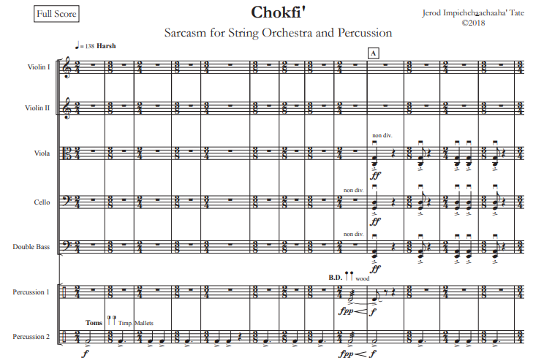

Slide 7
Rhythm Jerod Impichchaachaaha’ Tate’s Chokfi’
https://youtu.be/LHwNCxG9AoM?si=R-0rQ2JZEl75hIjM
Activity #2: Playing Instruments: Micro/Macro Beat
Mixed meter
Listen and keep the beat silently
Small groups – 2 maracas – micro beat
All get a turn
Small group – sand blocks – macro beat
Select students only
Add everyone else on 2 maracas (or egg shakers) each
How does this piece portray the character Chokfi’?

Slide 8
Rhythm Jerod Impichchaachaaha’ Tate’s Chokfi’
STEAM Classroom Extension Activity: Meter Math
Objective: Students will demonstrate an understanding of the common pulse in mixed meter by converting time signatures to related fractions with the same denominator.

Slide 9
Rhythm Jerod Impichchaachaaha’ Tate’s Chokfi’
STEAM Classroom Extension Activity: Meter Math
A fifth grade mathematics standard
Related fractions are fractions in which one denominator is a multiple of the other, e.g., halves, fourths, and eighths.
Math worksheet – six problems - several skills required

Slide 10
Rhythm Jerod Impichchaachaaha’ Tate’s Chokfi’
STEAM Classroom Extension Activity: Meter Math
Requisite skill – converting fractions into their equivalents

Slide 11
Rhythm Jerod Impichchaachaaha’ Tate’s Chokfi’
STEAM Classroom Extension Activity: Meter Math
Requisite skill – converting improper fractions into mixed numbers
Example – 9/8 = 1 1/8
Requisite skill – simplifying fractions
Example – 6/8 =3/4
Requisite skill – understand that when the numerator and the denominator are equal, the fraction is the equivalent of one whole
Example – 4/4 = 1

Slide 12
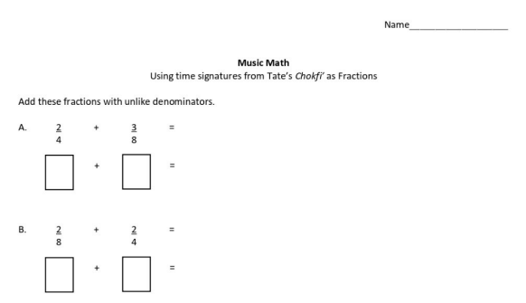
Music Math Worksheet –
6 questions
Complete whole group,
in small groups, or independently

Slide 13
Questions?
Zadda Bazzy
Onslow County Schools
Zadda.Bazzy@onslow.k12.nc.us
Focus: Rhythm

