Slide 1
Beethoven Symphony 4
Movement 1
Dynamics
Dr. Amanda Hoke
Notes:
Introduce yourself/school/family. Year around school….Forgetfulness and have people ask questions if something comes up. There are a total of 3 lessons in this segment. One is a STEAM demonstration. I am going to add in little tidbits of information as we go along in the presentation that you may not find in the teacher book.

Slide 2
Lesson #1
OBJECTIVE: Students will explore dynamics through guided movement.
Dynamic Movement
Notes:
Movement will go from non-locomoter to locomoter.

Slide 3
North Carolina Standards (non-revised)
3.MR.1.2 Use musical terminology when describing music that is presented aurally.
3.ML.2.3 Recognize standard symbols and traditional terms for dynamics, tempo, and articulation.
4.MR.1.1 Illustrate perceptual skills by moving to, answering questions about, and describing aural examples of music of various styles and cultures.
5.MR.1.2 Use music terminology in explaining music, including notation, instruments, voices, and performances.

Slide 4
PROCESS
Dynamic Movement
Materials you will need
North Carolina Symphony Education Concert video: Beethoven Symphony no. 4, Movement 1
Colorful scarves (you can use your hands)
Dynamic Signs
Dynamic poly spots
Non-Locomotor -> Locomotor

Slide 5
Beethoven Symphony 4, Mvt 1
1
Listen - no video
What do you hear? Ask open ended what students hear - there is no wrong answer!
Dynamic Movement
Notes:
I always like to start with listening without any visual, since we are so visually-oriented. I love hearing what students think about music.

Slide 6
Beethoven Symphony 4, Mvt 1
2
Show
Use your hands if you need another listen. Then, pass out scarves. Listen again. Show the size of sound with the size of your hands/scarf.
Dynamic Movement
Notes:
TEACH this portion of the presentation. Pass out some scarves after everyone does their hands.Upper elementary students love scarves, too! It’s not just for younger ones. I

Slide 7
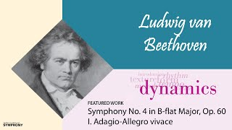
Beethoven Symphony 4, Mvt 1
Dynamic Movement

Slide 8
Beethoven Symphony 4, Mvt 1
3
Label
Label the size of the sound. Feel free to start with descriptive words and then move to Italian markings based on student’s knowledge.
Dynamic Movement
Notes:
I usually begin teaching Italian markings for dynamics in first grade, however, I find it’s always good for a review. If your students already know all Italian markings by heart, you can skip the past couple steps.
When I teach, I may say something like “Musicians use markings to know when to play medium, loud, or quite. Instead of using quiet, medium and loud, we can use pianissimo (very quiet), piano (quiet), mezzo forte (medium), forte (LOUD) and fortissimo (VERY Loud) These markings are most the time in Italian.” There are little symbols under the staff that are shortened versions of the full word.
Can you see them? Show next slide.

Slide 9
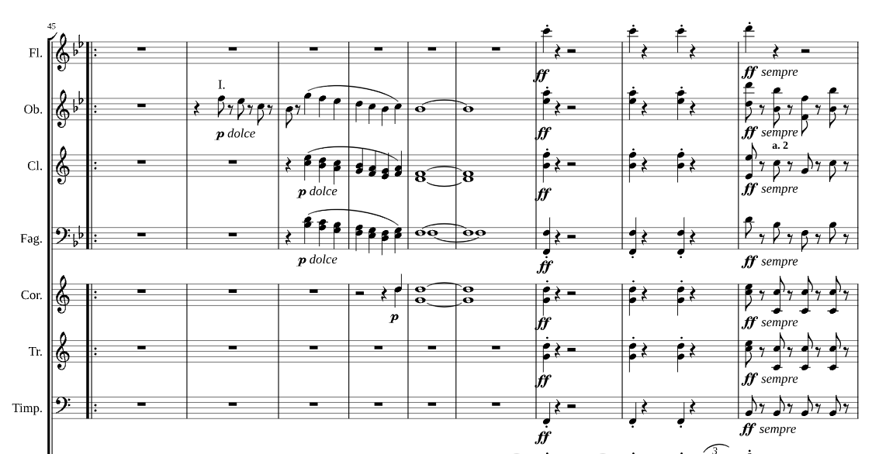
Dynamic Movement

Slide 10
Beethoven Symphony 4, Mvt 1
4
Move
Using your preferred labels, have students identify what they hear with movement.
Teacher tip: You can place dynamics in a continuum or in different corners of your classroom. Label the areas of the classroom with signs, polydots, or sit spots. Demonstrate how to move back and forth in your classroom to avoid collisions.
Dynamic Movement
Notes:
There’s a couple of different ways to do this. You can place the dynamic signs around the room in different corners, or place in a spectrum. Here are my students doing the spectrum activity. With Beethoven, there are such an extreme juxtaposition of dynamic level. It’s fun for the students and also for those who are watching to move up and down.

Slide 11
Lesson #2
OBJECTIVE: Students will practice identifying different dynamics in a game of 4 corners.
Notes:
Apply what students learned in the first lesson, but this lesson can also stand alone. I use this activity as an assessment.

Slide 12
North Carolina Standards (non-revised)
3.MR.1.2 Use musical terminology when describing music that is presented aurally.
3.ML.2.3 Recognize standard symbols and traditional terms for dynamics, tempo, and articulation.
3.ML.1.1 Apply elemental changes, including changes to dynamics, tempo, timbre, or texture, when singing or playing music.
4.MR.1.1 Illustrate perceptual skills by moving to, answering questions about, and describing aural examples of music of various styles and cultures.
4.ML.2.3 Interpret standard symbols and traditional terms for dynamics, tempo, and articulation while performing music.
4.ML.1.1 Apply expressive qualities when singing or playing a varied repertoire of music representing genres and styles from diverse cultures.
5.MR.1.2 Use music terminology in explaining music, including notation, instruments, voices, and performances.
5.ML.2.3 Apply understanding of standard symbols and traditional terms for dynamics, tempo, articulation, rhythm, meter, and pitch when reading and notating music.

Slide 13
PROCESS
Materials you will need
Material for the person calling: known songs, instruments, poems, etc.
Dynamic Signs
Teacher tip: This is a great activity to review voice types (speaking, singing, whisper, call etc.) and how it relates to dynamics. Ask classroom teachers for poetry used in classroom. Students can practice using dynamics while performing poetry.
Notes:
In this activity, you can take materials that your students know already and test their skills performing it at different dynamic levels. Call up 8-10 people.

Slide 14
1
Review & Assign
Review terminology for dynamic markings. Label 4 different areas in your classroom with a few of these dynamic markings. Have students choose a corner.
Dynamic Four Corners
Teacher tip: Scaffold based on what your students know. Do each dynamic level with your materials at hand, and have the class practice a few times.
Notes:
Place polydots in four different areas of stage. For this round we will use Bee, Bee Bumble Bee. Most of you know, but let’s say the chant together. There are so many different versions, but use yours.

Slide 15
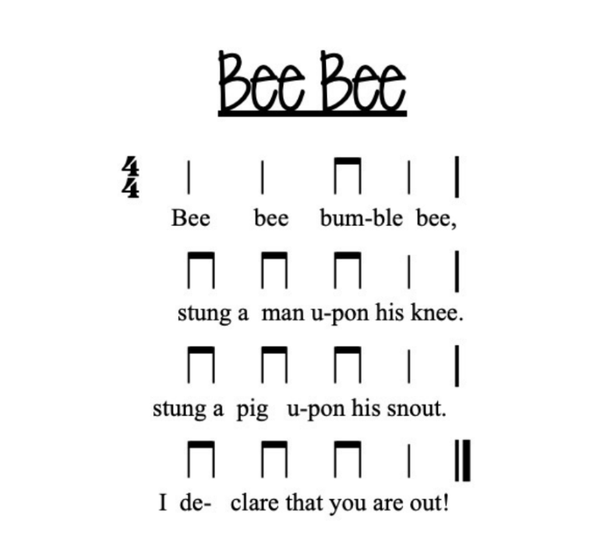
Dynamic Four Corners

Slide 16
2
Call
Choose a student to “call” choice or chosen repertoire at a specific dynamic level. You may have to coach a few students before you begin.
Dynamic Four Corners
Teacher tip: to use this activity as an assessment, you can write out prompt cards with dynamic level to hand students to read before they call.
Notes:
I like to go over with the class what it feels like to speak or sing at a particular dynamic level. I find students think they are doing a “forte” for example, but it’s actually coming out as a “piano.”
Show manipulative container, and popsicle sticks. It’s good to have a bit of “chance” involved so students don’t think you are influencing the decision in which corner is out.

Slide 17
3
You’re out!
The corner that corresponds to dynamic level performed sits out.
Dynamic Four Corners
Teacher tip: To expedite the game or to ensure everyone is included, once a corner is called, students who are out can join another corner. The corner that is “out” is no longer an option, thus there will be only three rounds per game. For example, if the student calling sings/speaks/plays an instrument at a forte dynamic level, the students in that corner can join another corner, but the forte corner is no longer an option for all students to join.
Notes:
If we continue on with this, after every call students would find a new corner. I usually give about 12 seconds to find new corners. As some of you who have played 4 corners know, this can take a long time to complete and the students who are out often become a behavior issue because they’re bored.
To remedy this, I play an alternate version of 4 corners. I’ll show you right now. When a corner is called, instead of the students being out, they join another corner. That corner then becomes “out” until there are only two corners left.
Students still seem to enjoy this version!

Slide 18
Lesson #3
OBJECTIVE: Students will experiment with different sounds at varying dynamic levels to understand basic sound production.
STEM - Jumping Rice!

Slide 19
North Carolina Standards (non-revised)
NORTH CAROLINA ESSENTIAL STANDARDS IN SCIENCE
3.P.1.1 Infer changes in speed or direction resulting from forces acting on an object.
4.P.3.1 Recognize the basic forms of energy (light, sound, heat, electrical, and magnetic) as the ability to cause motion or create change.
5.P.1.4 Predict the effect of a given force or a change in mass on the motion of an object.
NORTH CAROLINA ESSENTIAL STANDARDS IN MUSIC
3.MR.1.2 Use musical terminology when describing music that is presented aurally.
3.CR.1.2 Understand the relationships between music and concepts from other areas.
4.CR.1.2 Understand the relationships between music and concepts from other areas.
5.CR.1.2 Understand the relationships between music and concepts from other areas.

Slide 20
PROCESS
STEM: Jumping Rice
Materials you will need
small bowl
uncooked rice, sprinkles, fruity pebbles
plastic wrap
rubber band
a variety of different pitched and non-pitched percussion instruments,
tuning fork (optional)
Notes:
Go over different materials.
Because it may be hard to see, I’m going to show you a video of this instead of doing it here.

Slide 21
1
Prepare
Take a small bowl and cover it tightly with plastic wrap. To secure, you can place a rubber band around the bowl. Place a small amount of uncooked rice on top of the plastic wrap. Choose 1-2 non-pitched/pitched percussion instruments of varying sizes for students to experiment.
Teacher tip: This activity can be done as a centers activity. You can set up several bowls, or even have the students prepare materials!
STEM: Jumping Rice
Notes:
Depending on class size, I would suggest doing this as a centers activity or in groups.

Slide 22
2
Demonstrate
Strike the tuning fork (or another instrument) then hold it near the rice and watch it dance!
STEM: Jumping Rice
Teacher tip: if your students have not seen a tuning fork, you may want to show them how it works by allowing them to hear it. You can simply strike the tuning fork and hold it to their ear, or strike it and then place it on a wooden surface allowing the fork to ring.

Slide 23
3
Predict & Test
Ask students to predict how much the rice will jump for 1-2 different instruments of ranging sizes at different dynamic levels. You can have students write down predictions, and then test. Or, you may want to do this as a whole group activity.
Prediction Sheet
Example video (ASO Live Concert beginning at 16’30)
STEM: Jumping Rice

Slide 24
4
Integrate
Using musical terminology, ask students why instruments played very loud (fortissimo) or very soft (pianissimo), make the rice jump even more.
The louder dynamic causes more intense/louder sound waves, therefore causing the rice to move more.
STEM: Jumping Rice

Slide 25
Questions?

Slide 26
THANK YOU
Please email me!
Dr. Amanda Hoke
amanda.hoke@nhcs.net
New Hanover County Schools
My School Website
My Personal Website

