Slide 1

North Carolina Symphony
Teacher Workshop
August 14, 2024
Zadda Bazzy
Onslow County Schools
Zadda.Bazzy@onslow.k12.nc.us
Focus: Introduction

Slide 2
Introduction
Samuel Coleridge-Taylor’s
African Suite, Op. 35, No. 4
Activity #1: What Would You Do?
Objective: Students will demonstrate an understanding of the significance of Coleridge-Taylor’s impact and reflect on how they can make a different in their lifetime as well.

Slide 3
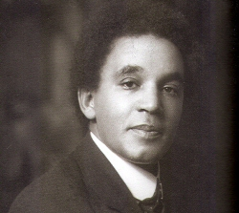

Samuel Coleridge-Taylor
Composer, Musician,
Conductor, Teacher,
Husband, Father,
Activist
Notes:
For more information, visit Samuel Coleridge-Taylor, composer - Division of Historical and Cultural Affairs - State of Delaware

Slide 4
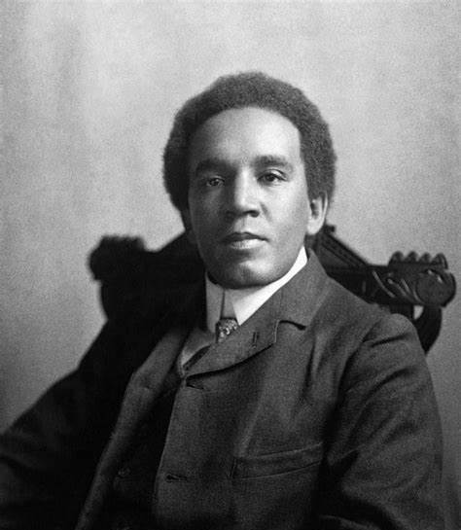
Samuel
Coleridge-Taylor
Born in London, England, in 1875
Studied violin at a young age
Was a successful composer during his lifetime, despite the rampant racism of the time
First heard African-American spirituals in 1899 (Remember, he was British not African-American.)
Featured music from African origins in many of his compositions
Notes:
For more information, visit Samuel Coleridge-Taylor, composer - Division of Historical and Cultural Affairs - State of Delaware

Slide 5
Samuel
Coleridge-Taylor
Traveled to the United States; toured the country three times
Invited to the White House to meet President Theodore Roosevelt in 1904
Conducted exclusive white orchestras in the United States in 1910
Used his success to address issues of racism and colonialism; Gave the opening address at the first Pan-African Conference in London in 1900
Died in England in 1912 at the age of 37
Notes:
For more information, visit Samuel Coleridge-Taylor, composer - Division of Historical and Cultural Affairs - State of Delaware

Slide 6
What would you do?
Imagine you are successful – even famous – during your lifetime. Perhaps you become a famous musician, athlete, politician, actor, scientist, author, or social media influencer.
How could you use your success to make a difference in the world?
Would you influence others in a positive way?
What sorts of issues would you draw attention to and why?
Notes:
For more information, visit Samuel Coleridge-Taylor, composer - Division of Historical and Cultural Affairs - State of Delaware

Slide 7
Samuel Coleridge-Taylor
Your North Carolina Symphony will
perform Coleridge-Taylor’s
“Danse Negre” from African Suite,
Op. 35, No. 4.
Notes:
For more information, visit Samuel Coleridge-Taylor, composer - Division of Historical and Cultural Affairs - State of Delaware

Slide 8
Introduction
Samuel Coleridge-Taylor’s
African Suite, Op. 35, No. 4
Activity #2: Move to the Music
Objective: Students will use a parachute and streamers to respond to musical elements that are presented aurally.

Slide 9

Timing | Section | Movement
0:07-0:33 | A | Washing machine
0:33-0:57 | B | Up
1:00-1:20 | C | Walk
1:24-1:49 | D | Groups go under (by color, when called by the teacher)
2:04-3:18 | E | Streamers
3:28-3:51 | C | Walk
3:51-3:58 | A | Washing machine 5 times
4:14-end | Coda | Washing machine 4 times Shake 12 times Lower to the floor quickly

Slide 10
Introduction
Samuel Coleridge-Taylor’s
African Suite, Op. 35, No. 4
Activity #3: Stick Dance
Objective: Students will use sticks to perform a rhythm and improvise movements to match the music while listening to Samuel Coleridge-Taylor’s “Danse Negre” from African Suite, Op. 35, No. 4.

Slide 11
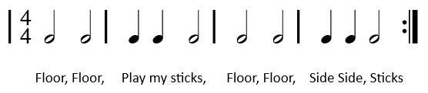
    Pause
    Rhythm pattern – 7 times
    Pause
    Rhythm pattern – 1 time
    Pause
    Rhythm pattern – 3 times
    Pause
    Student #1 improvises the stick dance
    Student #2 improvises the stick dance
    Student #3 improvises the stick dance
    Student #4 improvises the stick dance
    Student #5 improvises the stick dance
    Rhythm pattern – 1 time
    Pause
    Coda:
      All improvise a stick dance simultaneously
      Rhythm pattern – 1 time
      Shake sticks
      Arms up

Slide 12
Questions?
Zadda Bazzy
Onslow County Schools
Zadda.Bazzy@onslow.k12.nc.us
Focus: Introduction

